Slide 1
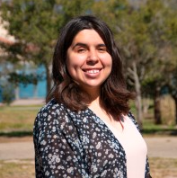
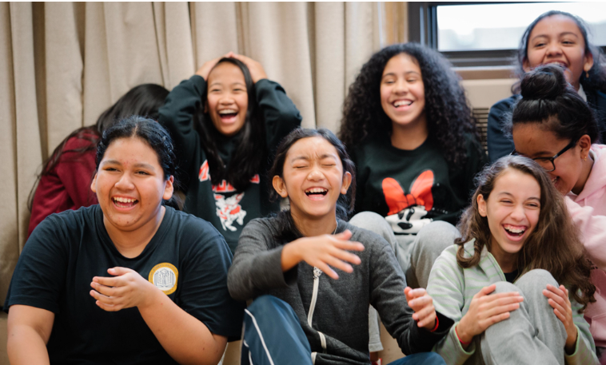
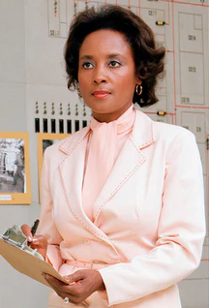
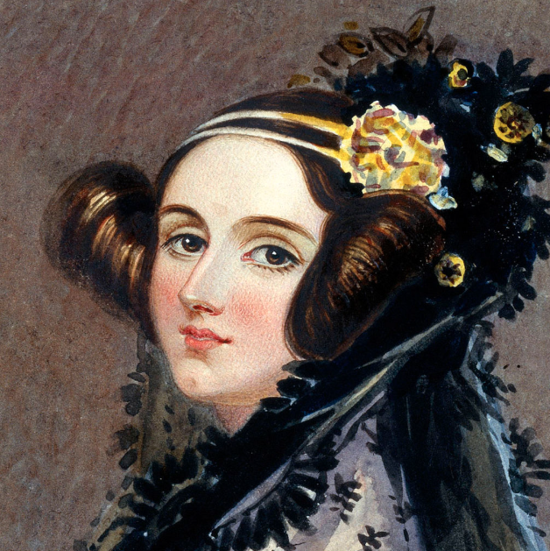
Tech Trek Day 1
Core Class: Math

Slide 2
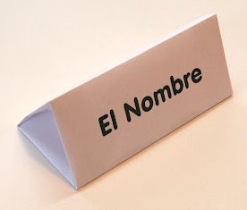
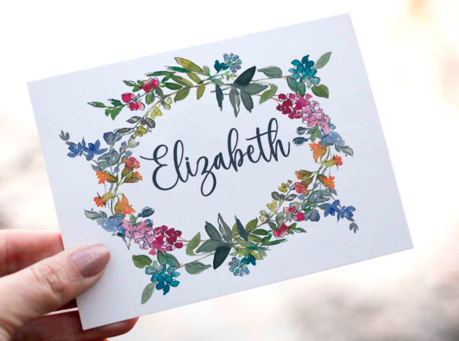
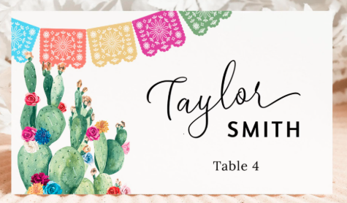
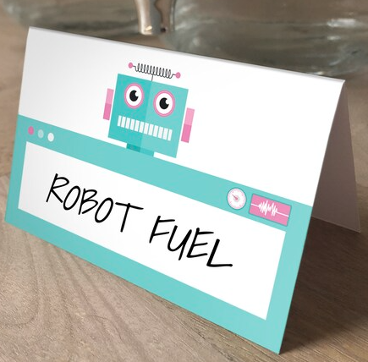
Name Card Decoration (15 minutes)
Choose paper for your name card.
Write your name in BIG letters.
Include your pronouns
  Example: Ms. Murphy (she/her)
  Example: Jackie (they/them)
Add stickers and drawings if you’d like :)

Slide 3
Important Announcements
Each day the schedule will be displayed on the board.
Peer counselors will be leading groups to the bathroom at each break.
If you have to use the bathroom during lesson time, let Ms. Murphy or a peer counselor know.

Slide 4
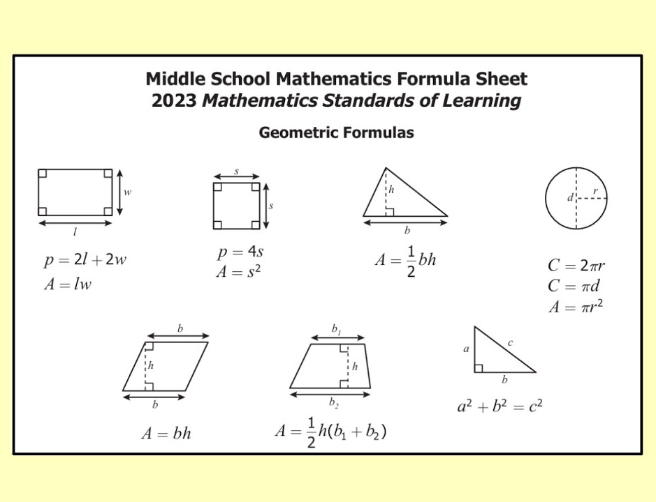
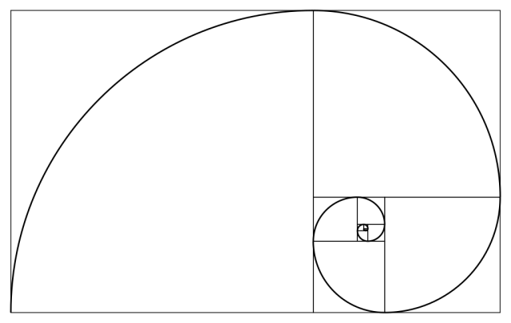
What do you think of math? (2 minutes)
In your small group, share one word for how math feels
Example: Sometimes, math feels EXCITING to me.
Example: Sometimes, math feels CONFUSING to me.

Slide 5
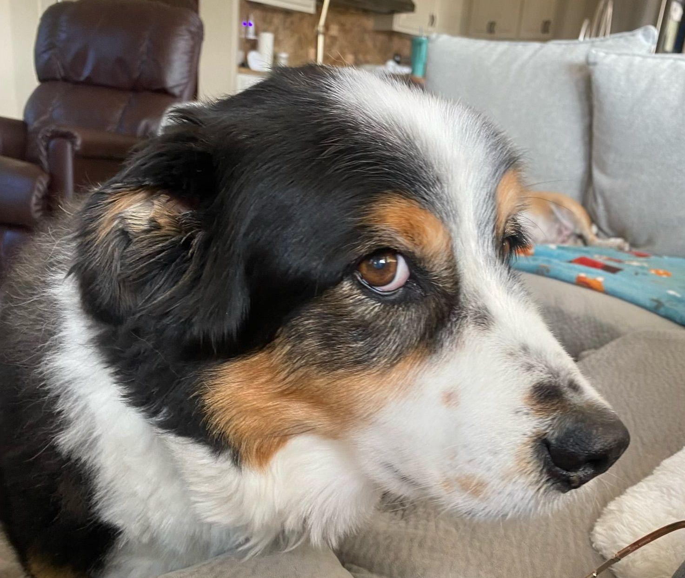
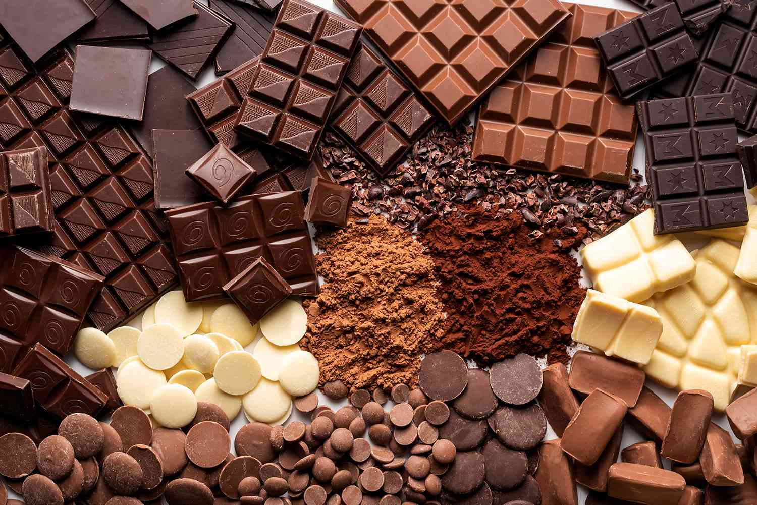
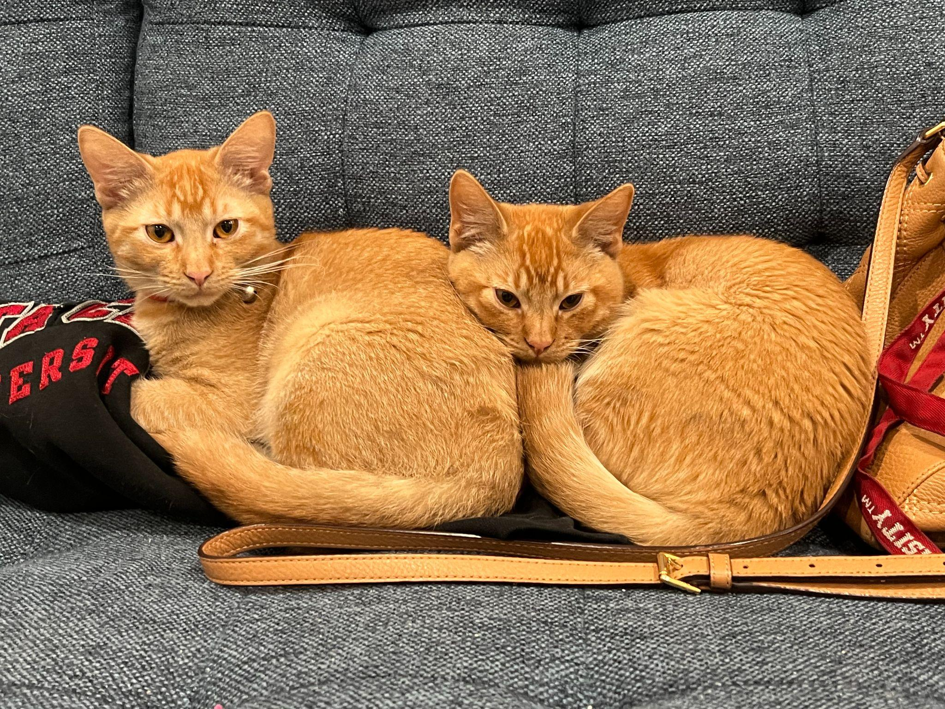
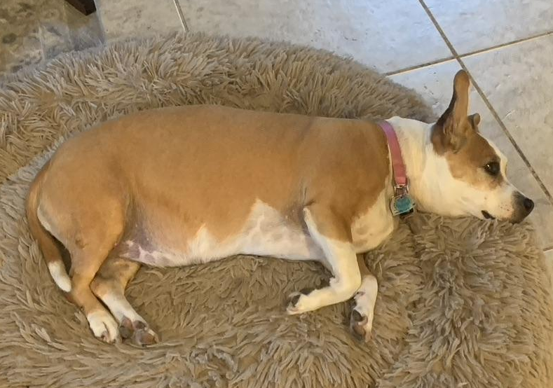
Set Building Activity Part 1
P = { people who have a pet }
C = { people who like chocolate }
P ⋂ C = { people who have a pet AND like chocolate }
P ⋃ C = { people who have a pet OR like chocolate }

Slide 6
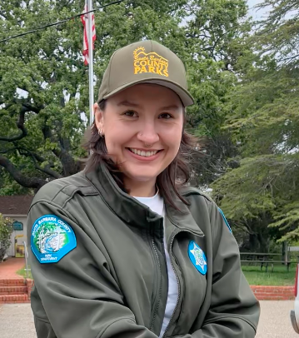
Set Building Activity Part 2 (15 minutes)
S = { people who have a sibling }
E = { people who eat spicy food }
S ⋂ E = { people who have a sibling AND eat spicy food }
S ⋃ E = { people who have a sibling OR eat spicy food }
Challenge: Can you think of other examples of sets?

Slide 7
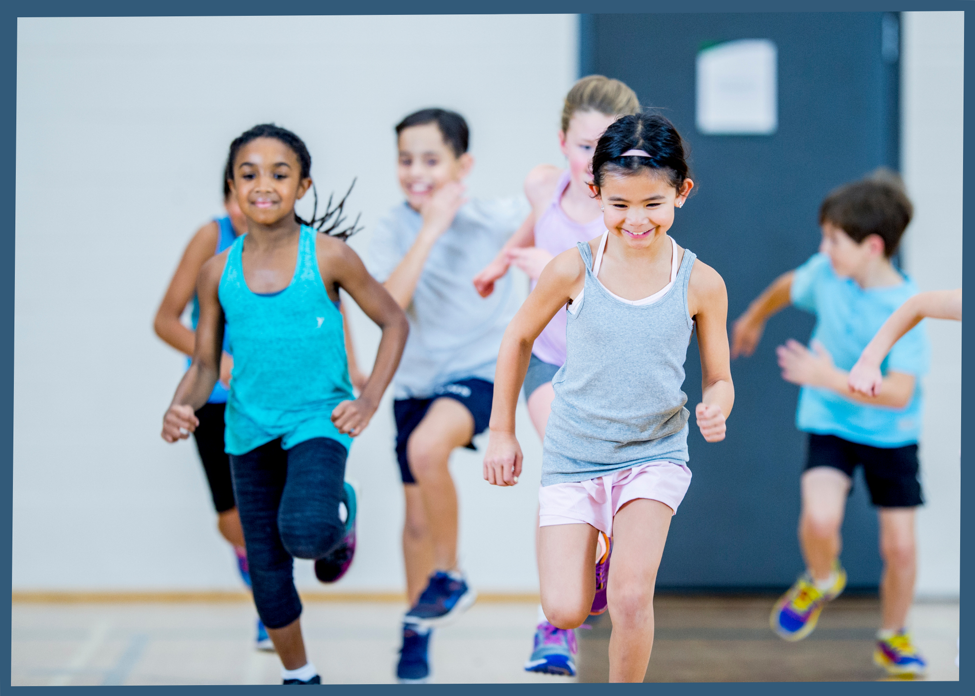
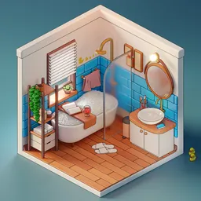


BREAK TIME (15 minutes)
You can…
Go to the bathroom
Get some water
Keep decorating your name card
Talk to Ms. Murphy or the peer counselors
Play a game

Slide 8
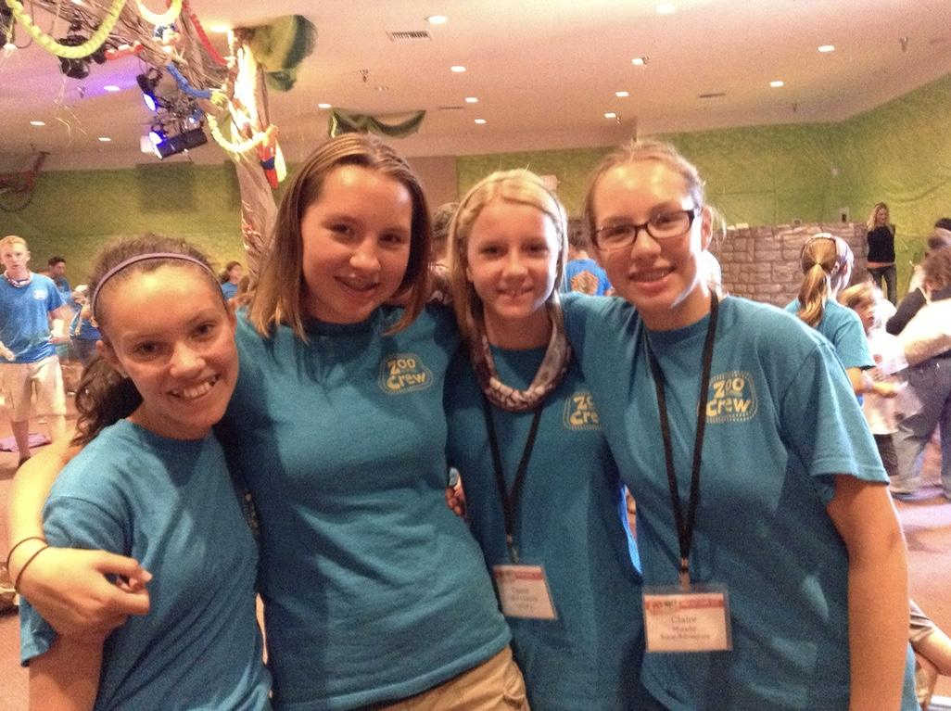
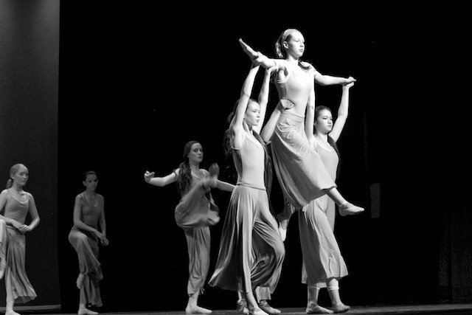





Ms. Murphy’s Story
Middle school
  Reading
  Ballet

Slide 9
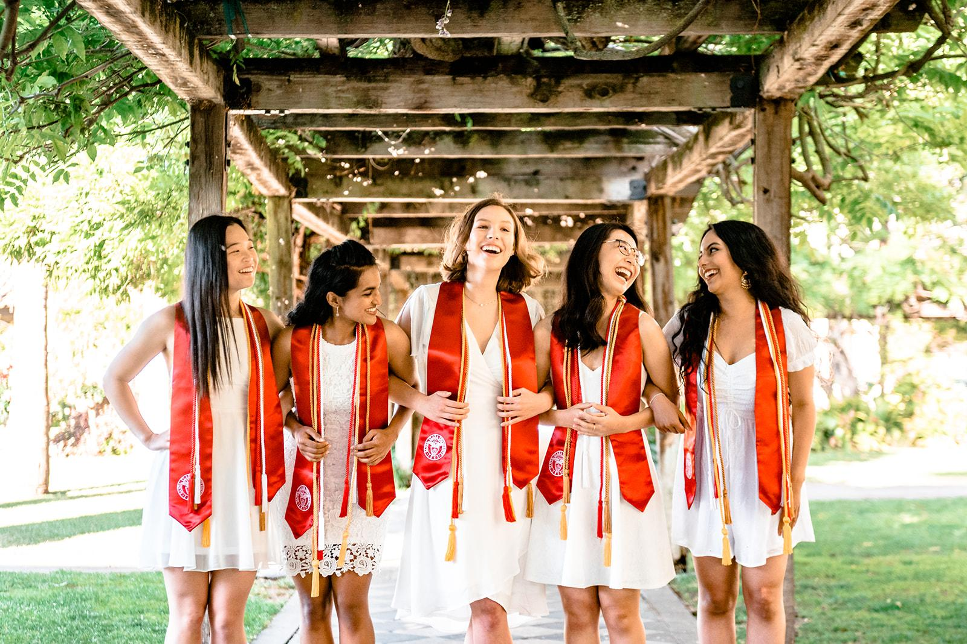

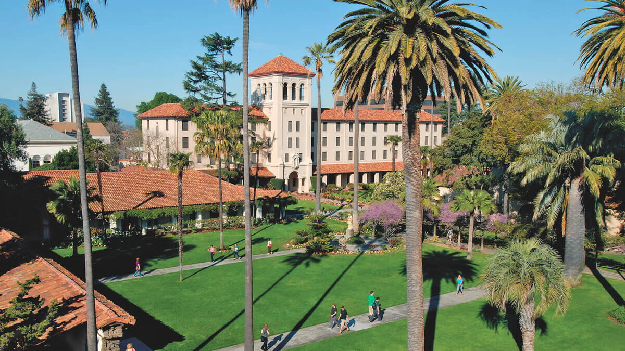
Ms. Murphy’s Story
College
  Internship at Intel
  Fun math classes
  Computer science => math

Slide 10
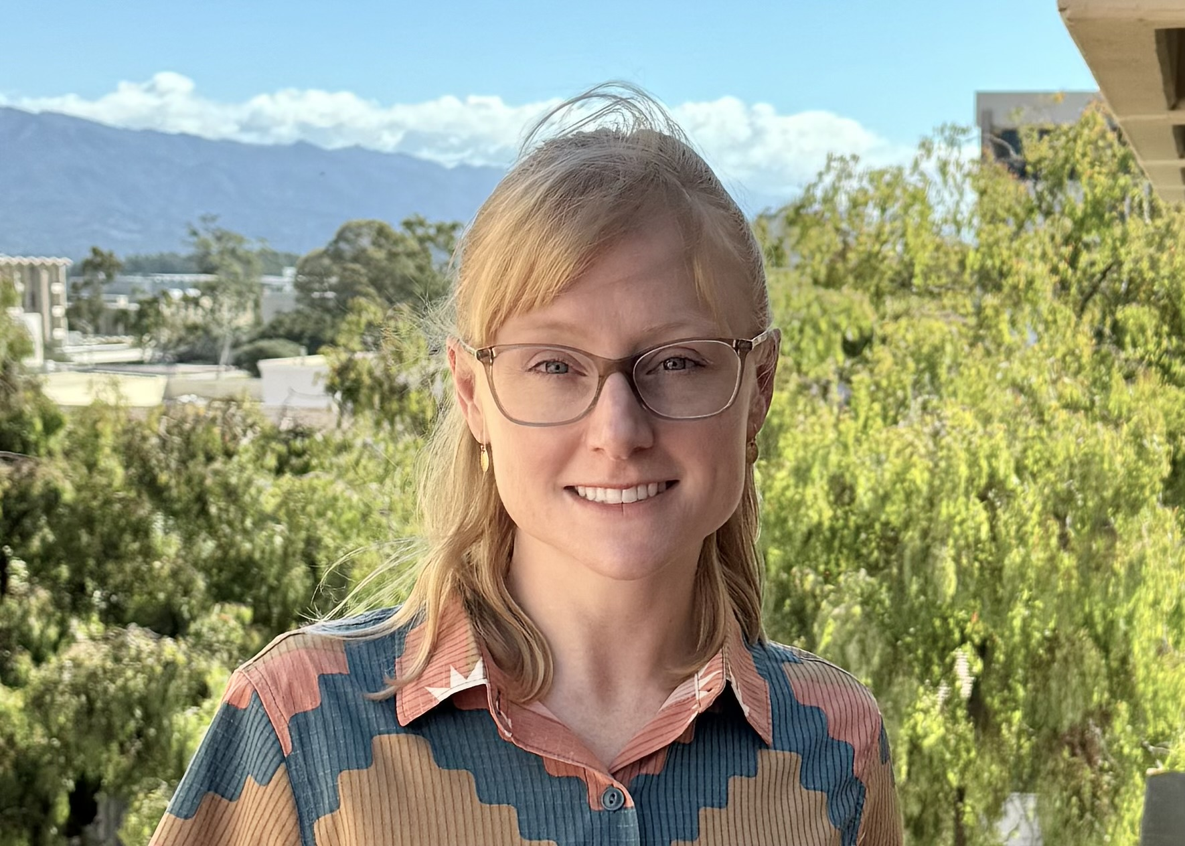
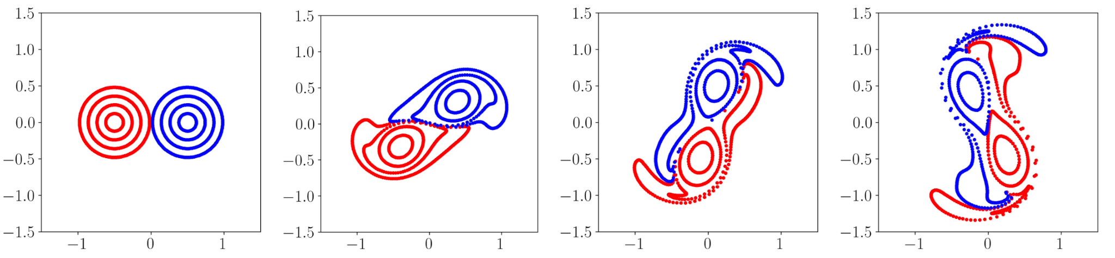
Ms. Murphy’s Story
Graduate school
  Interacting Particle Systems
  Society for Industrial and Applied Math

Slide 11
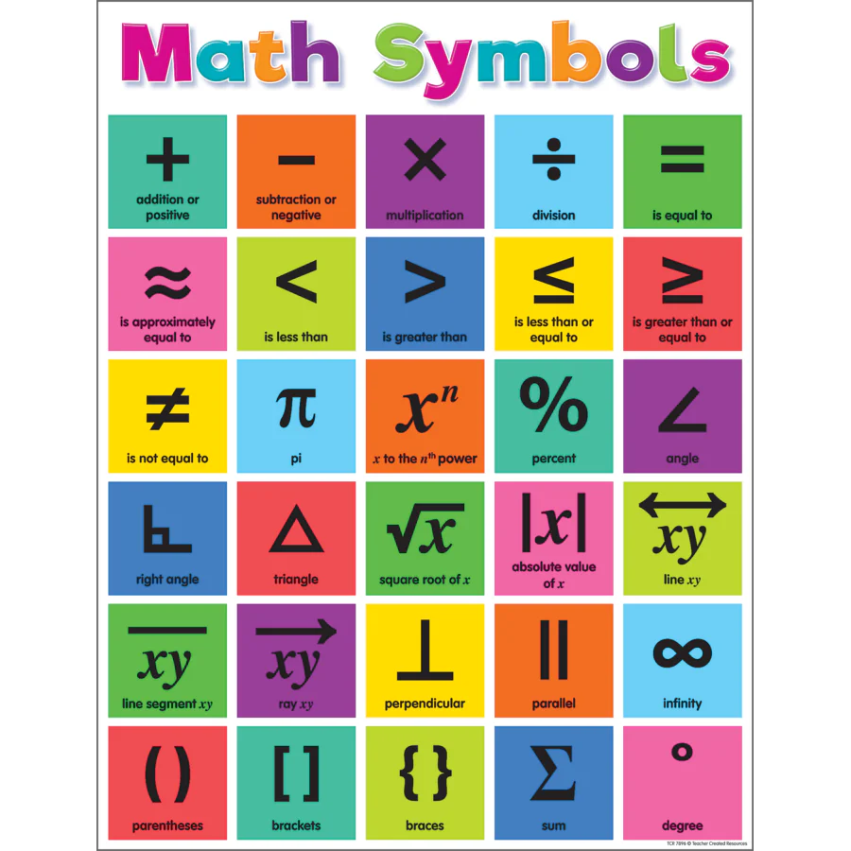
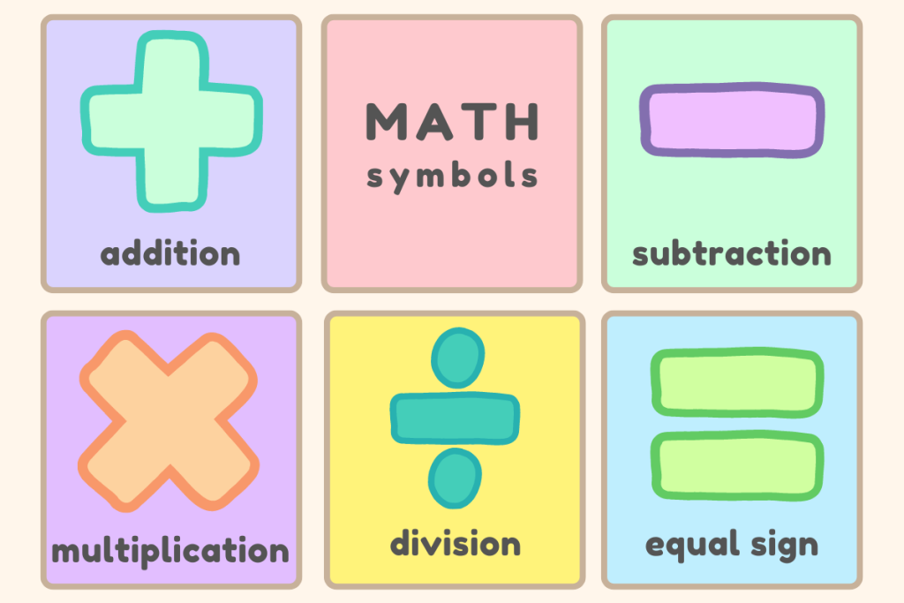

What is Notation?
Notation: The symbols we use to describe things in math
Example: +, -, =
Can you think of any other examples of notation?

Slide 12
Set Notation
A = { Ms. Murphy, Grace Hopper, Albert Einstein }
B = { Ms. Murphy, Taylor Swift, Billie Eilish }
⋂: Intersection
  A ⋂ B = { Ms. Murphy }
⋃: Union
  A ⋃ B = { Ms. Murphy, Grace Hopper, Albert Einstein, Taylor Swift, Billie Eilish }
∈: Element
  Grace Hopper ∈ A
\: Complement
  A \ { Albert Einstein } = { Ms. Murphy, Grace Hopper }
⊆: Subset
  { Taylor Swift, Billie Eilish } ⊆ B
Venn Diagram

Slide 13
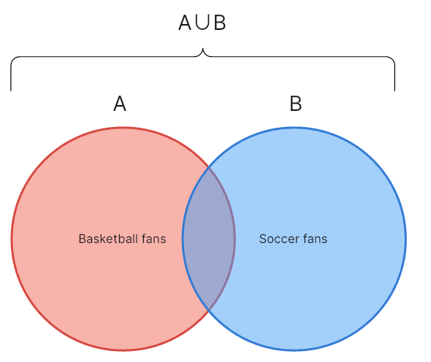
Small Group Activity (15 minutes)
Create two new sets, called A and B
  Example
    A = { people whose favorite color is blue }
    B = { people who like to draw }
Identify each of the following sets
  A ⋂ B
  A ⋃ B
  A \ B
  B \ A
  Challenge
    (B \ A) ⋃ B
    B \ (A ⋂ B)
    Hint: Parentheses always go first!
Draw a Venn diagram

Slide 14
BREAK TIME (15 minutes)
You can…
Go to the bathroom
Get some water
Keep decorating your name card
Talk to Ms. Murphy or the peer counselors
Play a game

Slide 15

Challenge: Sets of Numbers (15 minutes)
Natural numbers: 1, 2, 3, …
Integers: …, -3, -2, -1, 0, 1, 2, 3, …
Rational numbers: All fractions, e.g. 1/2, 17/4, -1/3, 4, etc.
Real numbers: Every number on the number line
Are the following statements true or false?
1 ∈
-2 ∈
⊆
⊆
⋂ =
⋃ =
-1 ∈ \
1 ∈ { 0, 1, 2 }
1 ∈ \ { 0, 1, 2 }
-1 ∈ \ { 0, 1, 2 }
1/5 ∈ \
π ∈

Slide 16
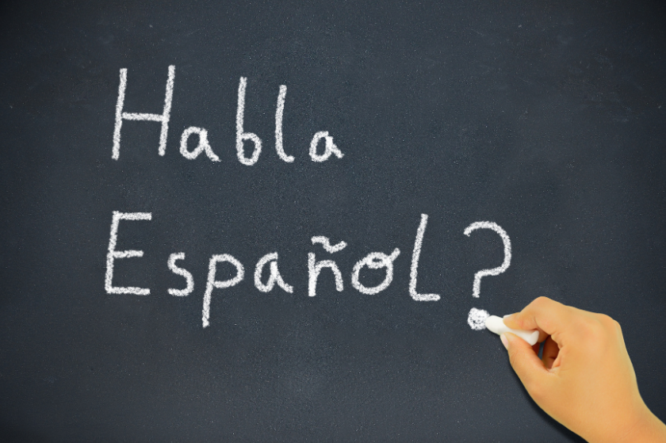
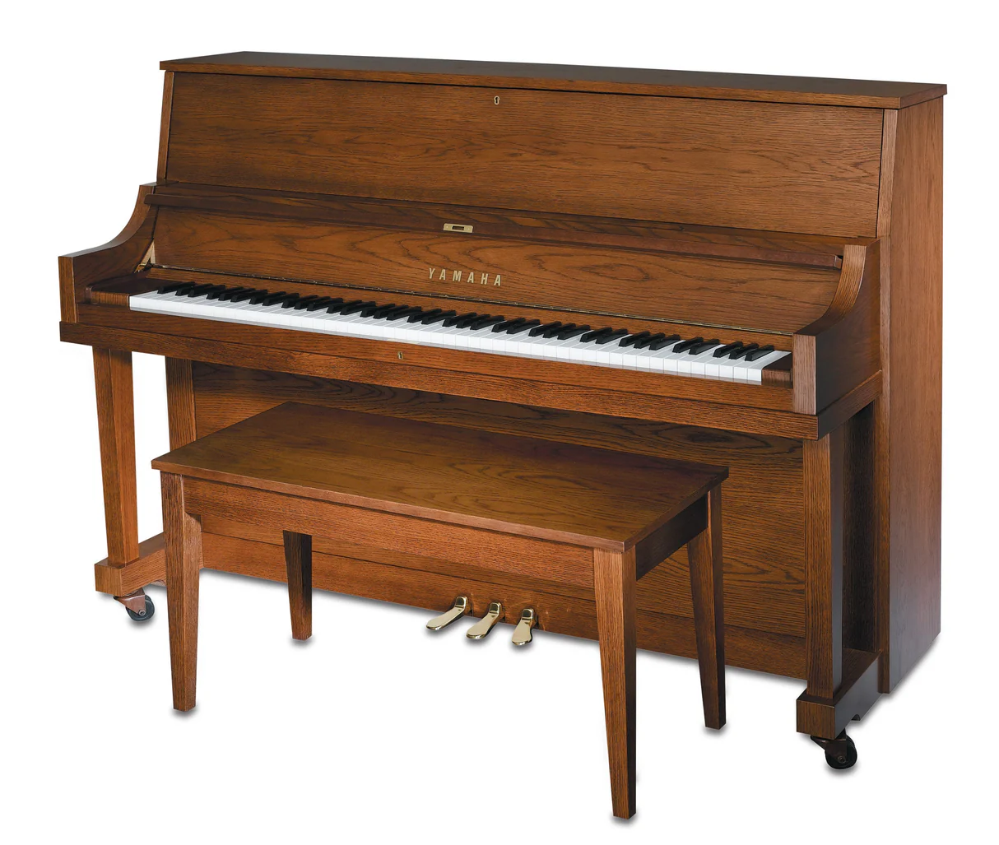
Discovering a Formula
| A | = number of elements in A
Example: | {-1, 0, 1} | = 3
What is | A ⋃ B |?
Formula: | A ⋃ B | = | A | + | B | - | A ⋂ B |
Challenge:
There are ten students in the classroom.
6 speak Spanish.
3 play the piano.
2 speak Spanish AND play the piano.
How many can speak Spanish OR play the piano?

Slide 17

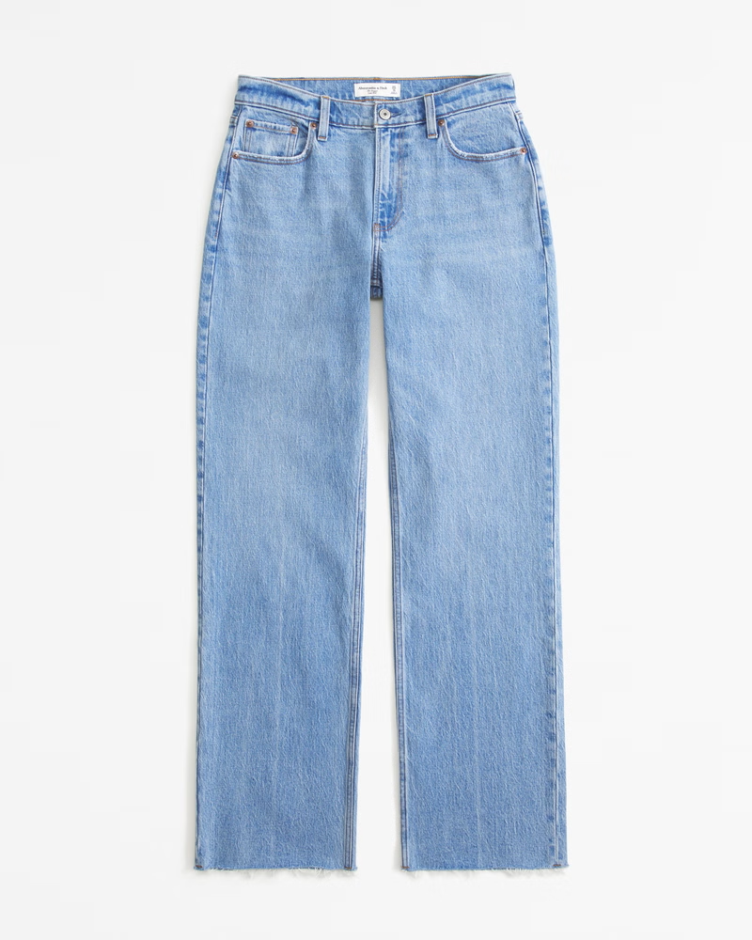
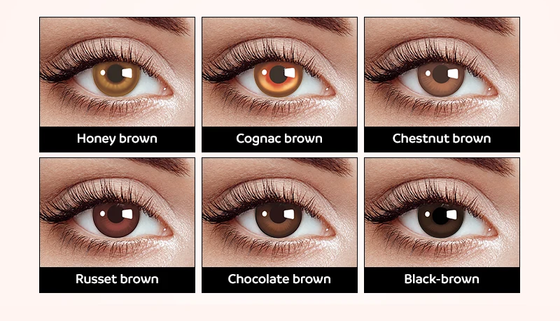
The Set Game
J = { students wearing jeans }
S = { students who play a sport }
B = { students with brown eyes }
If you’re in a set, run to the front of the room!
Example: S ⋃ B

Slide 18
The Set Game
J = { students wearing jeans }
S = { students who play a sport }
B = { students with brown eyes }
S ⋂ B

Slide 19
The Set Game
J = { students wearing jeans }
S = { students who play a sport }
B = { students with brown eyes }
B \ J

Slide 20
The Set Game
J = { students wearing jeans }
S = { students who play a sport }
B = { students with brown eyes }
J ⋂ S ⋂ B

Slide 21
The Set Game
J = { students wearing jeans }
S = { students who play a sport }
B = { students with brown eyes }
J \ S

Slide 22
The Set Game
J = { students wearing jeans }
S = { students who play a sport }
B = { students with brown eyes }
J ⋃ S

Slide 23
The Set Game
J = { students wearing jeans }
S = { students who play a sport }
B = { students with brown eyes }
B \ (J ⋃ S)

Slide 24

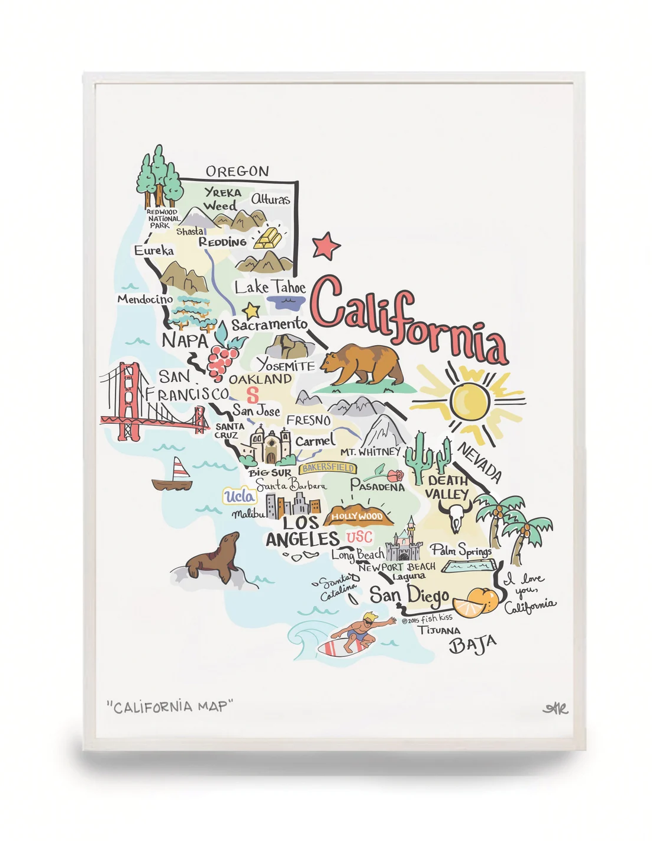
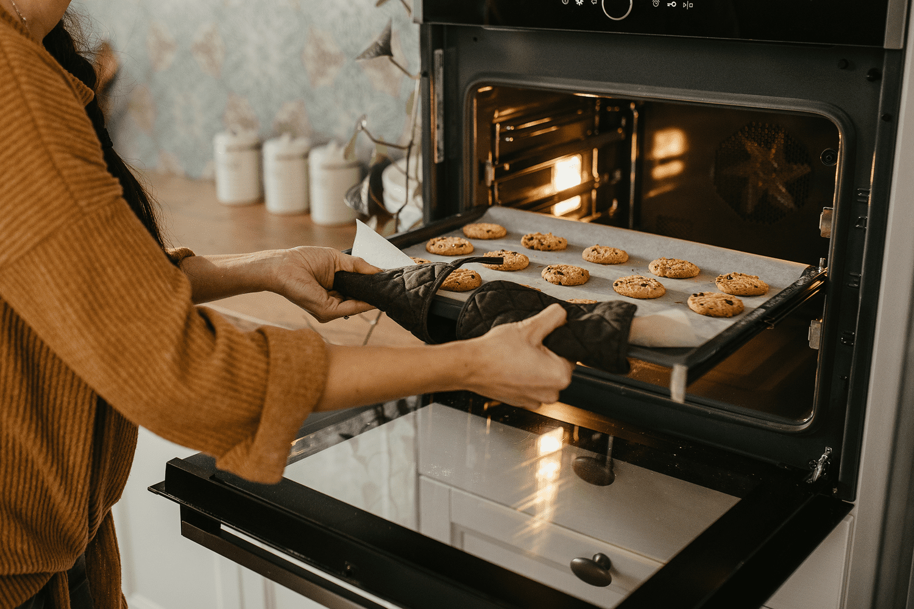
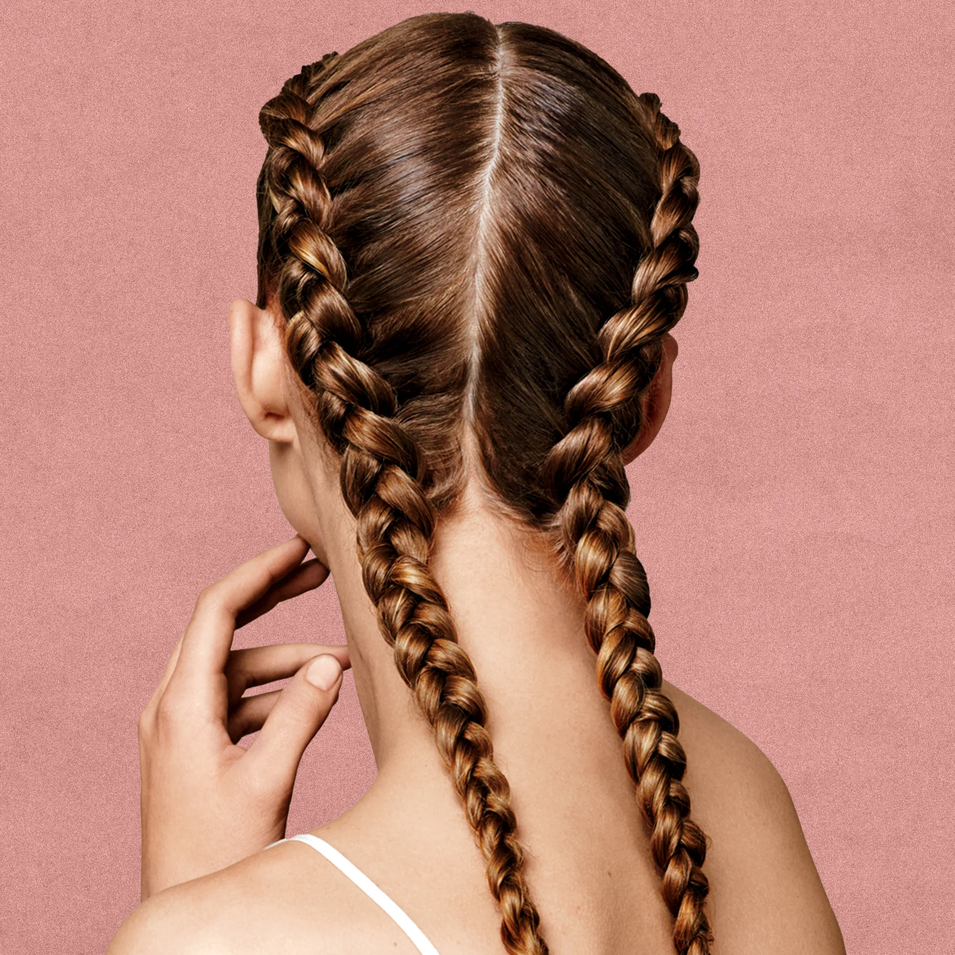
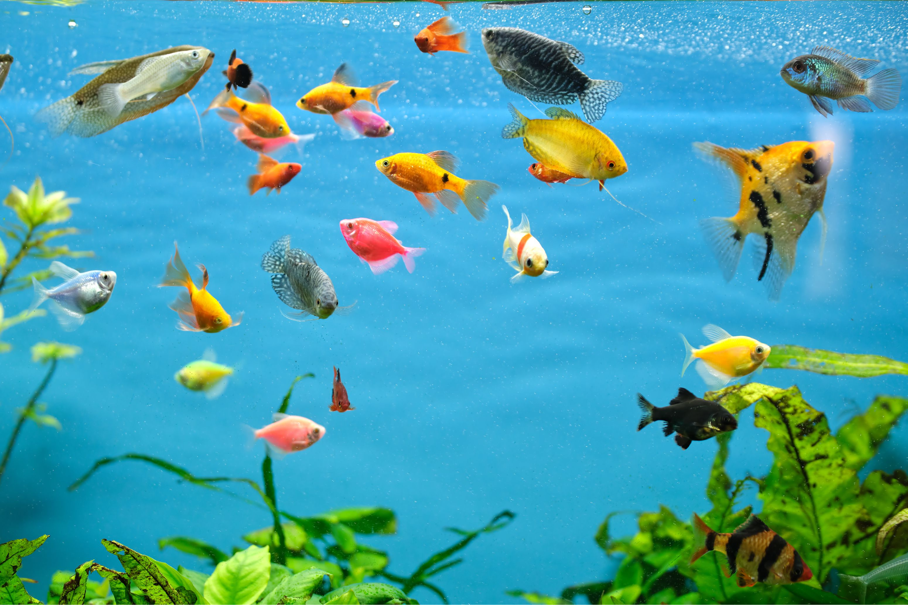
The Set Game Continued
Can we think of three new sets?

Slide 25
Daily Reflection
What’s one new thing you learned today?
Leave your name card at your desk! We will be using them each day.

