Slide 1
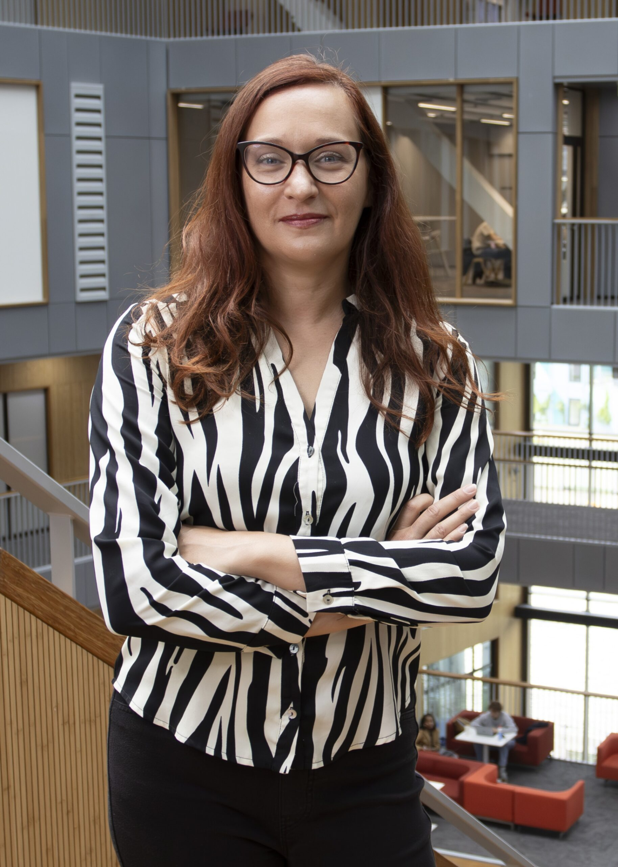
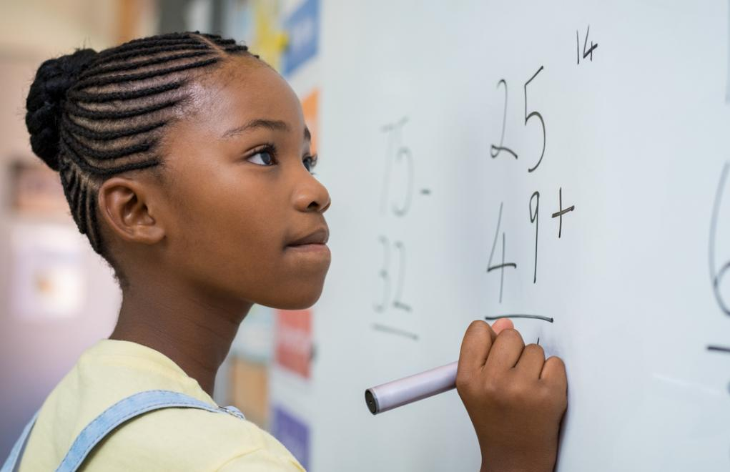
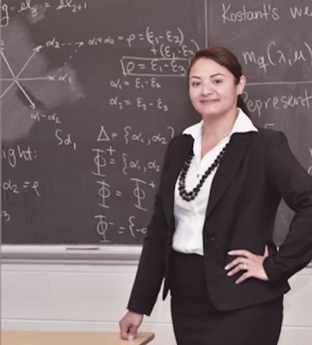
Tech Trek Day 2
Core Class: Math

Slide 2
Important Announcements
I’m Ms. Murphy and I use she/her pronouns!
The schedule will be on the whiteboard each day.
Peer counselors will be leading groups to the bathroom at each break.
If you have to use the bathroom during lesson time, let Ms. Murphy or a peer counselor know.
What did you do yesterday after class?

Slide 3
Review: Set Notation
A = { Ms. Murphy, Grace Hopper, Albert Einstein }
B = { Ms. Murphy, Taylor Swift, Billie Eilish }
⋂: Intersection
  A ⋂ B = { Ms. Murphy }
⋃: Union
  A ⋃ B = { Ms. Murphy, Grace Hopper, Albert Einstein, Taylor Swift, Billie Eilish }
∈: Element
  Grace Hopper ∈ A
\: Complement
  A \ { Albert Einstein } = { Ms. Murphy, Grace Hopper }
⊆: Subset
  { Taylor Swift, Billie Eilish } ⊆ B
Venn Diagram

Slide 4
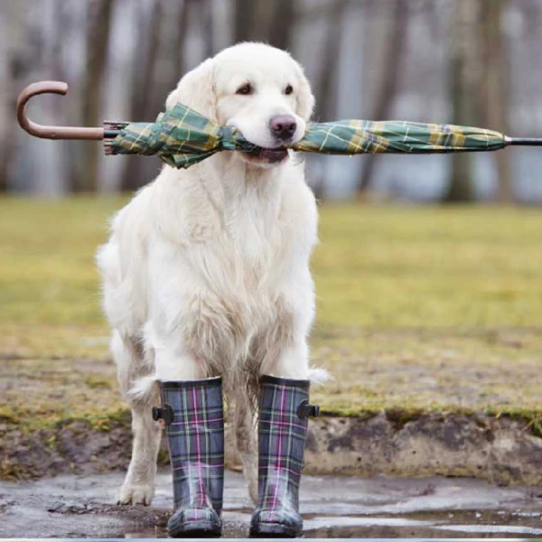
True or False?
If it’s raining, then the ground is wet.
If the ground is wet, then it’s raining.
All dogs are animals.
All animals are dogs.
Challenge: Can we translate any of these statements into set notation?

Slide 5
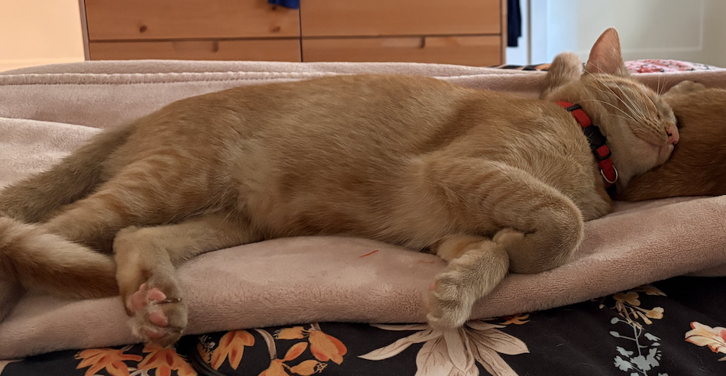
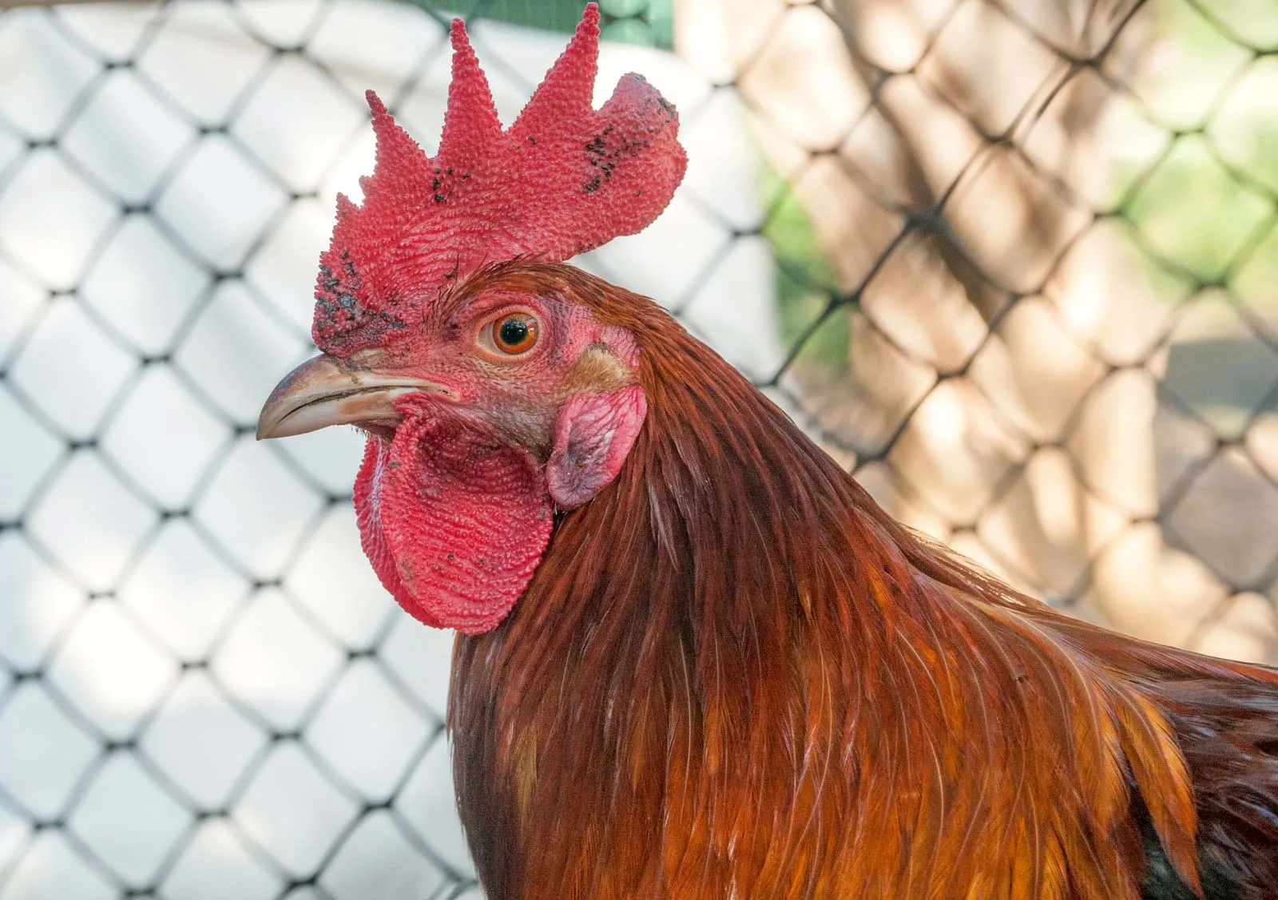
A Logic Puzzle
The cat, the chicken, and the grain
You need to move your cat, your chicken, and your grain across a bridge.
Each time you cross the bridge, you can carry only one of these three things.
If left alone, the chicken eats the grain and the cat eats the chicken.
How do you move these three things back and forth along the bridge so nothing gets eaten and the cat, the chicken, and the grain get across?

Slide 6
More Logic Puzzles (15 minutes)
Five people are eating apples. A finishes before B, but behind C. D finishes before E, but behind B. What is the final order?
A man has 53 socks in his drawer: 21 are blue, 15 are black and 17 are red. The lights are out, and it is dark. How many socks must he take out of the drawer to make 100 percent certain he has at least one pair of black socks?
Two friends, Hans and Marta, play games of tennis against each other. They bet $1 on each game they played. In the end, Hans won three bets. Marta made $5 after all the games. How many games did they play?

Slide 7
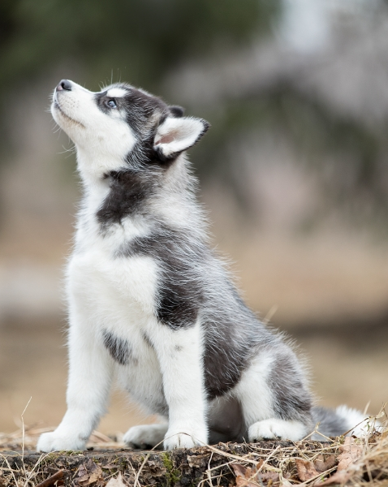
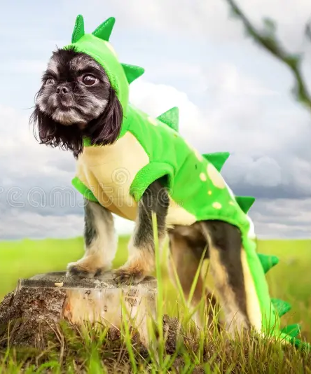
A Challenging Logic Puzzle
Two guards, two doors
You must choose between two doors: one to a puppy and one to a dragon.
There are two guards. One always lies, one always tells the truth. You're not sure which is one lies and which one tells the truth.
You get to ask the guards a single question.
What should you ask so you pick the correct door?
Hint #1: You don't know which guard is which, so "which door has the puppy?" is useless — you can't tell if the answer is a lie. You need a question that gives the same answer no matter which guard you ask.
Hint #2: Make your question about what the other guard would say. Ask one guard to predict the other's answer.

Slide 8

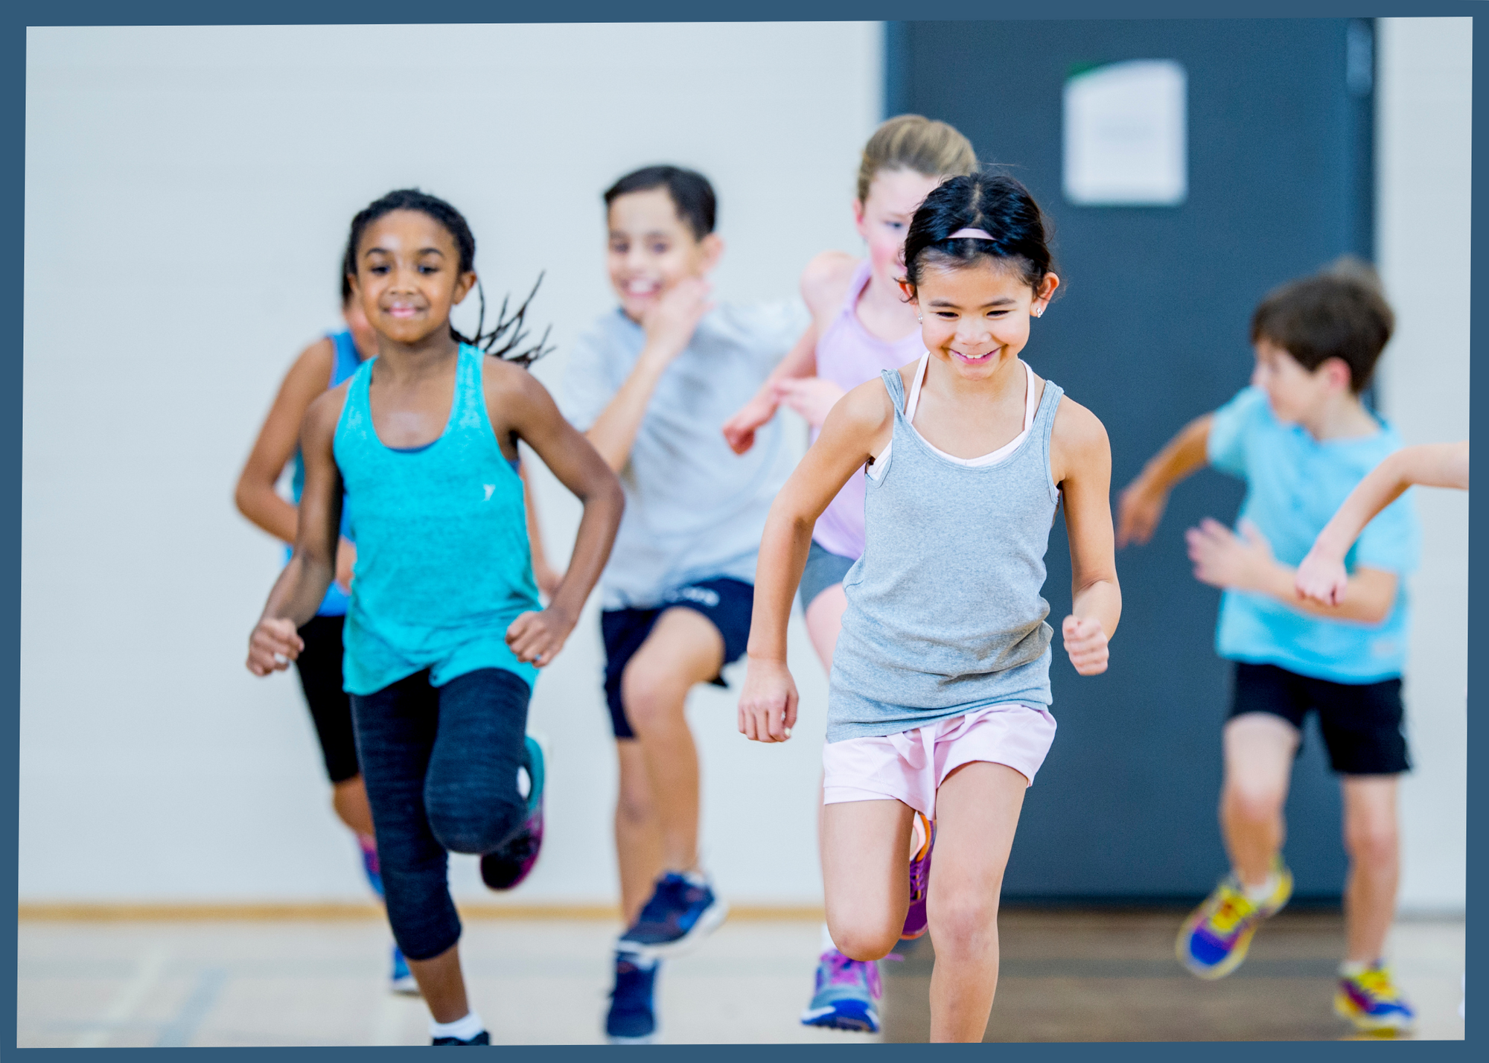

BREAK TIME (15 minutes)
You can…
Go to the bathroom
Get some water
Talk to Ms. Murphy or the peer counselors
Play a game

Slide 9

Mathematician of the Day: Pamela Harris
Born in 1983 in Guadalajara, Mexico
Emigrated to the U.S. at age 12
Undocumented immigrant => couldn’t attend university in the U.S.
Eventually her immigration status changed and she was able to get a degree in math
Studies algebraic combinatorics, i.e. “the math of counting”
President and co-founder of Lathisms, an organization that highlights Latine mathematicians

Slide 10
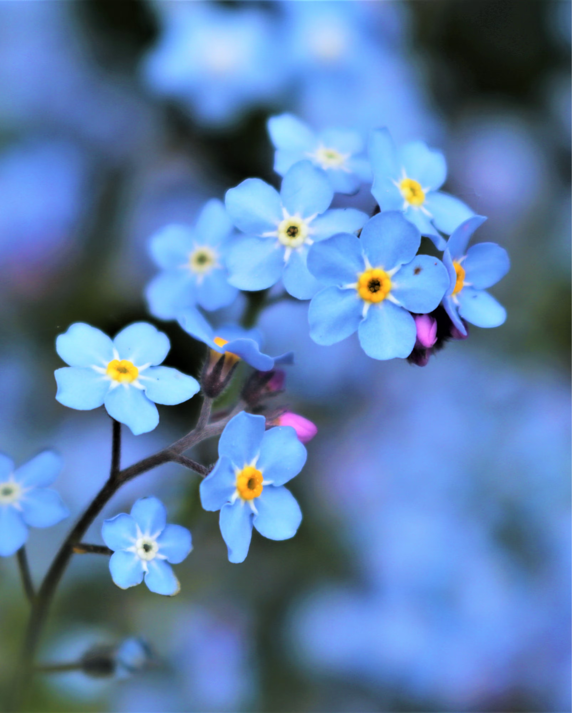
Pick a Number
Choose any number => 7.
Double it => 2 ྾ 7 = 14.
Add 10 => 14 + 10 = 24.
Halve it => 24 / 2 = 12.
Subtract your original number => 12 - 7 = 5.
What is the result?
(5 minutes) Choose your own number and repeat the process. What is the result? Compare with the other members of your group.

Slide 11
How to Write a Proof
How do we PROVE the answer is always 5?
Choose any number and call it x.
Double it => 2x.
Add ten => 2x + 10.
Halve it => (2x + 10) / 2.
Subtract your original number => (2x + 10) / 2 - x.
Simplify: (2x + 10) / 2 - x = (2x / 2 + 10/2) - x = (x + 5) - x = 5.

Slide 12

Your Turn: Prove It (10 minutes)
Choose any number => 7.
Triple it => 3 ྾ 7 = 21.
Add 9 => 21 + 9 = 30.
Divide by three => 30 / 3 = 10.
Subtract your original number => 10 - 7 = 3.
What is the result?
=> Prove that the result is always 3 <=

Slide 13
Dots on a circle (25 minutes)

Slide 14
BREAK TIME (15 minutes)
You can…
Go to the bathroom
Get some water
Talk to Ms. Murphy or the peer counselors
Play a game

Slide 15
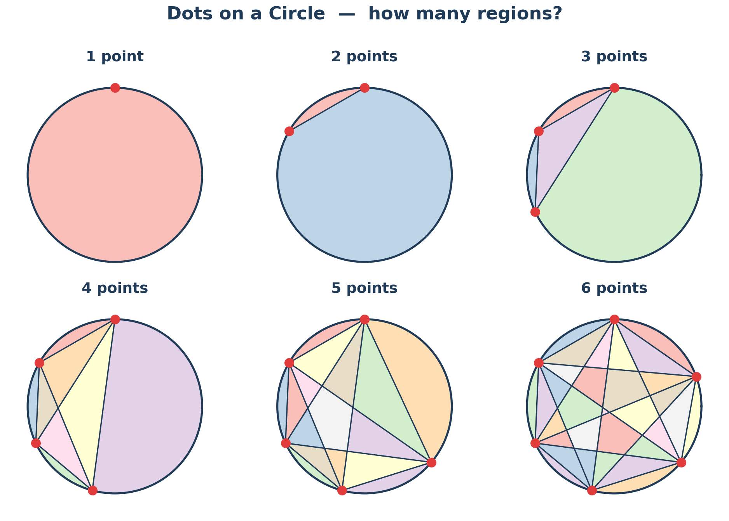
Why do we need proofs?
Each time we add a point, how many regions does the circle get split into?

Slide 16
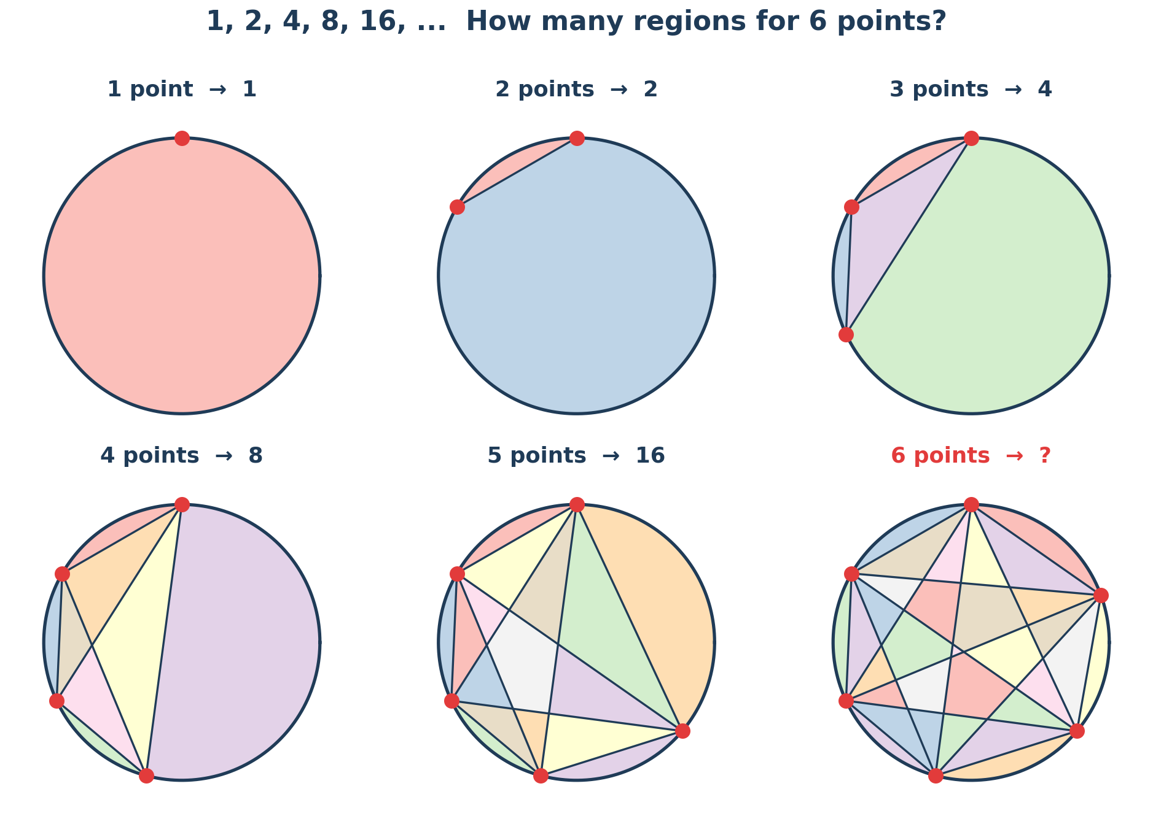
Why Do We Need Proofs?
How many regions for six points?
1 -> 2 -> 4 -> 8 -> 16 -> ???
The answer is 31.
We can’t just rely on our intuition to prove something. We have to give clear mathematical explanations, or proofs.

Slide 17
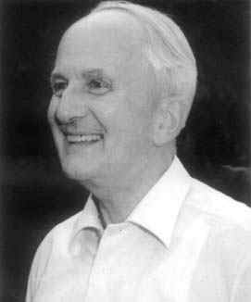
The Collatz Conjecture (5 minutes)
Pick any positive number.
If it's even, divide it by 2. If it's odd, multiply it by 3 and add 1.
Continue the sequence. What eventually happens?
4 => 2 => 1 => 4 => 2 => 1 => …
No one has been able to give a proof yet that this pattern continues forever!

Slide 18
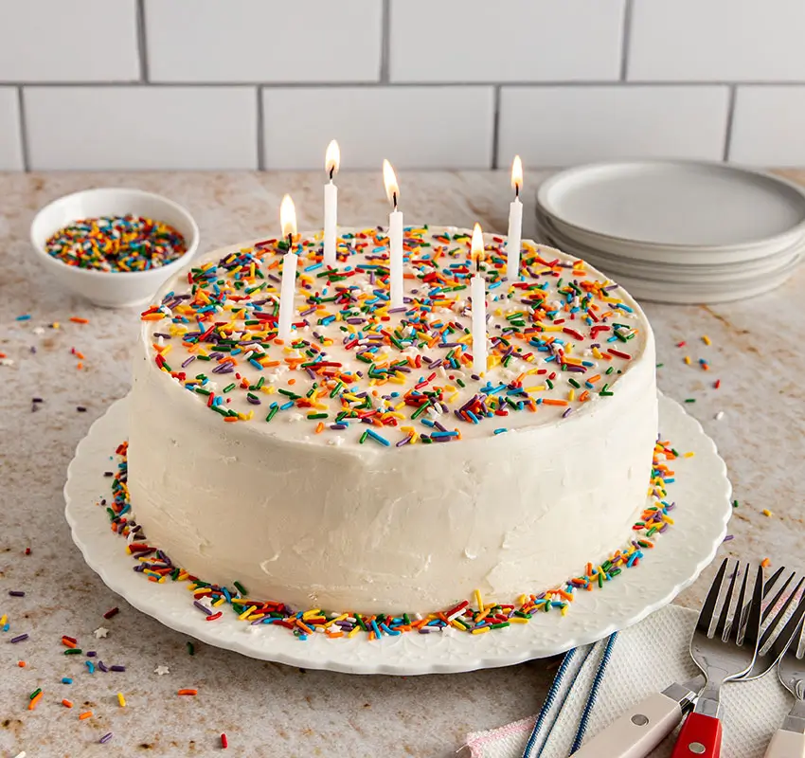
Activity: Intuition vs. Reality
We have about 23 people in this room. What are the chances that two of us share the same birthday — same day and month? Higher or lower than 50%?
Do two of us have the same birthday?

Slide 19


Mathematical Paradoxes
A mathematical paradox is a statement or question that seems to defy intuition.
Paradox #1: This statement is false.

Slide 20


Mathematical Paradoxes
Paradox #2: A barber shaves all men in town who do not shave themselves, and only those men. Does the barber shave himself?

Slide 21
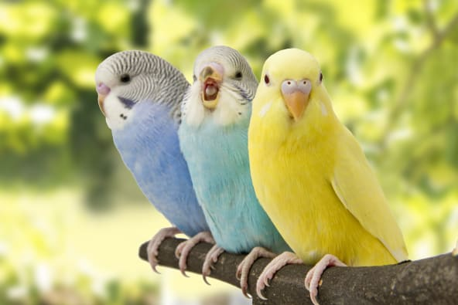
Challenge: A Final Logic Puzzle
Four campers — Ava, Bella, Carmen, and Dakota — each have a different favorite subject (math, art, science, music) and a different pet (cat, dog, bird, fish). Use the clues to figure out each girl's subject and pet.
The girl who loves math has a cat.
The girl who loves science has a bird.
Carmen loves music.
Ava does not love math.
Dakota has a dog.
Bella does not love art.
This is a variant of the Zebra Puzzle, attributed to Albert Einstein.

Slide 22
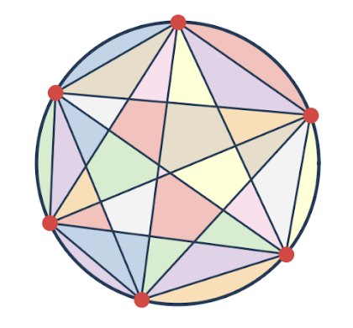
Daily Reflection
What’s one new thing you learned today?
Leave your name card at your desk! We will be using them each day.

