Slide 1

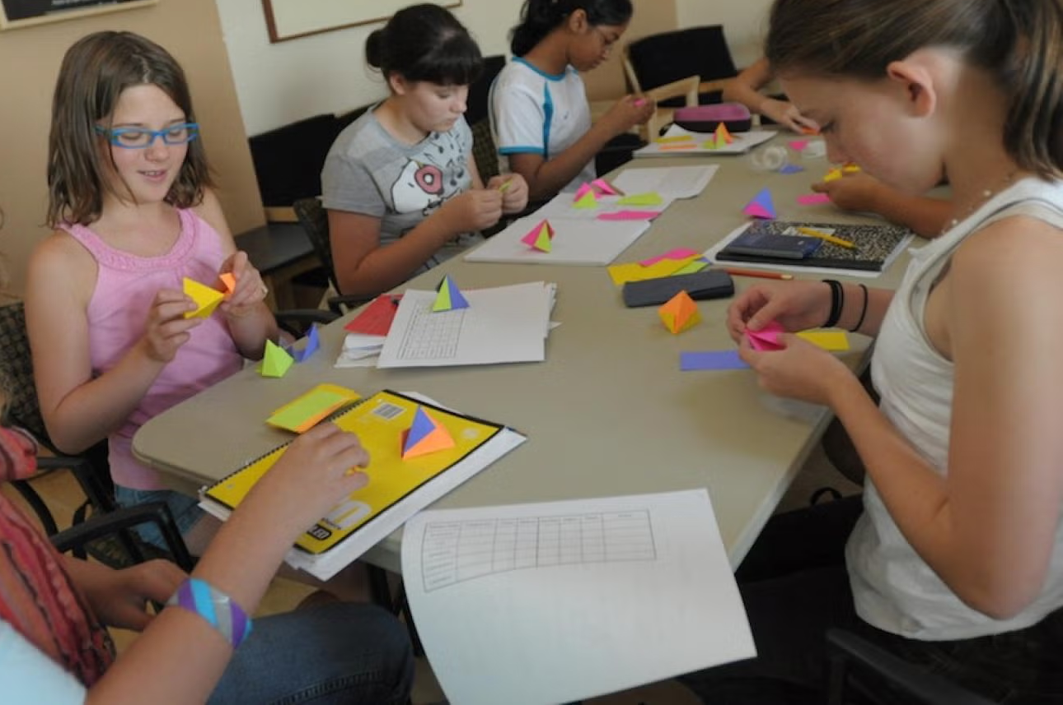

Tech Trek Day 3
Core Class: Math

Slide 2
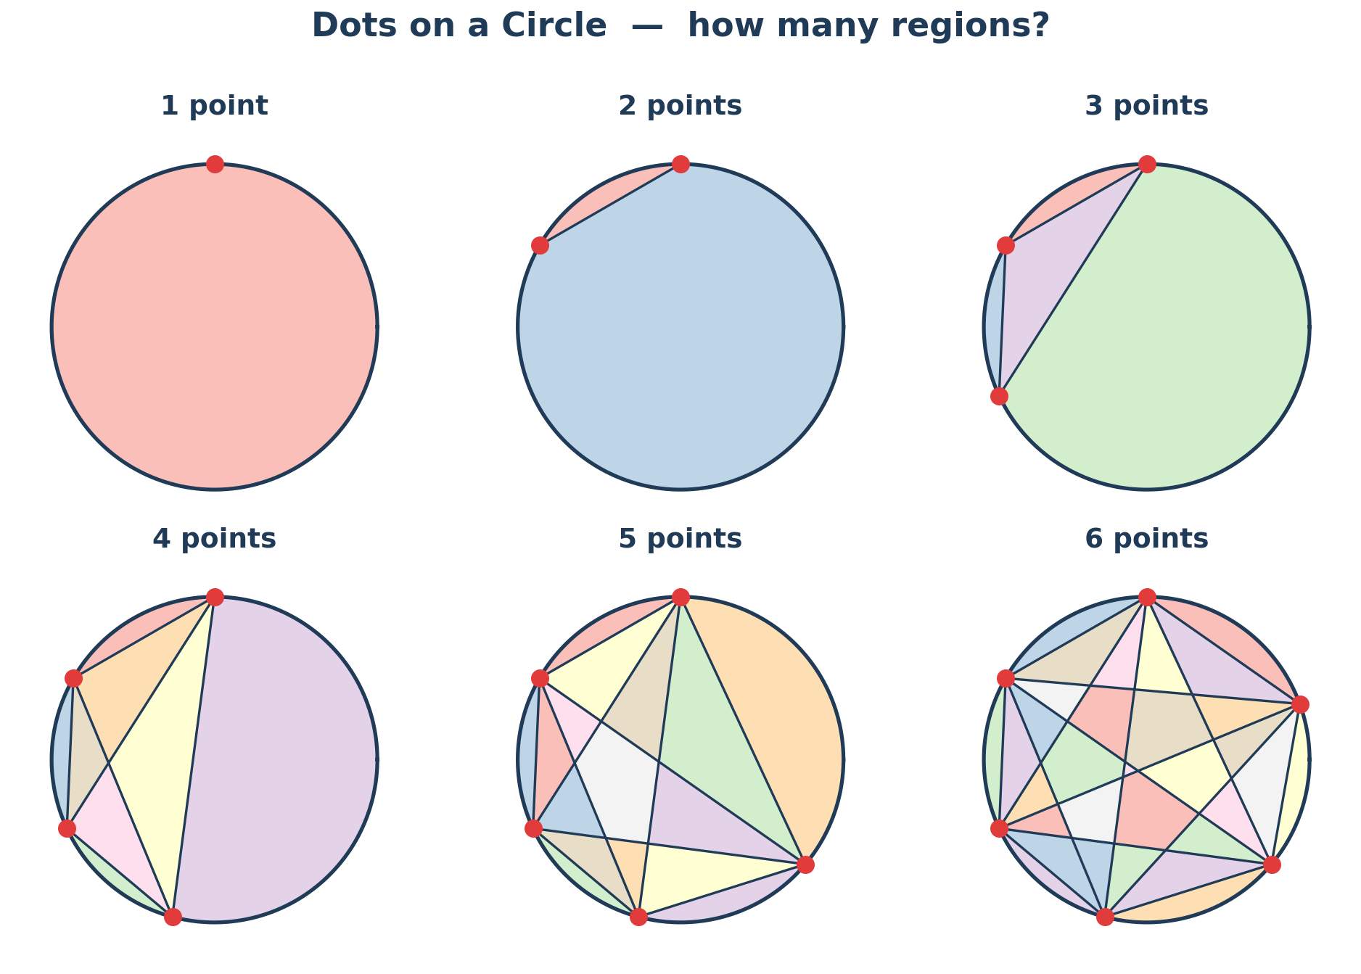
Review: Logic and Proof-forward Thinking
What did you do yesterday after class?
What is a proof? Why do they matter?
What is a paradox? What’s an example of a paradox?

Slide 3
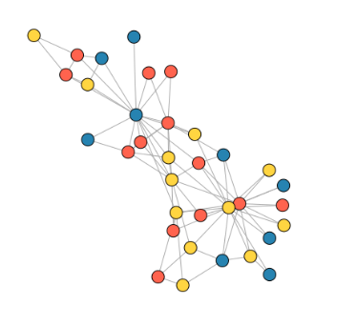
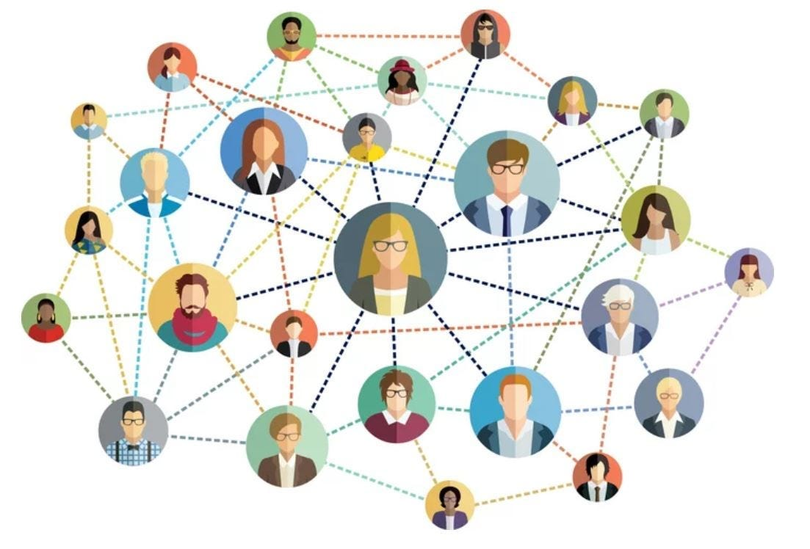
What is a graph?
A graph is a set of nodes and edges.
We can think of nodes as people, things, etc. and edges as a way that those things are connected.
Example
Nodes = all the people in the world
Two nodes / people share an edge if those two people know each other

Slide 4
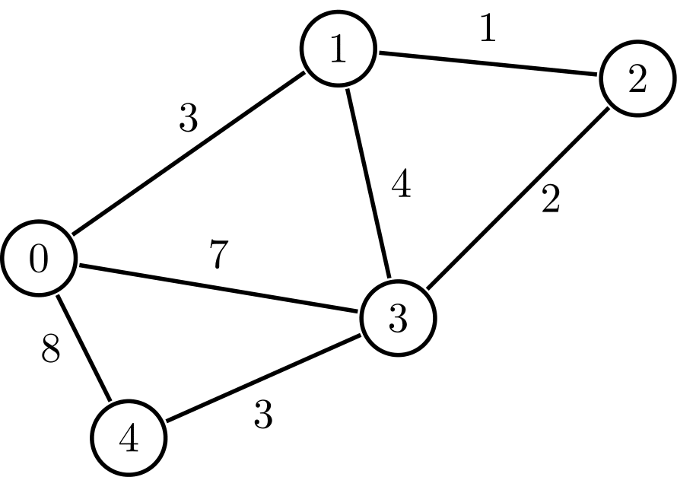
Weighted and unweighted graphs
Weighted graphs: Edges have weights, i.e. some connections are farther apart than others.
Example
Nodes = all the people in the world
Two nodes / people share an edge with weight 2 if they know each other
Two nodes / people share an edge with weight 1 if they’re related
Unweighted graphs: All edges have the same weight.

Slide 5
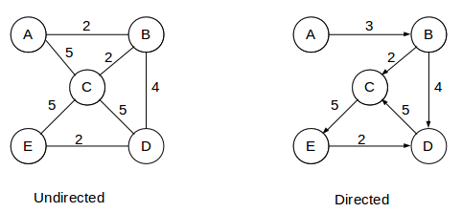
Directed and undirected graphs
Directed graphs: Edges have directions, i.e. node A is connected to node B, but node B may not be connected to node A.
Example
Nodes = all Instagram accounts
There is an edge from account A to account B if account A follows account B
Undirected graphs: If node A is connected to node B, then node B is connected to node A.
Example
Nodes = everyone in this room
Two people / nodes share an edge if they have the same eye color

Slide 6
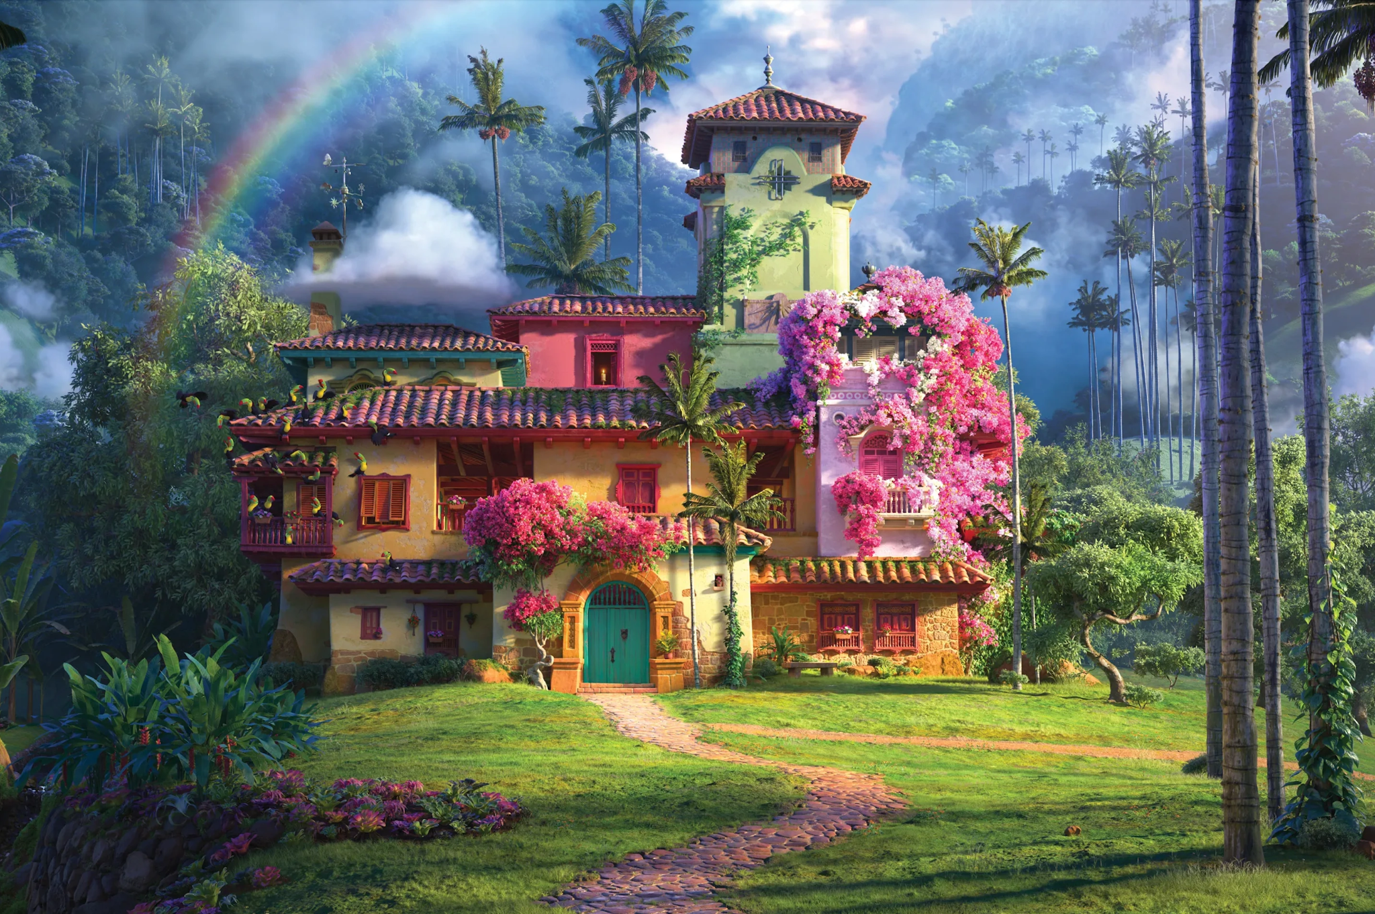
Example: Where do we live?
Nodes = everyone’s houses.
There is an edge between two houses if you can drive between them.
How could we make this a weighted graph?
Edge weight = how long it takes to drive between house A and house B
How could we make this a directed graph?
There is an edge from house A to house B if we can get to house B from house A

Slide 7
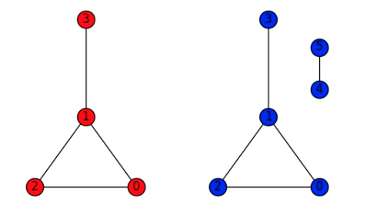
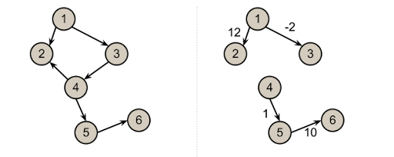
Connectedness
A graph is connected if we can get to any node from any other node.
Are the following graphs connected or unconnected? Weighted or unweighted? Directed or undirected?

Slide 8
Cycles
A cycle is a loop in a graph, i.e. a path from a node back to itself.
Do any of the following graphs have cycles? Which ones?

Slide 9
Small group activity: Graph creation (15 minutes)
Nodes = each member of your small group
Two nodes share an edge if an item of clothing is the same color.
Example: Person A and person B are both wearing purple shirts => they share an edge.
Draw the graph!
Is your graph connected?
Are there cycles?
Could you modify your graph so it’s weighted? How?
Could you modify your graph so it’s directed? How?

Slide 10



BREAK TIME (15 minutes)
You can…
Go to the bathroom
Get some water
Talk to Ms. Murphy or the peer counselors
Play a game

Slide 11
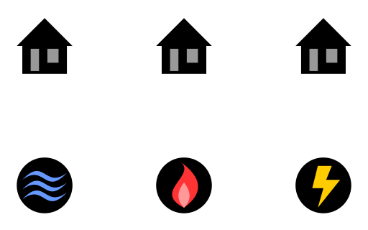
Small group activity: The three utilities puzzle (5 minutes)
There are three houses.
Each house needs:
A pipe going to the water.
A pipe going to the gas.
A pipe going to the electricity.
Is there a way to connect each of the houses to each of the utilities without any of the lines crossing each other?

Slide 12
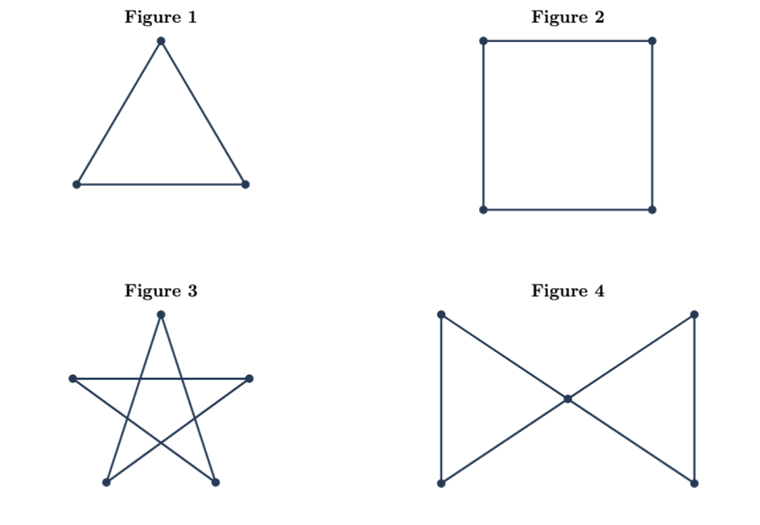
Small group activity: One-stroke tracing game (25 minutes)

Slide 13
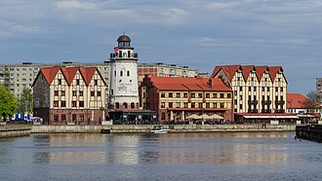
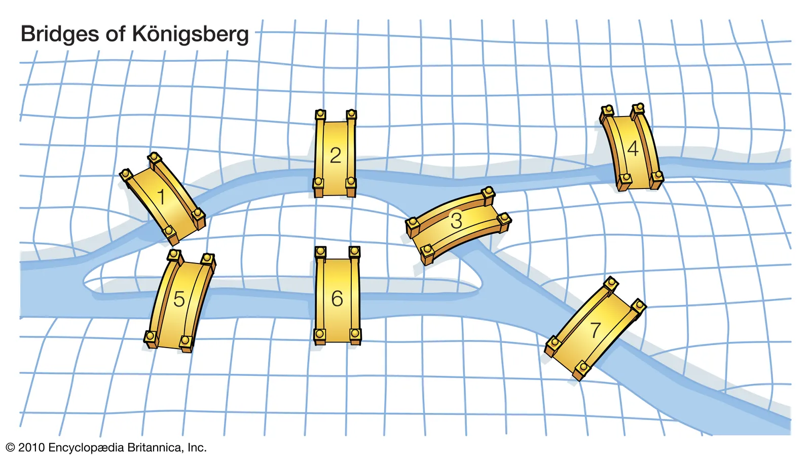
The Seven Bridges of Königsberg Problem
The city of Königsberg is situated on the Pregel River and featured two large islands.
These land masses are connected to each other and to the two riverbanks by seven distinct bridges.
Is there a continuous route across every bridge without ever repeating a single one?

Slide 14
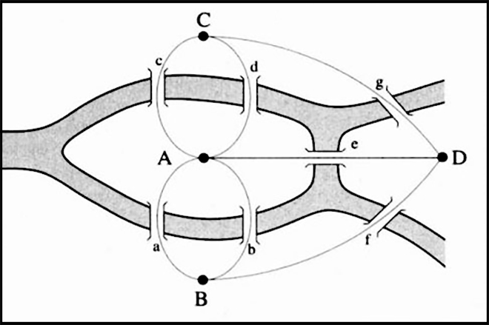
The Seven Bridges of Königsberg Problem
Is there a continuous route across every bridge without ever repeating a single one?
Can we turn our picture into a graph? Can we turn this into a question about the graph?

Slide 15
Your turn (5 minutes)
Can you solve the Seven Bridges of Königsberg Problem?
Count the number of odd nodes.
Based on the one-stroke tracing game, do you think it’s possible to come up with a solution?

Slide 16
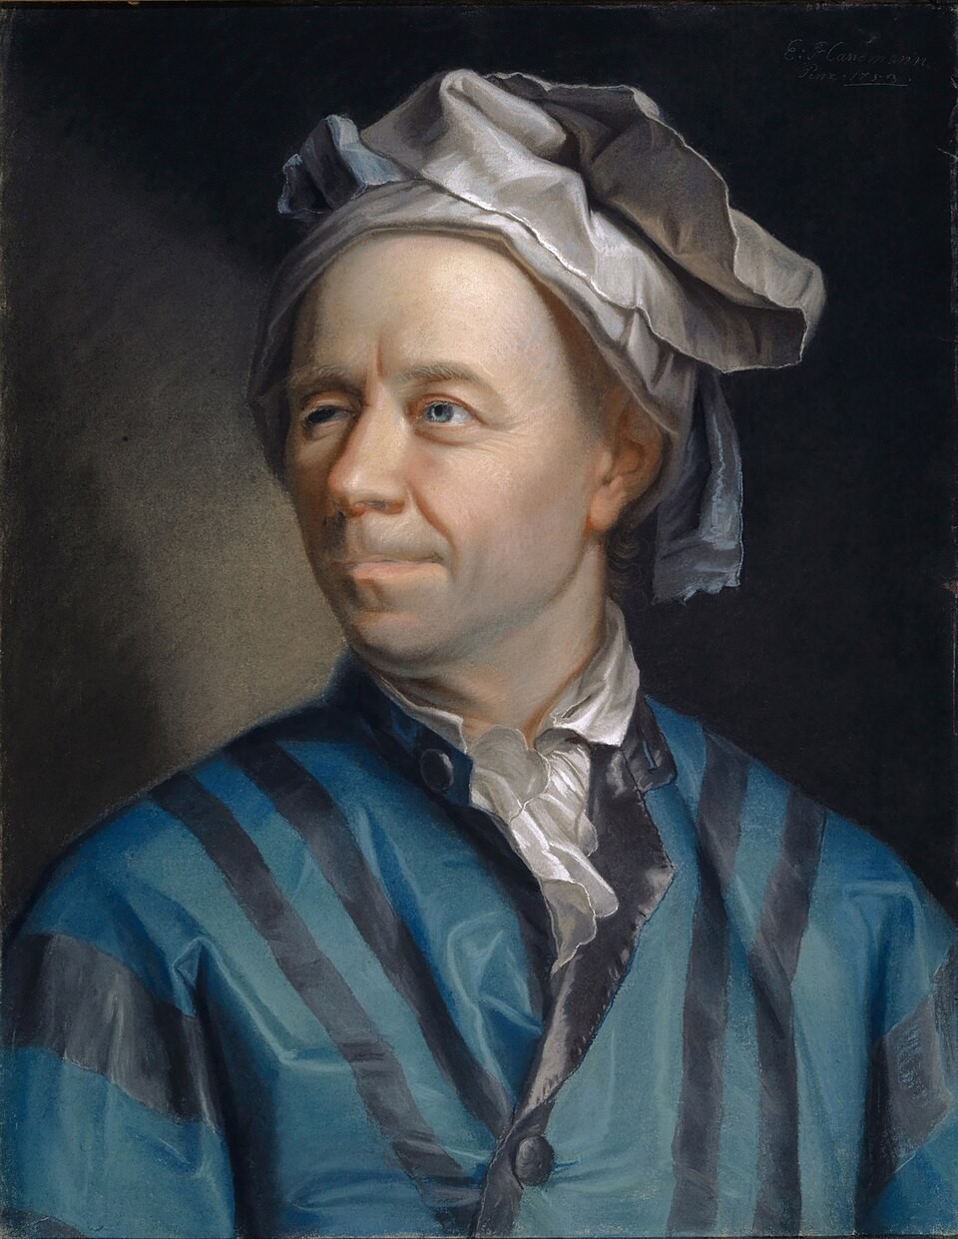
The Seven Bridges of Königsberg Problem
4 odd nodes => no solution.
Is this a proof?
Our worksheet suggests a pattern, but Leonhard Euler proved this pattern is true in 1736.

Slide 17
BREAK TIME (15 minutes)
You can…
Go to the bathroom
Get some water
Talk to Ms. Murphy or the peer counselors
Play a game

Slide 18
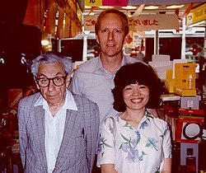
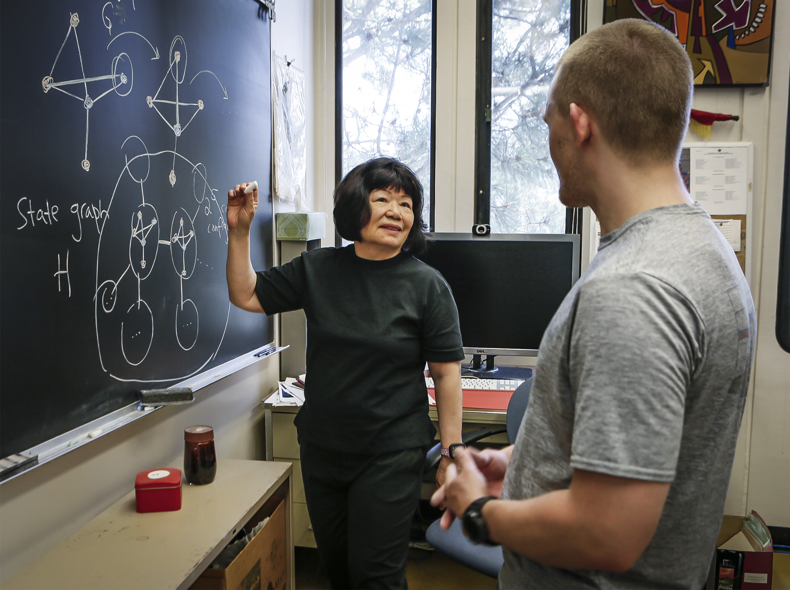
Mathematician of the day: Fan Chung
Born in 1949 in Taiwan.
Surrounded by other female mathematicians in college => encouraged her to pursue and study mathematics.
Immigrated to the U.S. after college => difficult and lonely.
Worked with Paul Erdős and many other really cool researchers to prove some incredible results.

Slide 19
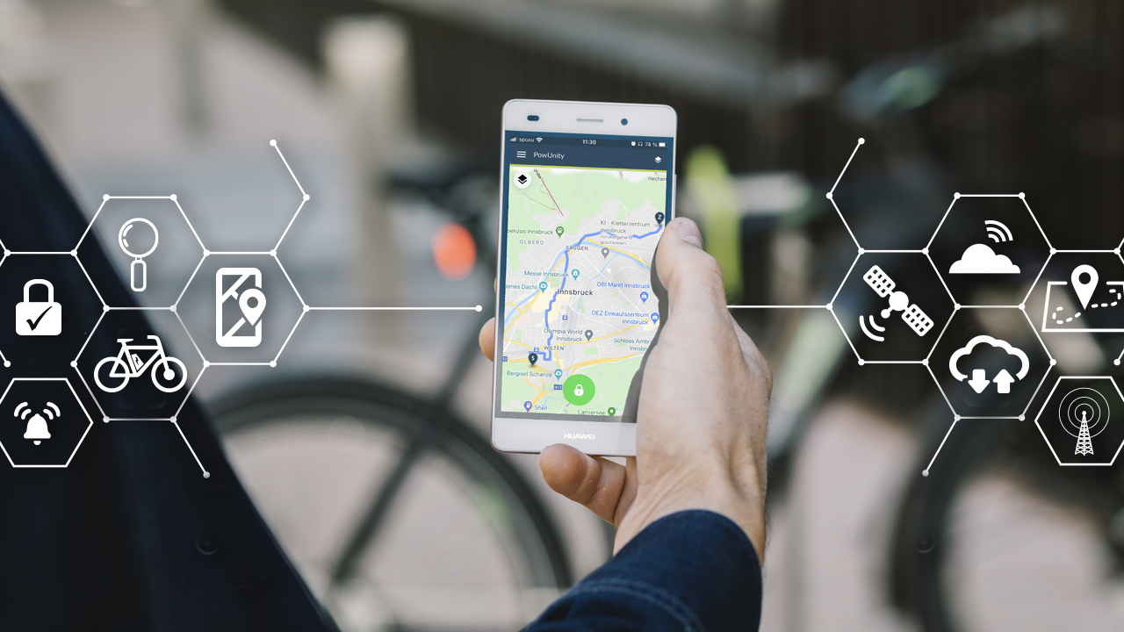
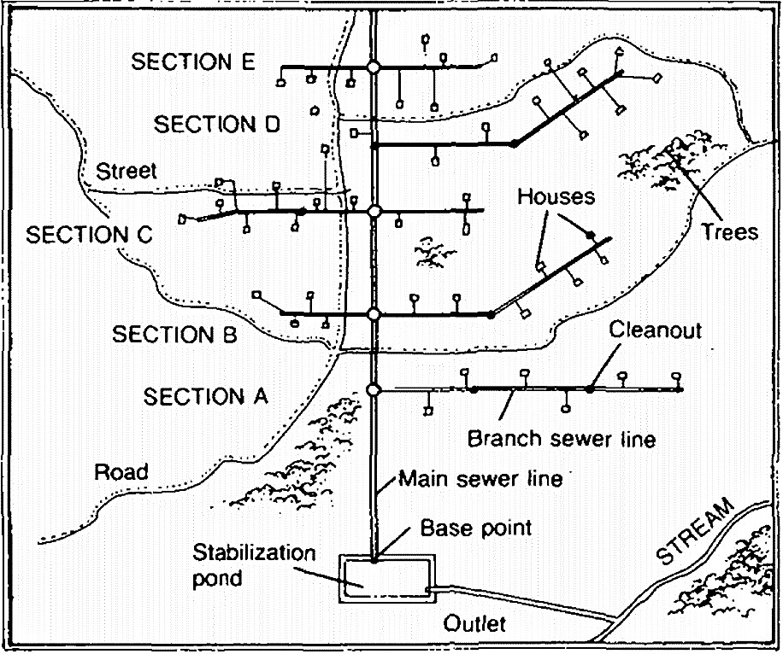
The Shortest Path Problem
Guiding question: Given a graph, what is the shortest path from one node to another?
Why do we care?
GPS systems
Least expensive way to transport goods
Most efficient way to direct water through a city’s pipe system

Slide 20

Small group: Shortest path challenge (10 minutes)
Nodes = { your small group } ⋃ { the people in the picture below }
If two people share the same color PANTS, they share an edge with weight 2.
If two people share the same color of ANY OTHER ITEM (e.g. shoes, shirt, sweater, etc.), they share an edge with weight 1.
What’s the shortest path from each member of your small group to the woman on the right?

Slide 21
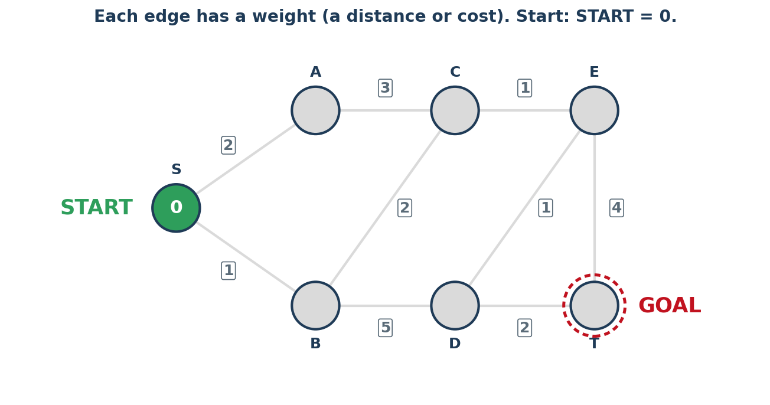
The shortest path problem: Dijkstra’s algorithm
Suppose we want to find the shortest path from the start node to the goal node.
How do we do it?

Slide 22
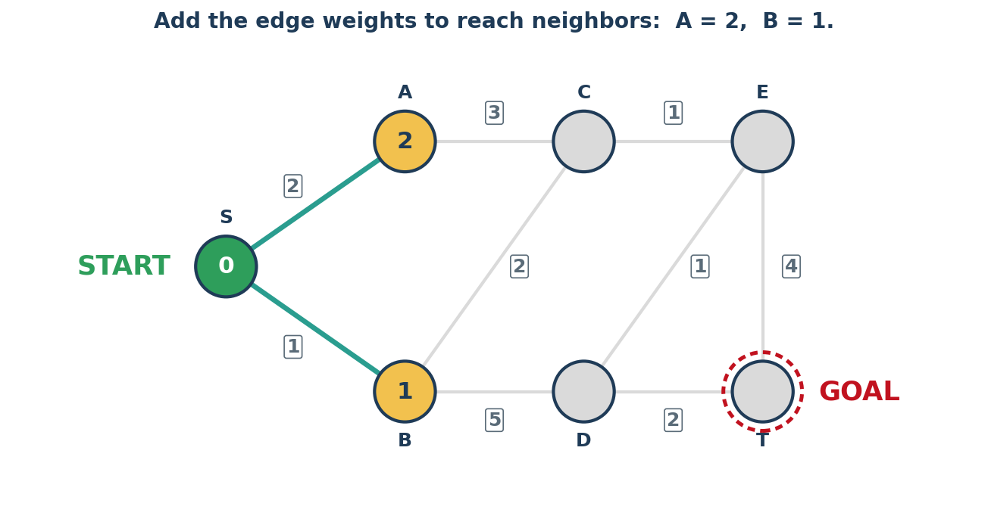
The shortest path problem: Dijkstra’s algorithm
Suppose we want to find the shortest path from the start node to the goal node.
How do we do it?

Slide 23
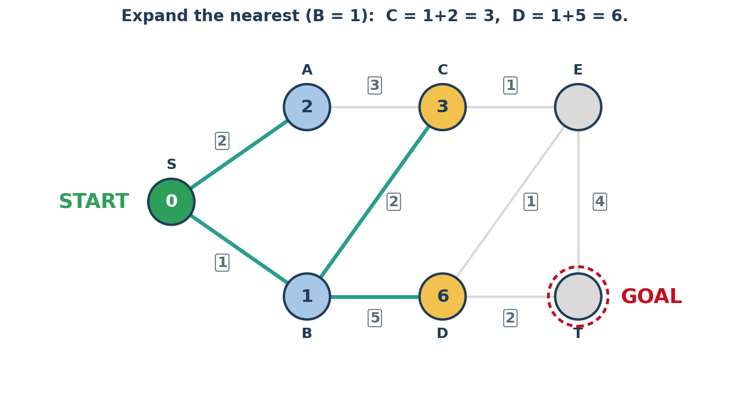
The shortest path problem: Dijkstra’s algorithm
Suppose we want to find the shortest path from the start node to the goal node.
How do we do it?

Slide 24
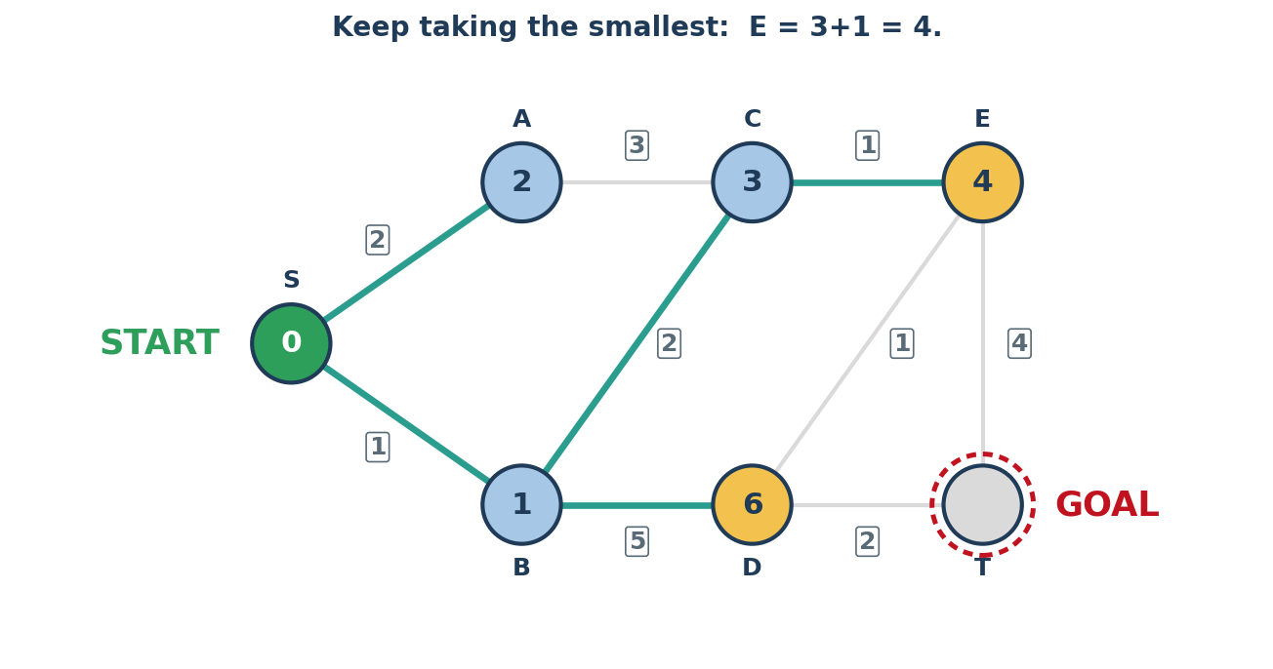
The shortest path problem: Dijkstra’s algorithm
Suppose we want to find the shortest path from the start node to the goal node.
How do we do it?

Slide 25
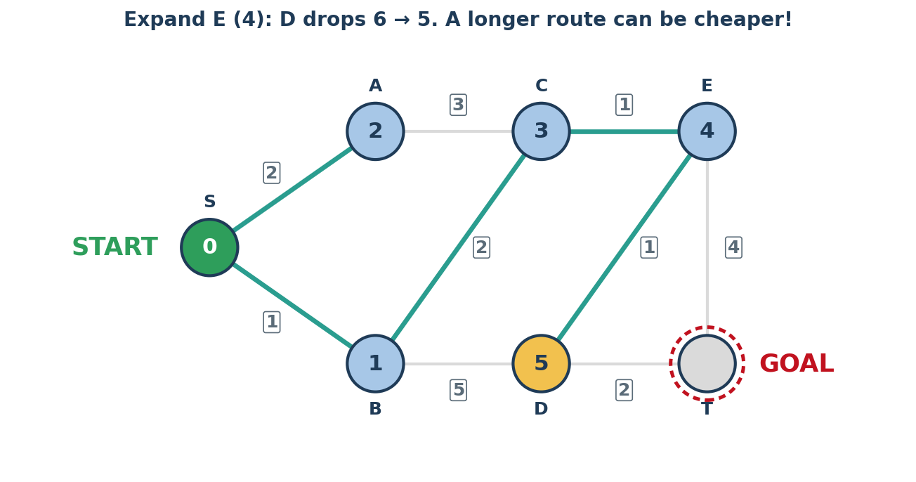
The shortest path problem: Dijkstra’s algorithm
Suppose we want to find the shortest path from the start node to the goal node.
How do we do it?

Slide 26
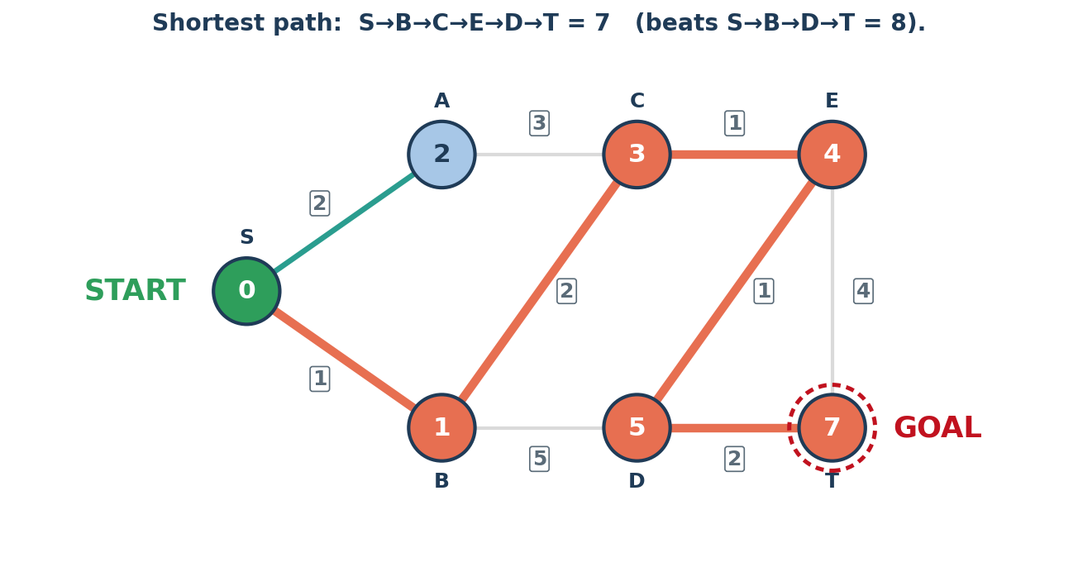
The shortest path problem: An algorithm
Suppose we want to find the shortest path from the start node to the goal node.
How do we do it?

Slide 27
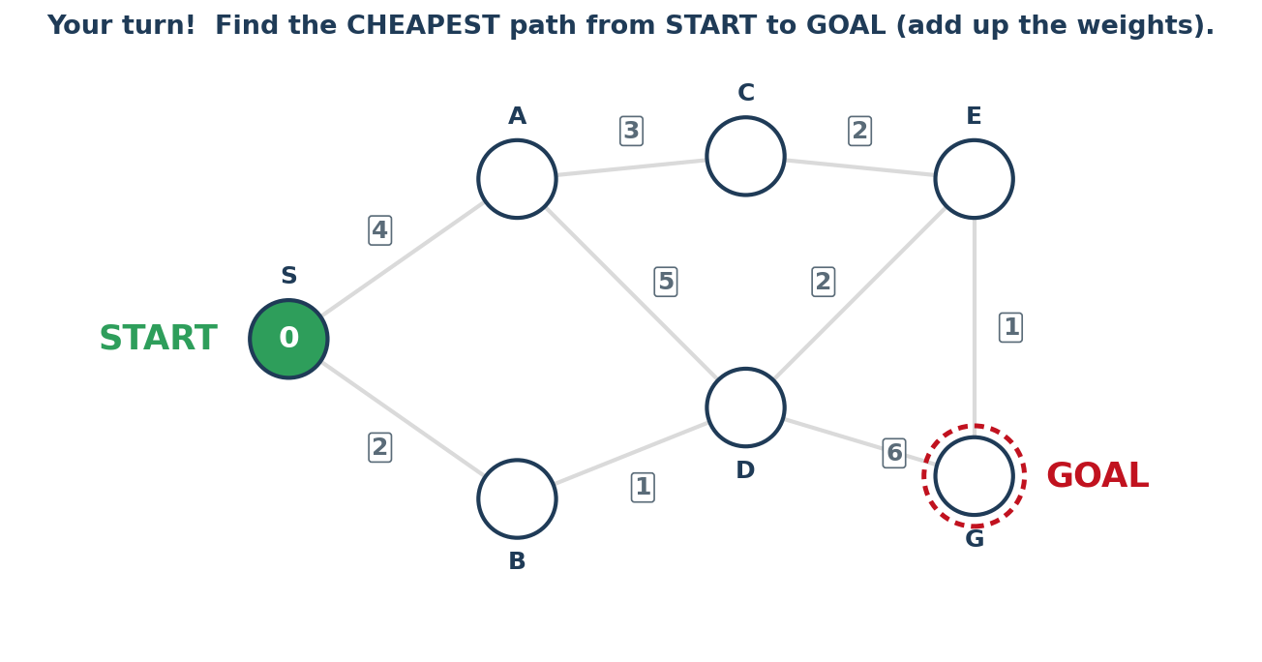
The shortest path problem: An algorithm
Dijkstra’s algorithm:
For each node A connecting to the start node, write INSIDE A the cost / weight to move from the start node to A.
At each node A that we’ve reached, consider each node B connected to A. Write INSIDE B the cost inside A PLUS the cost / weight to move from A to B.
Continue the process until we reach the goal node.

Slide 28
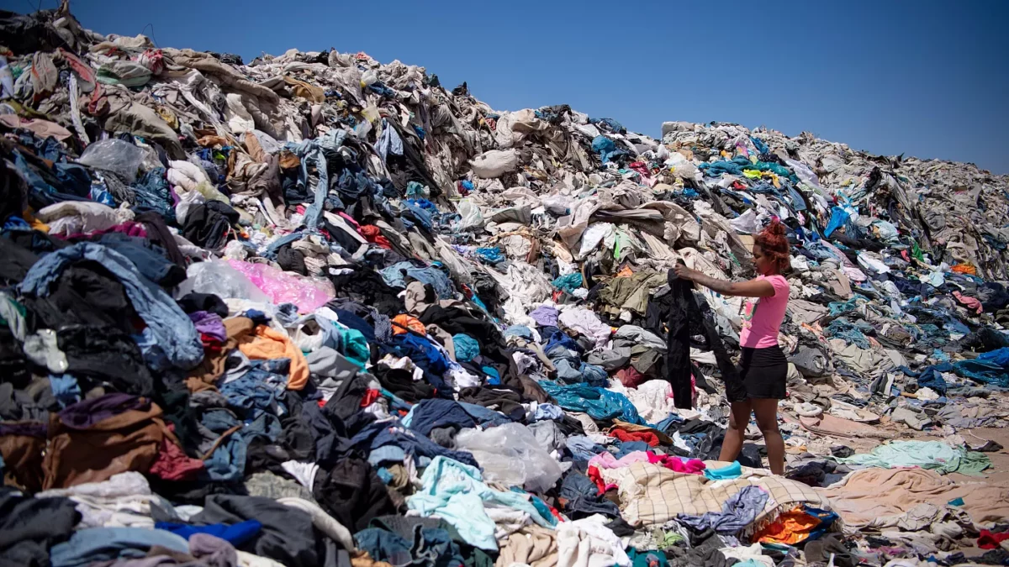
Graphs and overconsumption
Overconsumption is the excessive use of goods, services, and natural resources beyond what is necessary for survival or sustainable living.
Overconsumption leads to issues like
Environmental damage
Resource depletion
Climate change

Slide 29
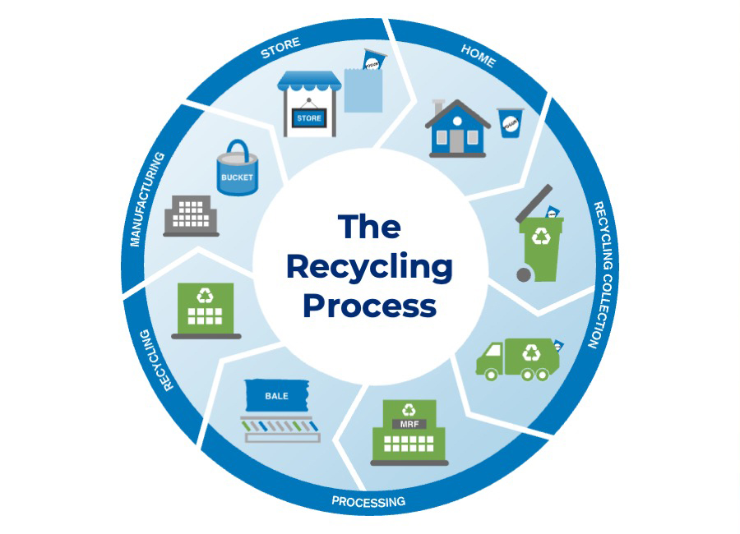
Idea #1: Cyclic Graphs
Overconsumption: Raw materials => factory => consumption => landfill.
How can we model this as a graph?
How could we change this graph to include recycling?

Slide 30
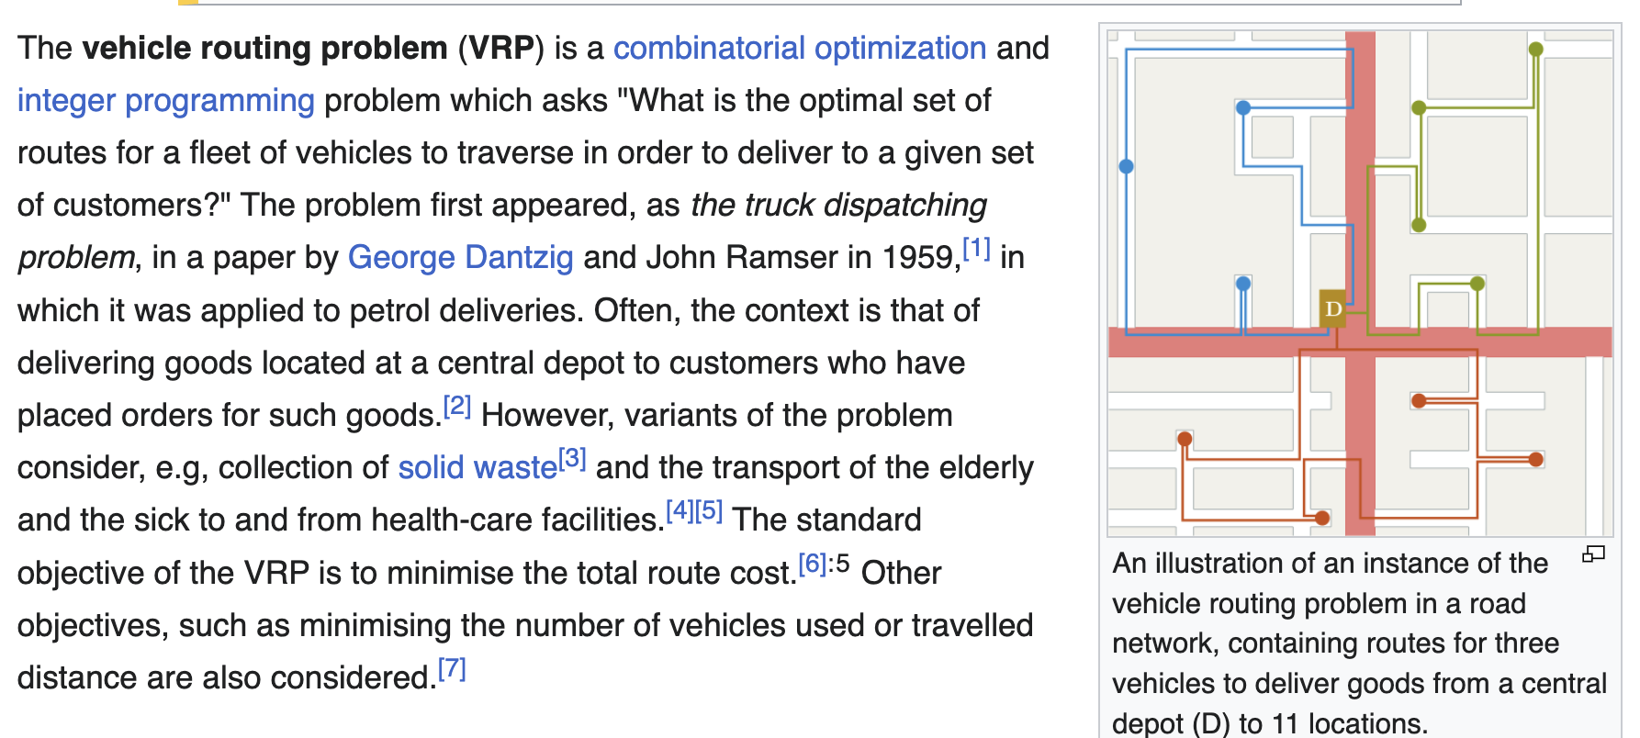
Idea #2: Route optimization
Garbage trucks, delivery vans, and recycling pickups all have to cover every street.
In order to save on fuel, we want to cover every street ONLY once.
This is the Könisberg bridge problem in action.

Slide 31

Final Activity: The Yarn Game
Ms. Murphy will share a fun fact about herself.
  Example: I have brown hair.
If someone else has the same thing in common, they raise their hand.
  Example: If you ALSO have brown hair, raise your hand.
Ms. Murphy will pass the yarn to someone who has the SAME fact in common.
If you get the yarn:
  Try not to tangle it.
  Speak with a LOUD VOICE.
  Share something that you think AT LEAST one other person has in common with you.

Slide 32
Daily Reflection
What’s one new thing you learned today?
Leave your name card at your desk!

