Slide 1
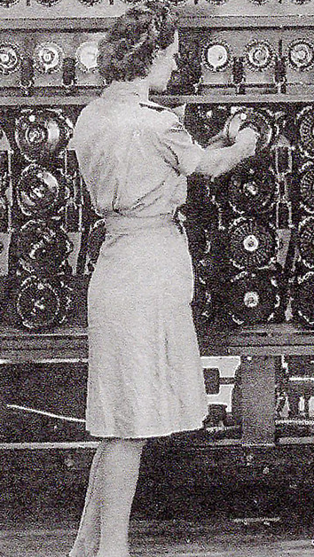
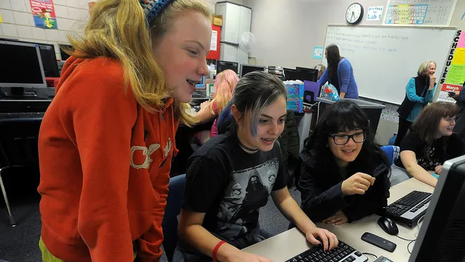
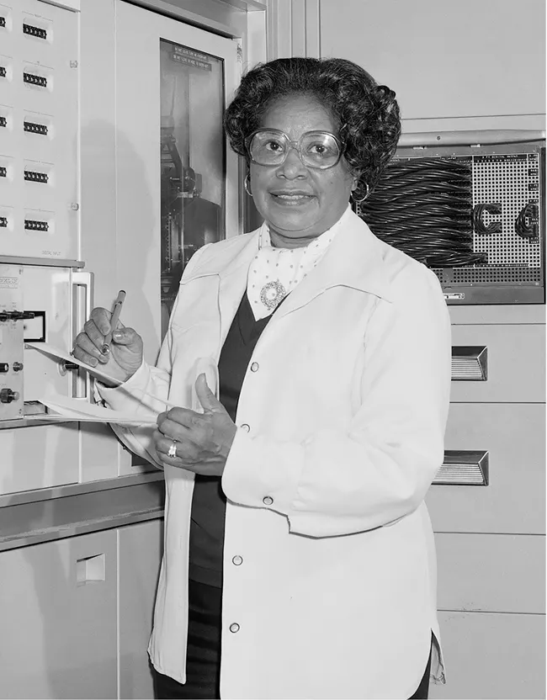
Tech Trek Day 4
Core Class: Math

Slide 2
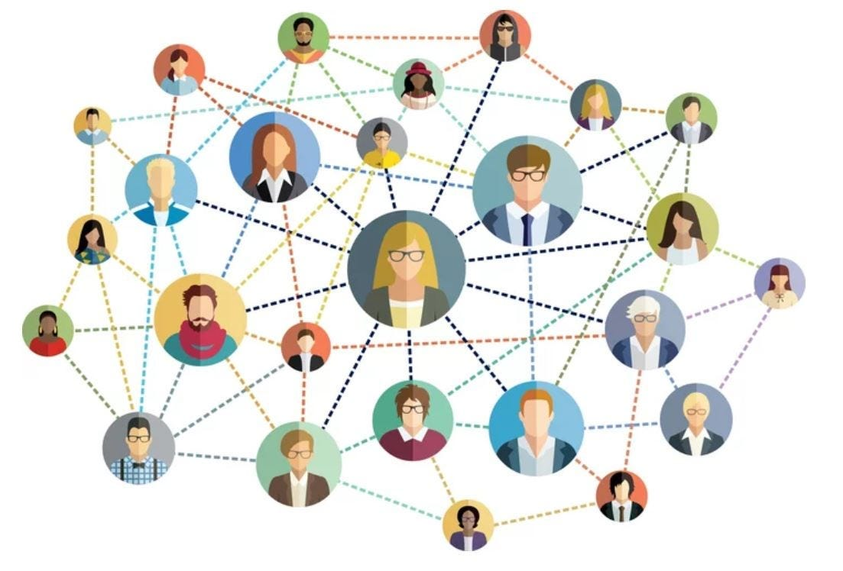
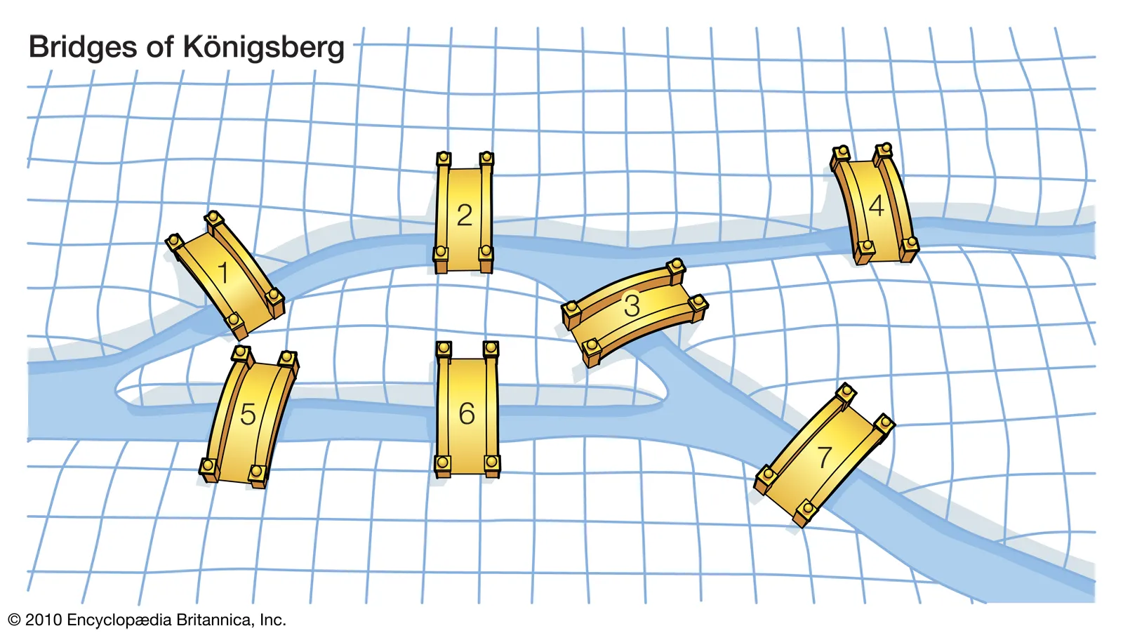
Review: Graph Theory
What did you do yesterday after class?
What is a graph? Can you give an example?
Weighted vs. unweighted?
Directed vs. undirected?
What is the Seven Bridges of Königsberg problem?
What is the shortest path problem? Why do we care?

Slide 3
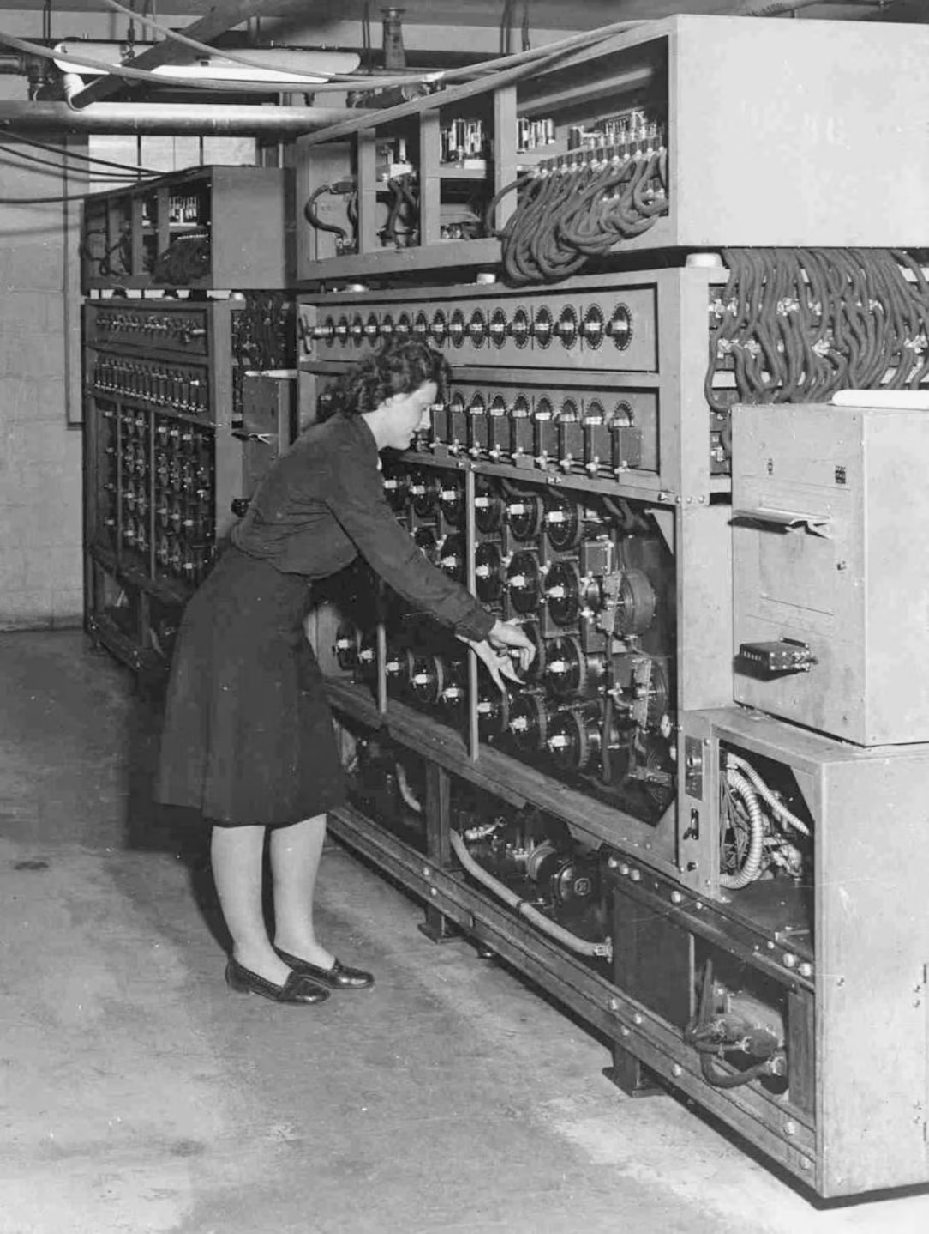
Code-breaking and ciphers
Mathematicians who study cryptography find secure ways to communicate important and private information.
During World War II, cryptographers developed the first computers to decode Nazi communications.
Today, cryptographers find ways to encode important information like passwords, credit card numbers, and medical information.
Cryptographers may use ciphers to encode information.
A cipher is an algorithm or secret method used to encrypt or decrypt data, rendering a message unreadable without the proper key.

Slide 4
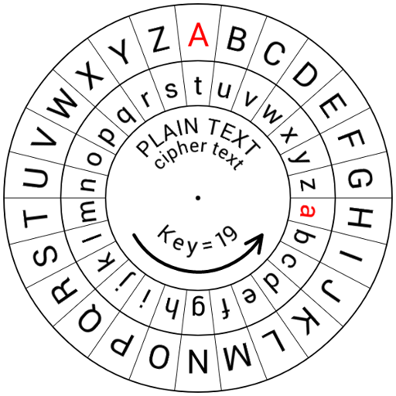
An example of a cipher
Tuhnm 75% hy Phkew Ptk BB vkrimhzktiaxkl pxkx yxftex. Maxbk phkd ptl oxkr bfihkmtgm bg xgwbgz max ptk.
About 75% of World War II cryptographers were female. Their work was very important in ending the war.
This type of cipher is called a Caesar cipher.

Slide 5
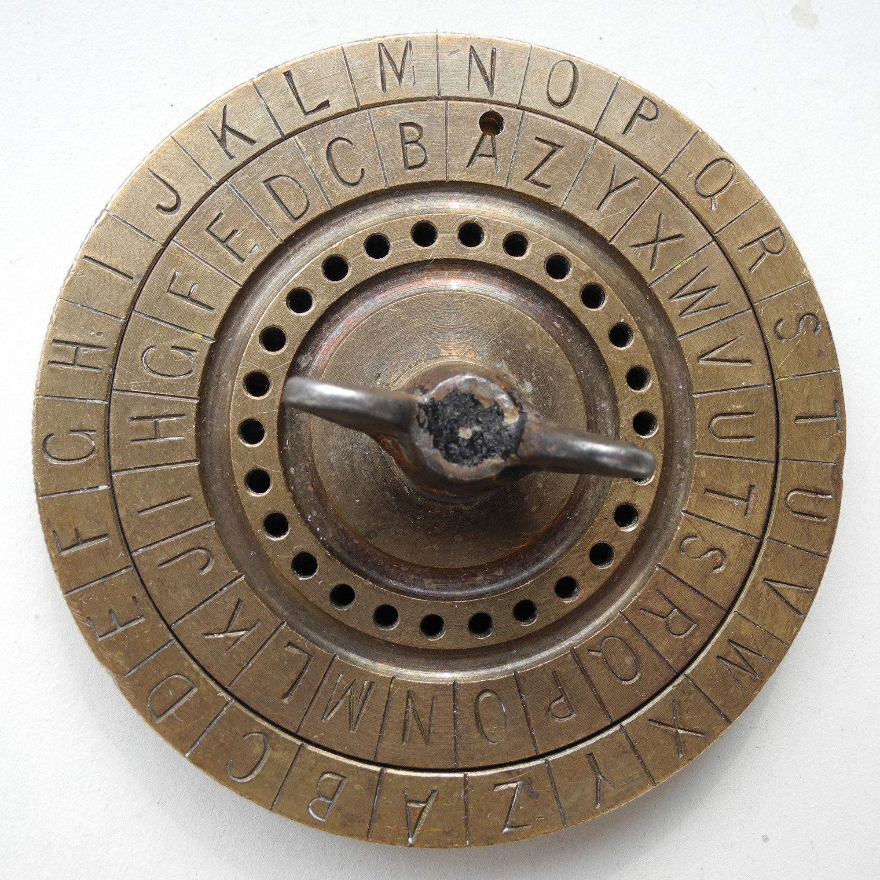
Caesar Ciphers
Some tips for cracking Caesar ciphers:
The most common letter in the English language is “e.” Count the letter appearing most in the encoded message — there’s a good change it corresponds to “e.”
A one letter word is usually “a” or “I.”
“t” and “s” usually come after apostrophes (e.g. can’t, Mia’s)

Slide 6
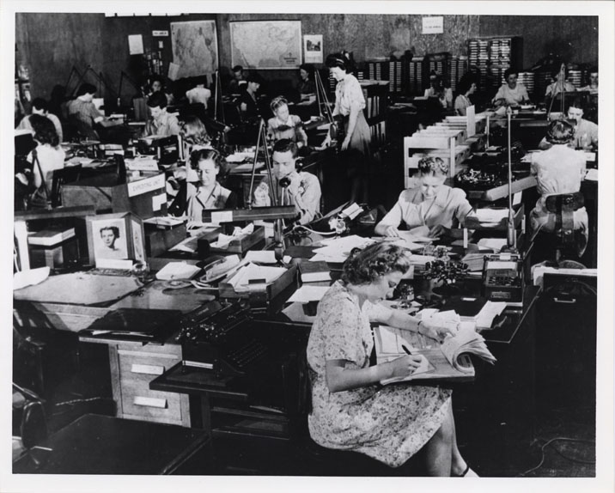
Decode a Caesar cipher (15 minutes)
Gur H.F. zvyvgnel npgviryl erpehvgrq gbc srznyr zngurzngvpvnaf, yvathvfgf, naq chmmyr fbyiref sbe gbc-frperg bcrengvbaf. Nobhg 10,000 Nzrevpna jbzra jbexrq nf pelcgbtencuref qhevat gur jne.
The U.S. military actively recruited top female mathematicians, linguists, and puzzle solvers for top-secret operations. About 10,000 American women worked as cryptographers during the war.

Slide 7
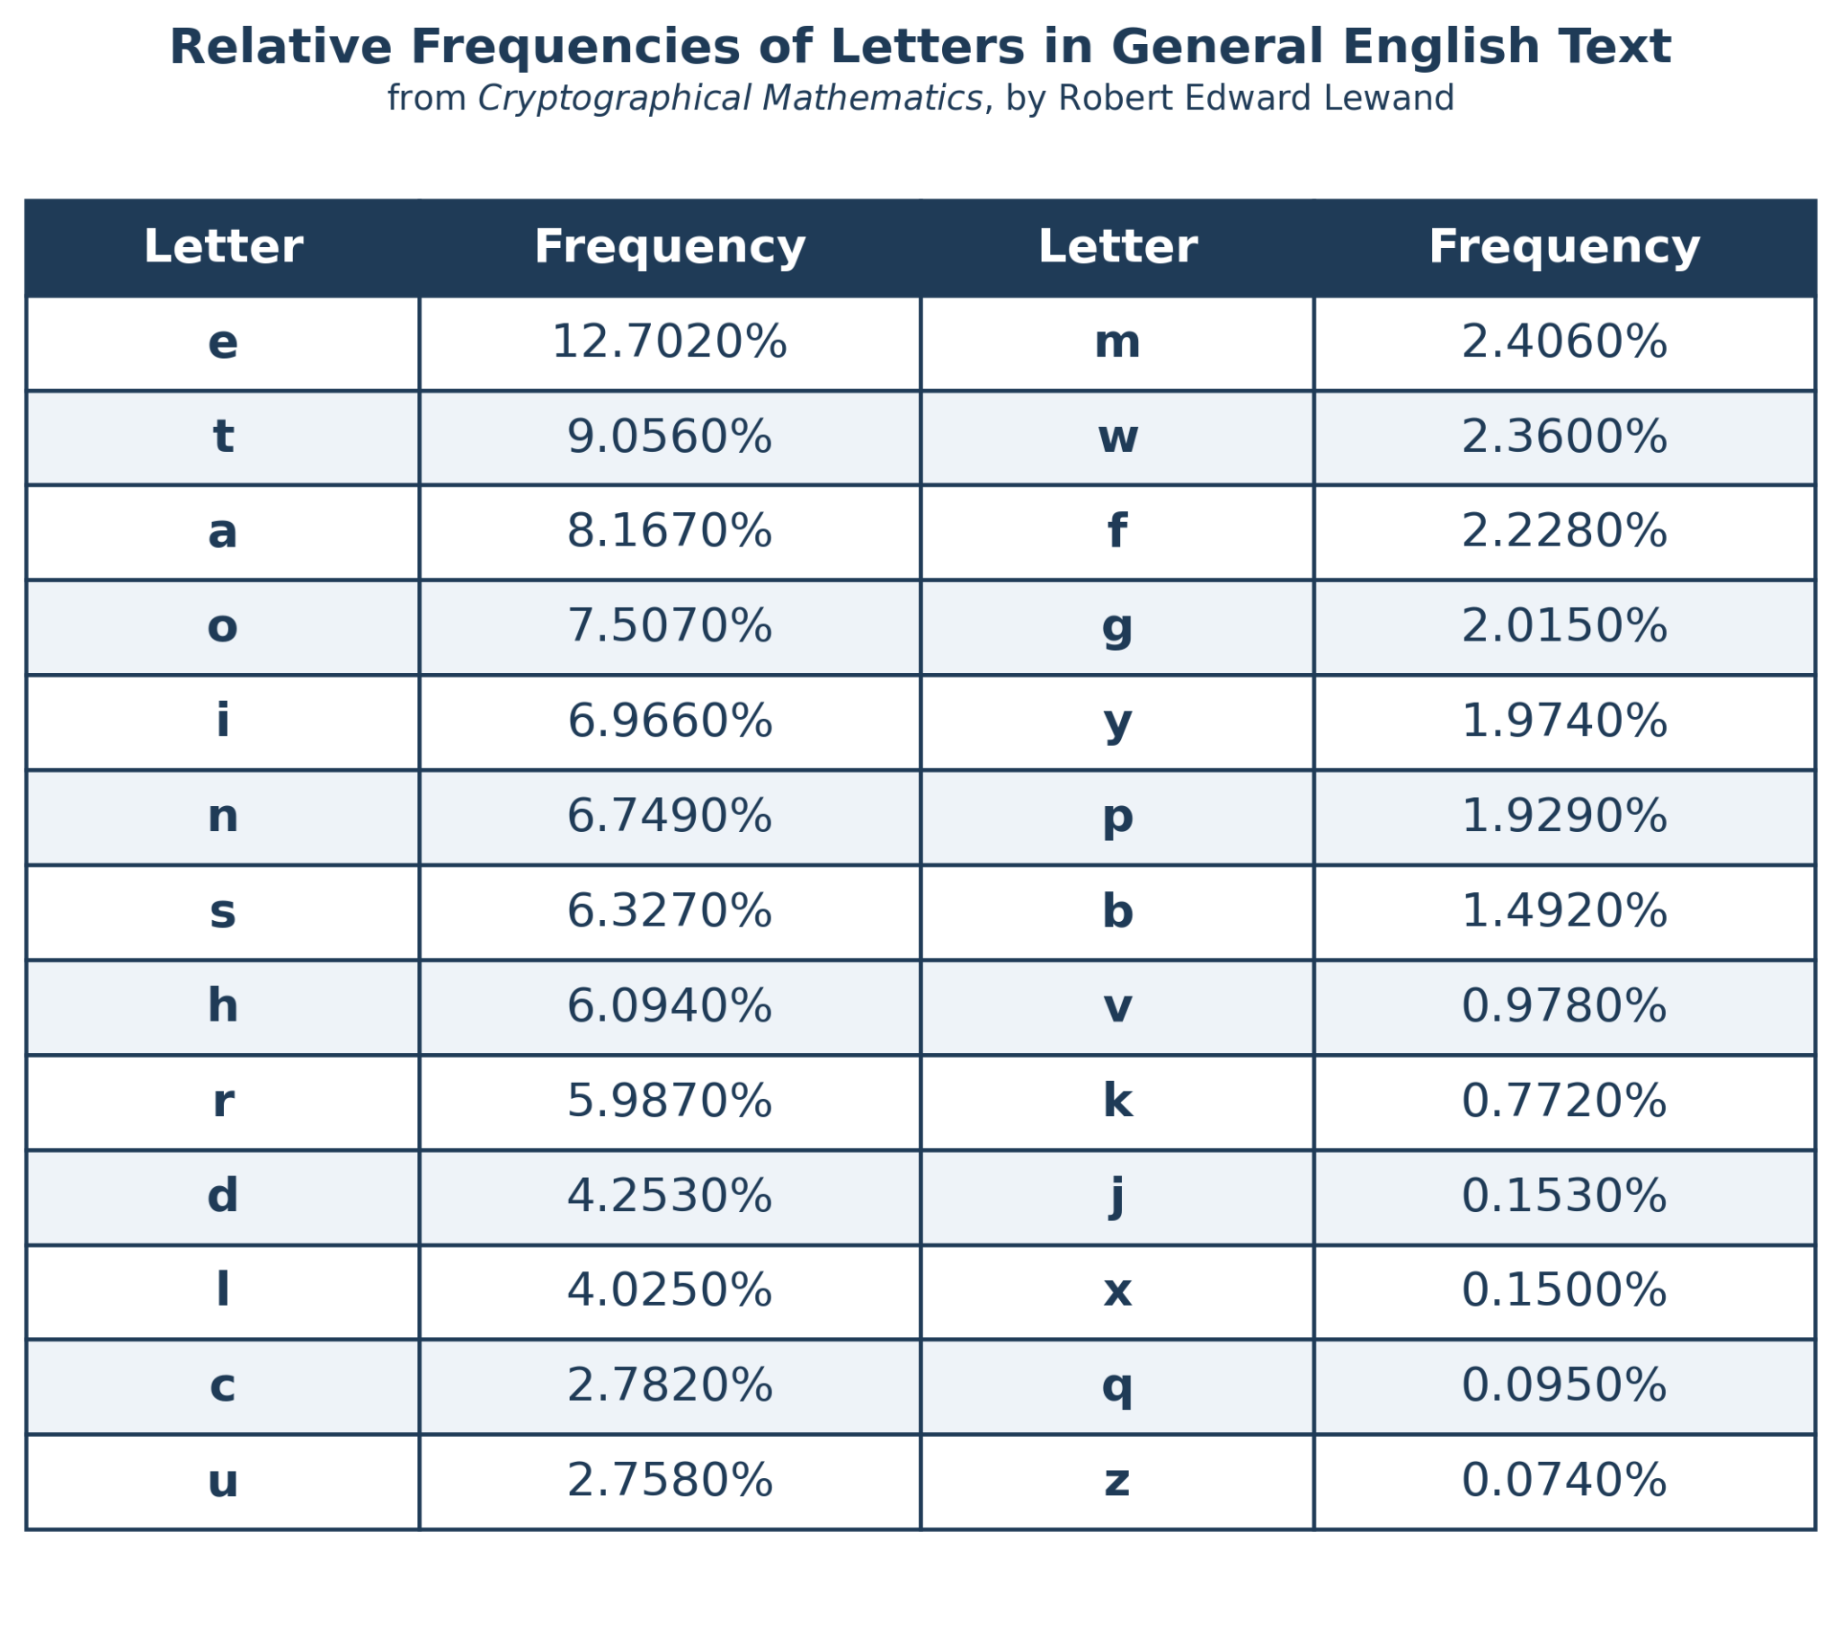
Frequency analysis
Suppose we’re analyzing a Caesar cipher and the letter “q” makes up 0.074% of the text.
What does the letter “q” most likely correspond to?
This type of reasoning is called frequency analysis.

Slide 8
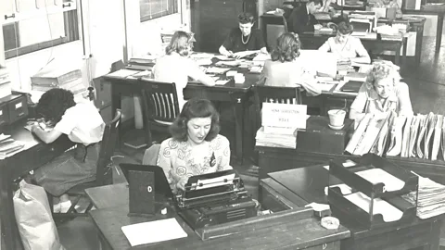
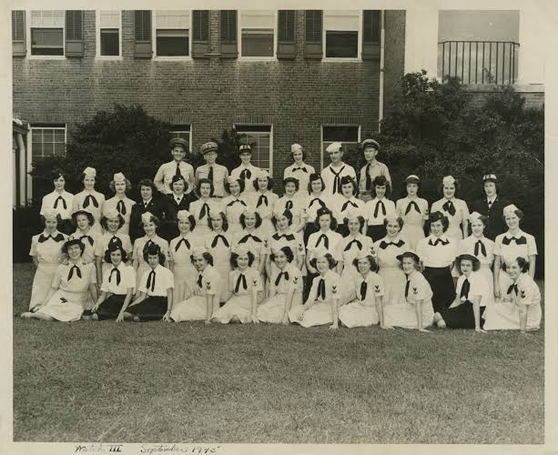
Create your own Caesar cipher (20 minutes)
As a group, come up with a secret phrase that’s at least ten words long.
Encode your phrase using a secret cipher.
Trade your phrase with another group’s and attempt to decode their phrase.

Slide 9

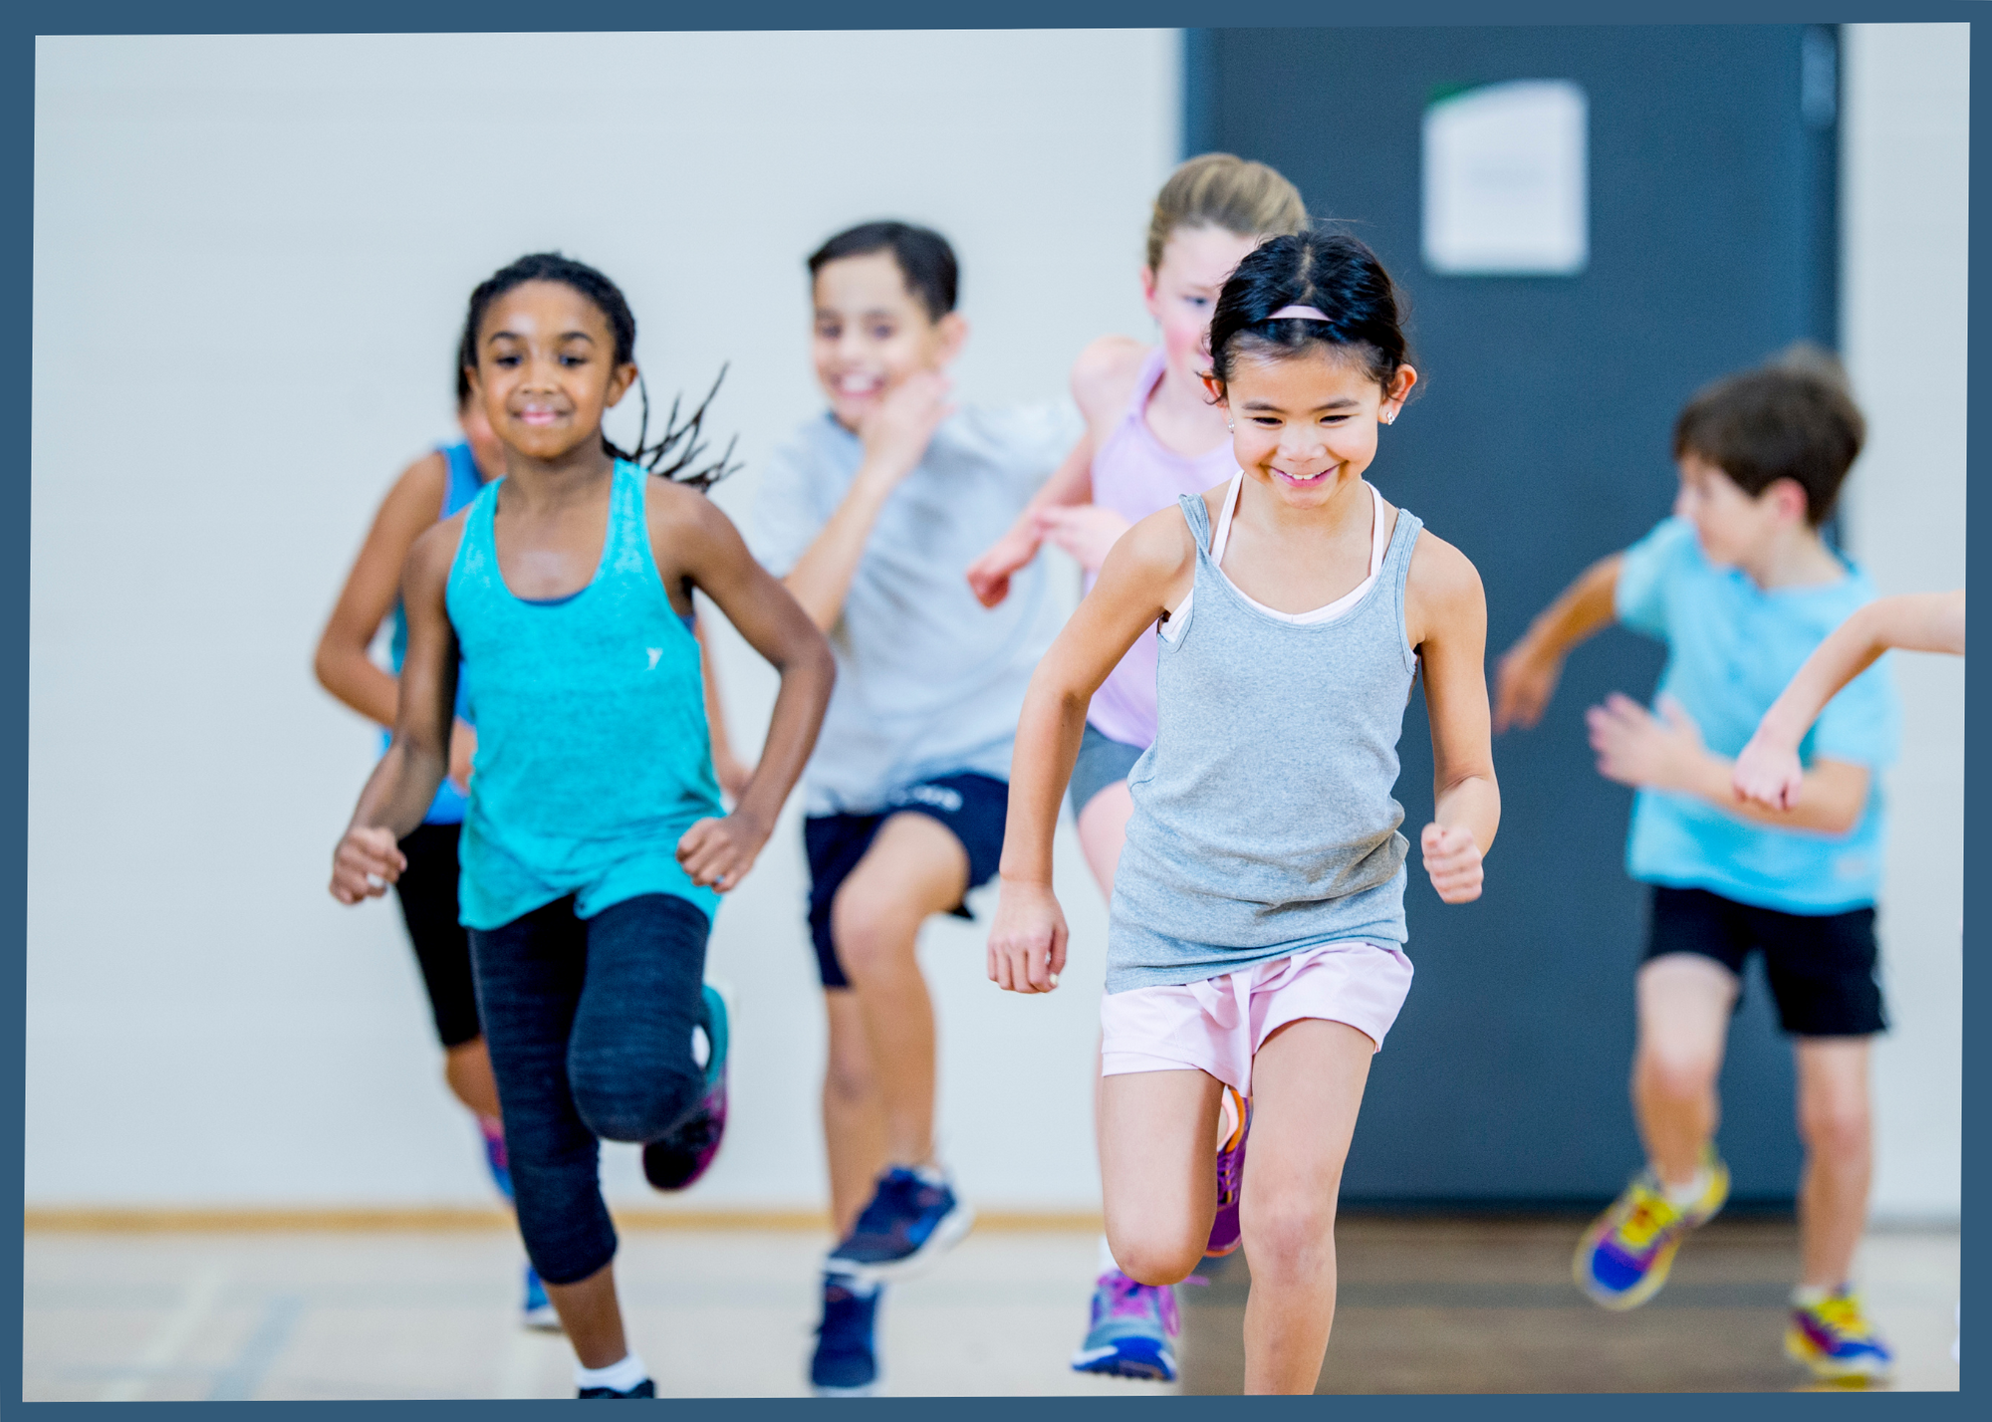

GWJFP YNRJ (15 rnszyjx)
Dtz hfs…
Lt yt ymj gfymwttr
Ljy xtrj bfyjw
Yfqp yt Rx. Rzwumd tw ymj ujjw htzsxjqtwx
Uqfd f lfrj
Ijhtij ymnx hnumjw

Slide 10
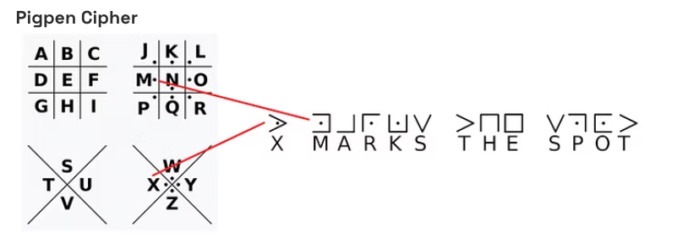
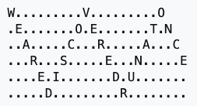

Other types of ciphers
Atbash cipher
  A <=> Z, B <=> Y, etc.
  Xlnnlm rm ylgs zmxrvmg Svyivd zmw Tivvp xrerorazgrlm
Railroad cipher
=f

Slide 11
BREAK TIME (15 minutes)
You can…
Go to the bathroom
Get some water
Talk to Ms. Murphy or the peer counselors
Play a game

Slide 12
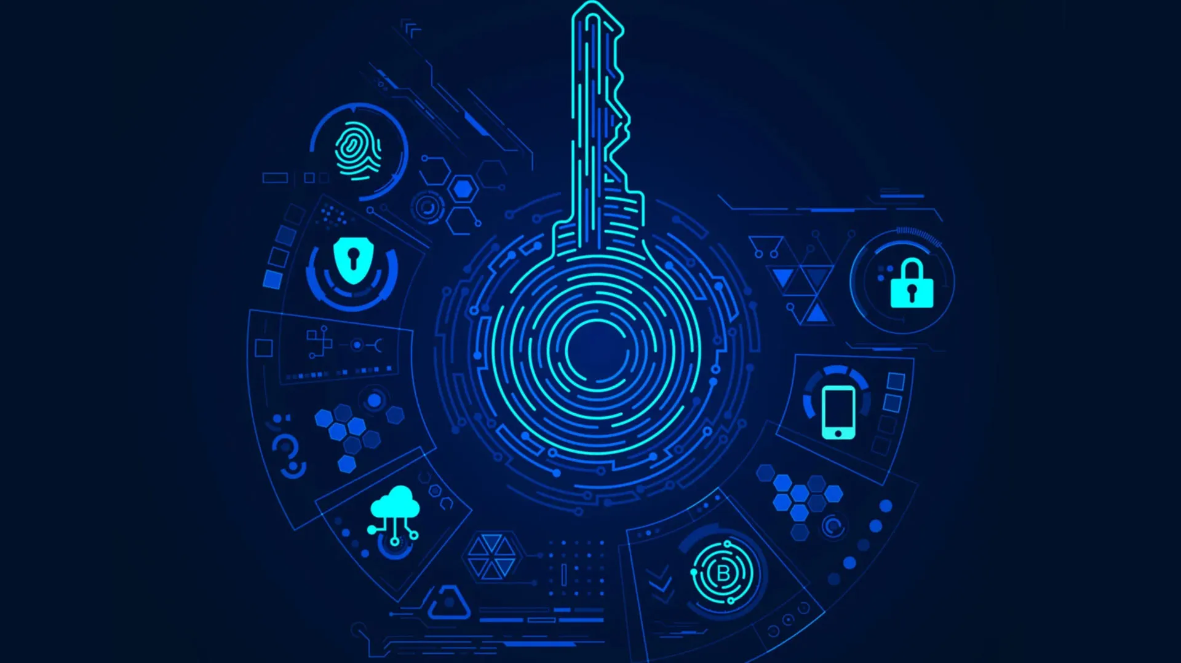
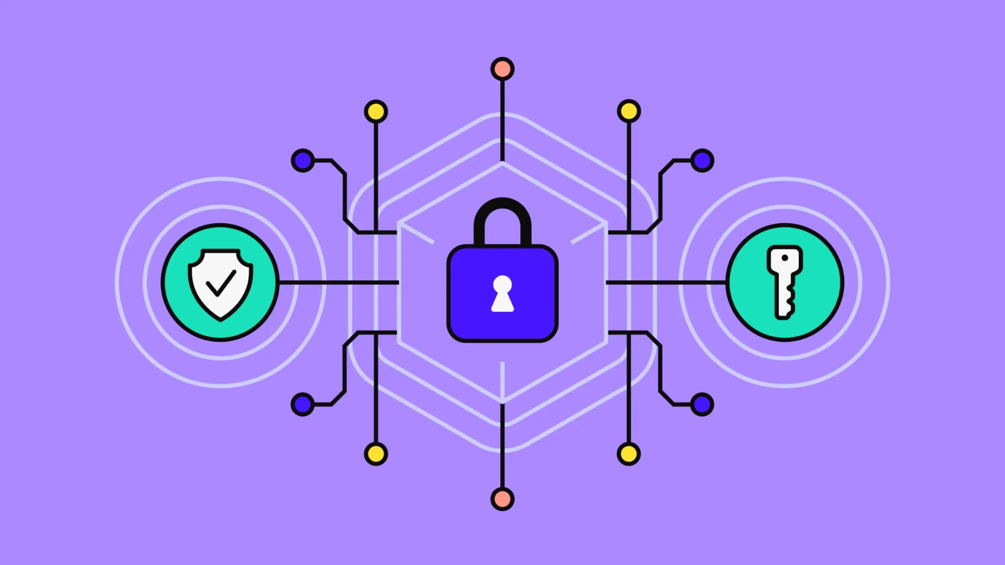
Design your own cipher (15 minutes)
As a group, decide on a secret message at least ten words long.
Design your own unique cipher and encode the message.
Trade your cipher with another group’s. Can you decode their cipher?

Slide 13
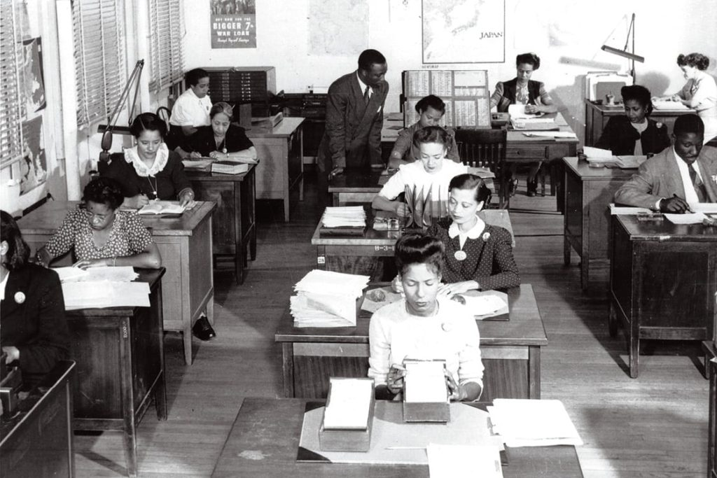
Mathematicians of the Day
Arlington Hall Station was a former women's college that became a major cryptography center during World War II.
About 15% of its workforce was made up of Black women, which was a really large number in an office setting at that time.
Because the work was both top-secret and segregated, very few people know about Black women’s contributions to Arlington Hall’s success.

Slide 14
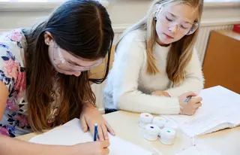
WORKSHEET TIME (15 minutes)

Slide 15
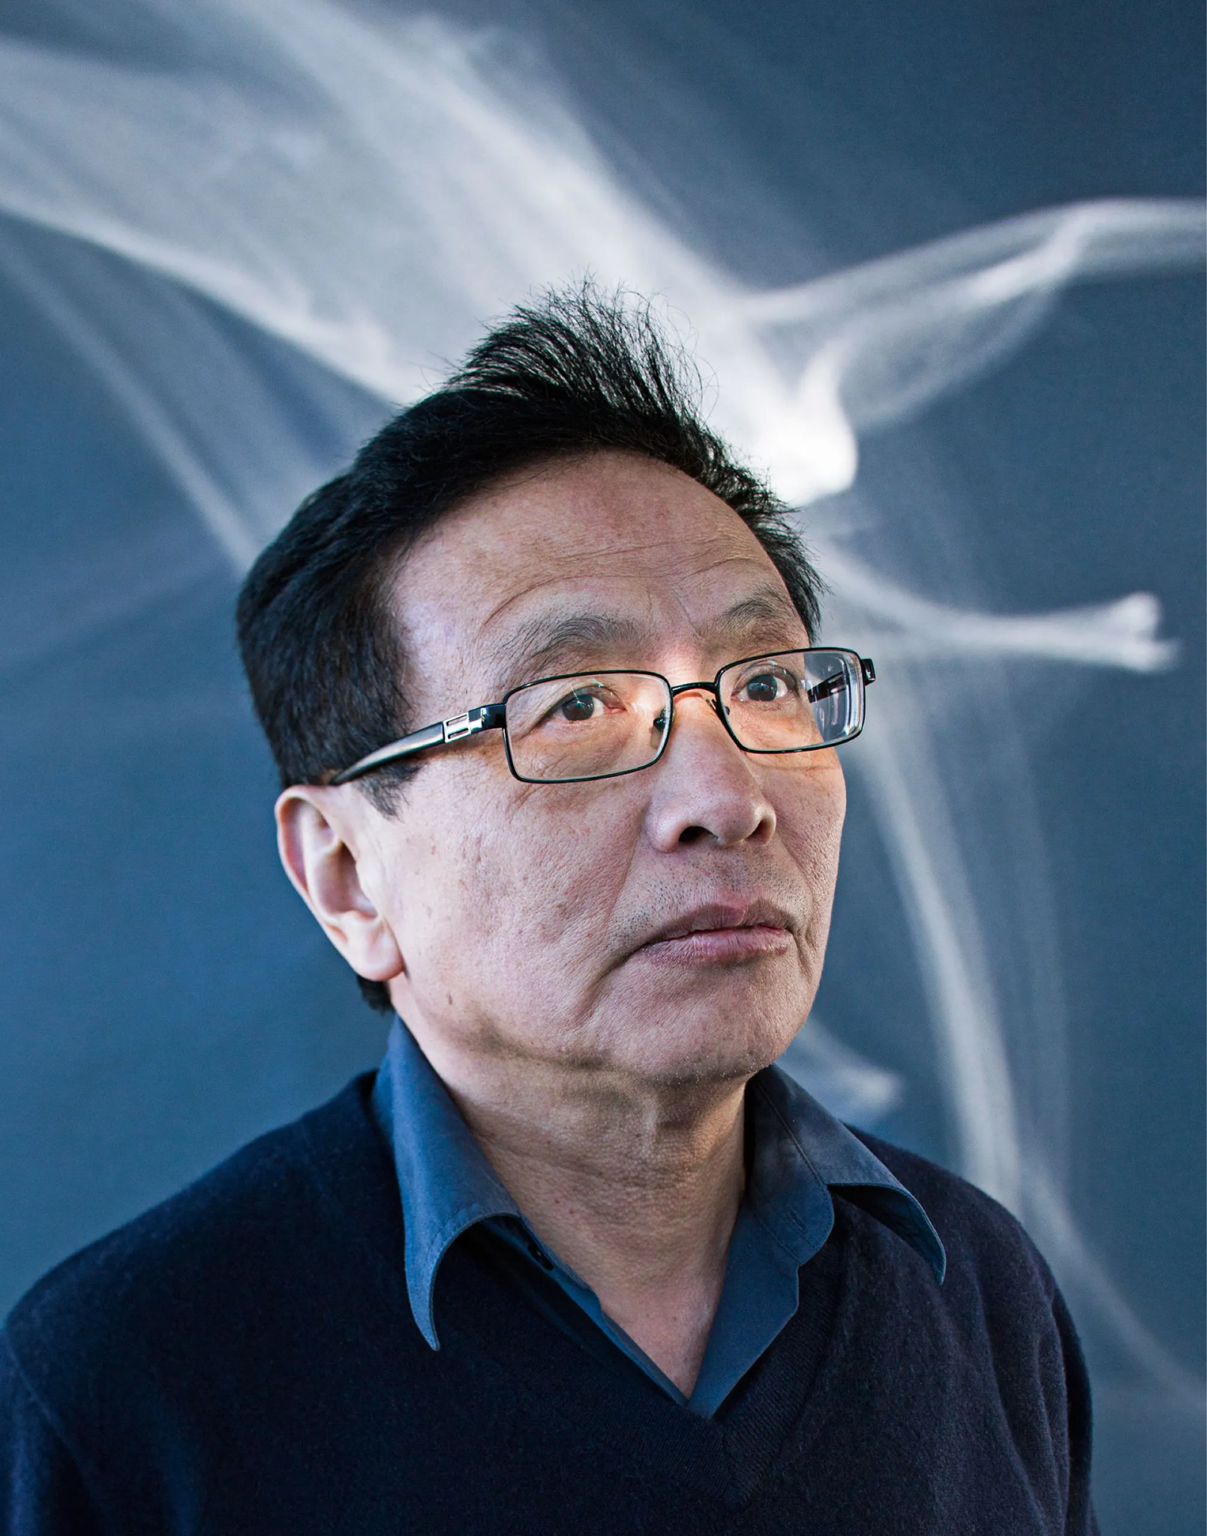
Public-key encryption
Ms. Murphy has a public key (3233) and a private key (the two primes, 53 and 61).
Helen sends Ms. Murphy a text message and encrypts it using her public key (3233).
Ms. Murphy uses her private key to decrypt the message.
Two big takeaways
Public key encryption is widely used and is a foundational pillar of modern internet security.
The generation of large prime numbers is of significant mathematical interest and is an ACTIVE area of research (including at UCSB).

Slide 16
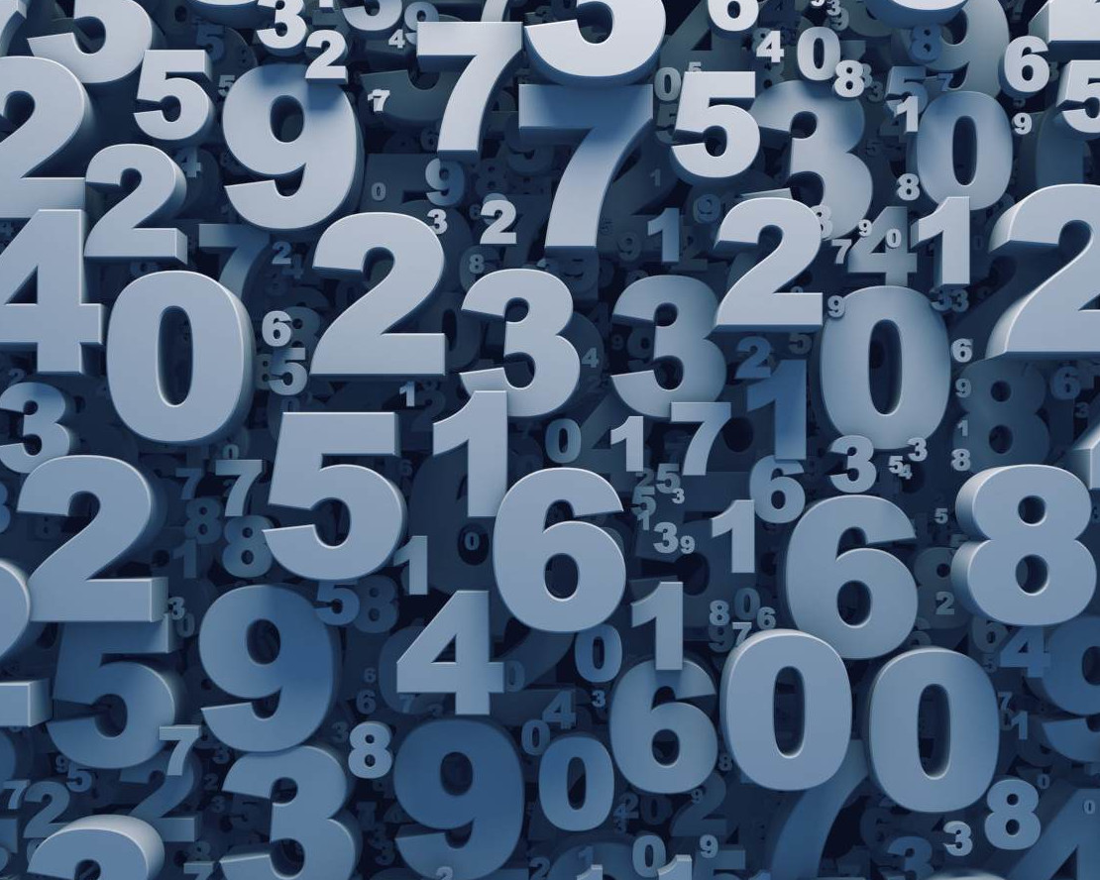
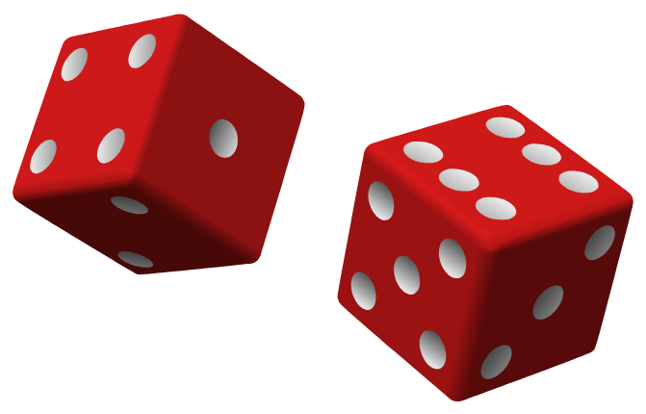
Random Number Generation
Pick a number between 1 and 10.
Without showing anyone, write your number on a piece of paper.
Generating truly random numbers is really hard!

Slide 17
Why do we care about random numbers?
Suppose you and your friend Alice like to send each other Caesar ciphers, but a dragon is constantly trying to decode your messages.
You get lazy, and every time you send Alice a message, you use a Caesar cipher with key 7 (A => H, B => I, C => J, …)
This makes it much easier for the dragon to decode your message.
In order to make your communication more secure, you want to pick a random key for each Caesar cipher.

Slide 18

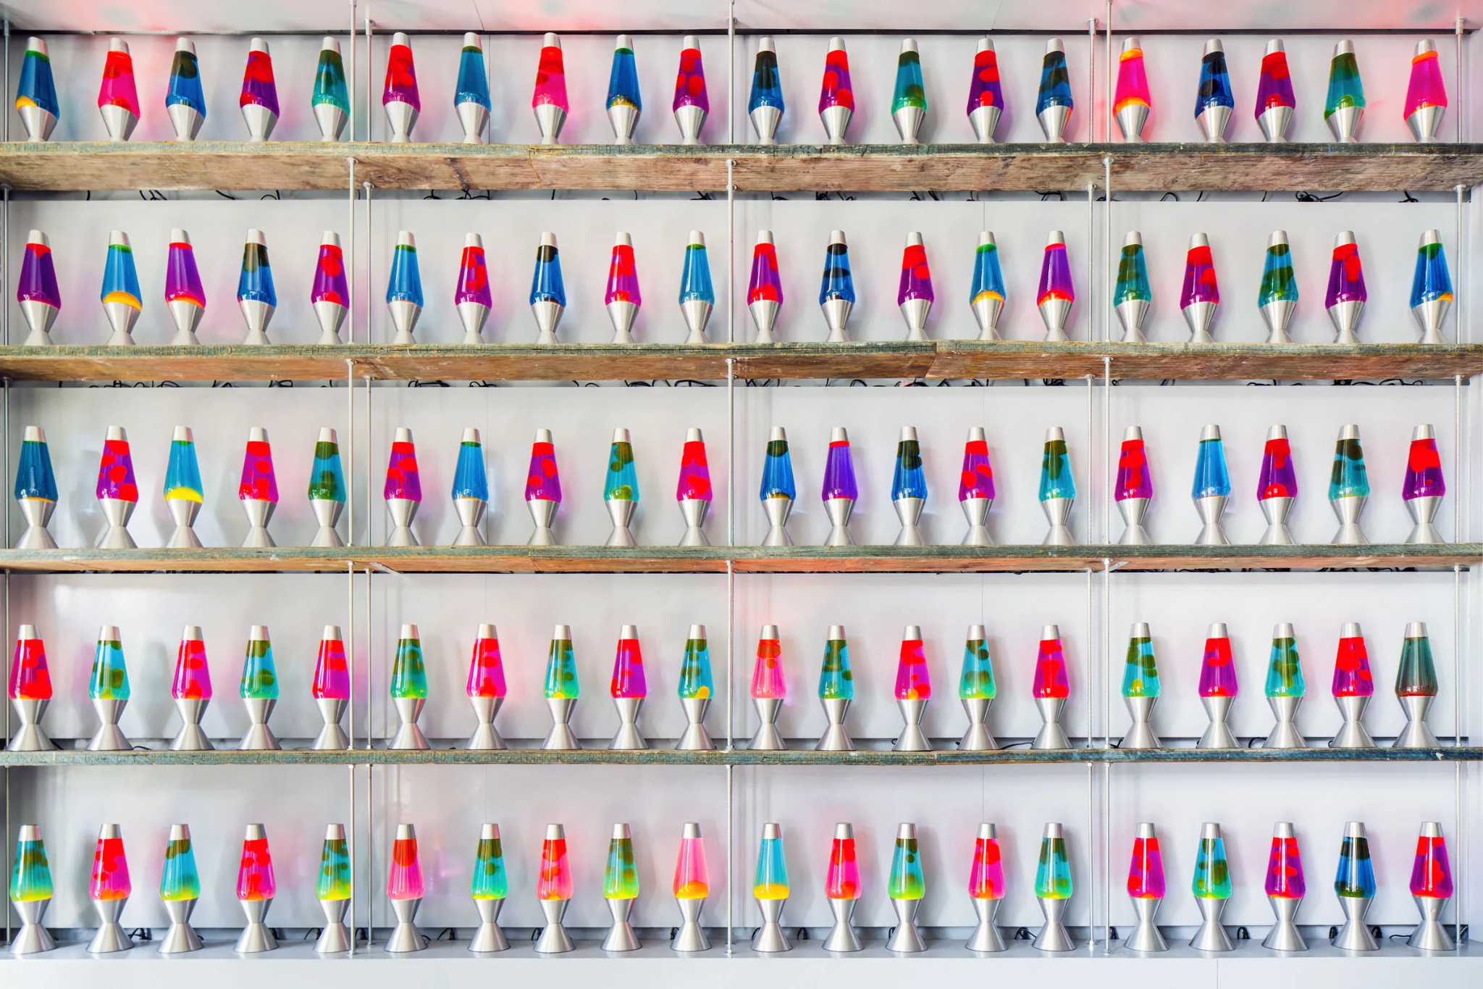
How do we “make” randomness?
Computers simply follow long lists of instructions => they can’t come up with truly random numbers.
Random number generation is an important area of cryptography.
Mathematicians have invented formulas that transform a seed — a number chosen by the user — into another number in a way that feels random.
A company called Cloudflare points a camera at a wall of lava lamps and uses the blobby chaos to generate randomness for encryption.

Slide 19
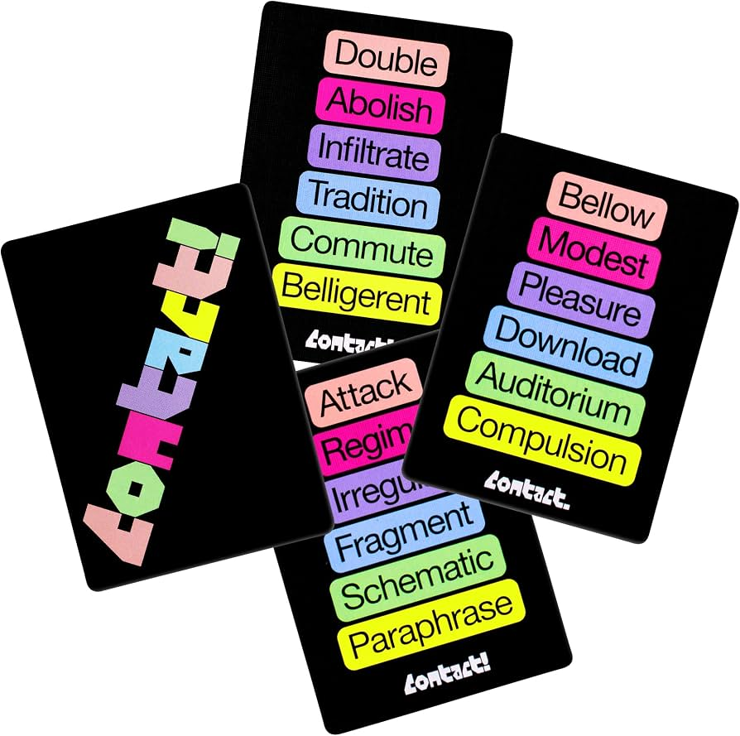

If we have enough time…
Contact
Small groups
The “defender” thinks of a secret word, while the other players use shared clues to try reveal successive letters of the secret work.
Mafia
EVERYONE
Social deduction game that pits an informed minority (the Mafia) against an uninformed majority (the Townspeople).

Slide 20
Daily Reflection
What’s one new thing you learned today?

