Slide 1
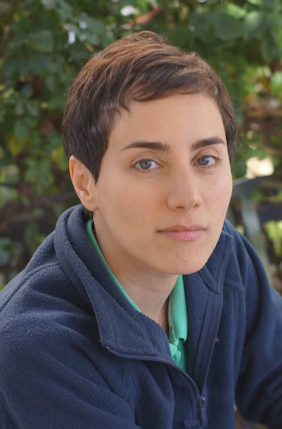
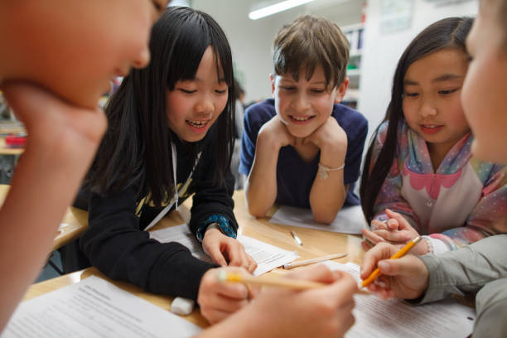
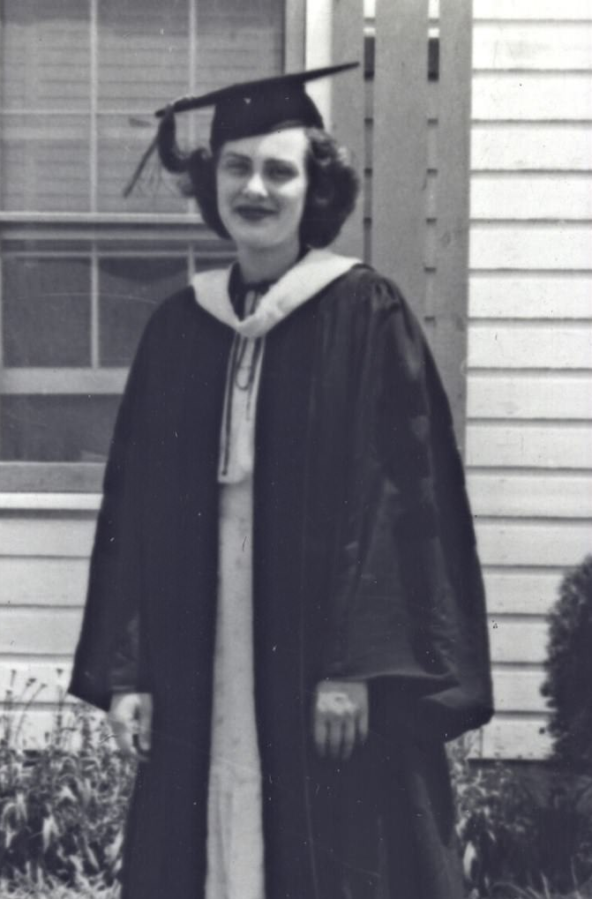
Tech Trek Day 5
Core Class: Math

Slide 2
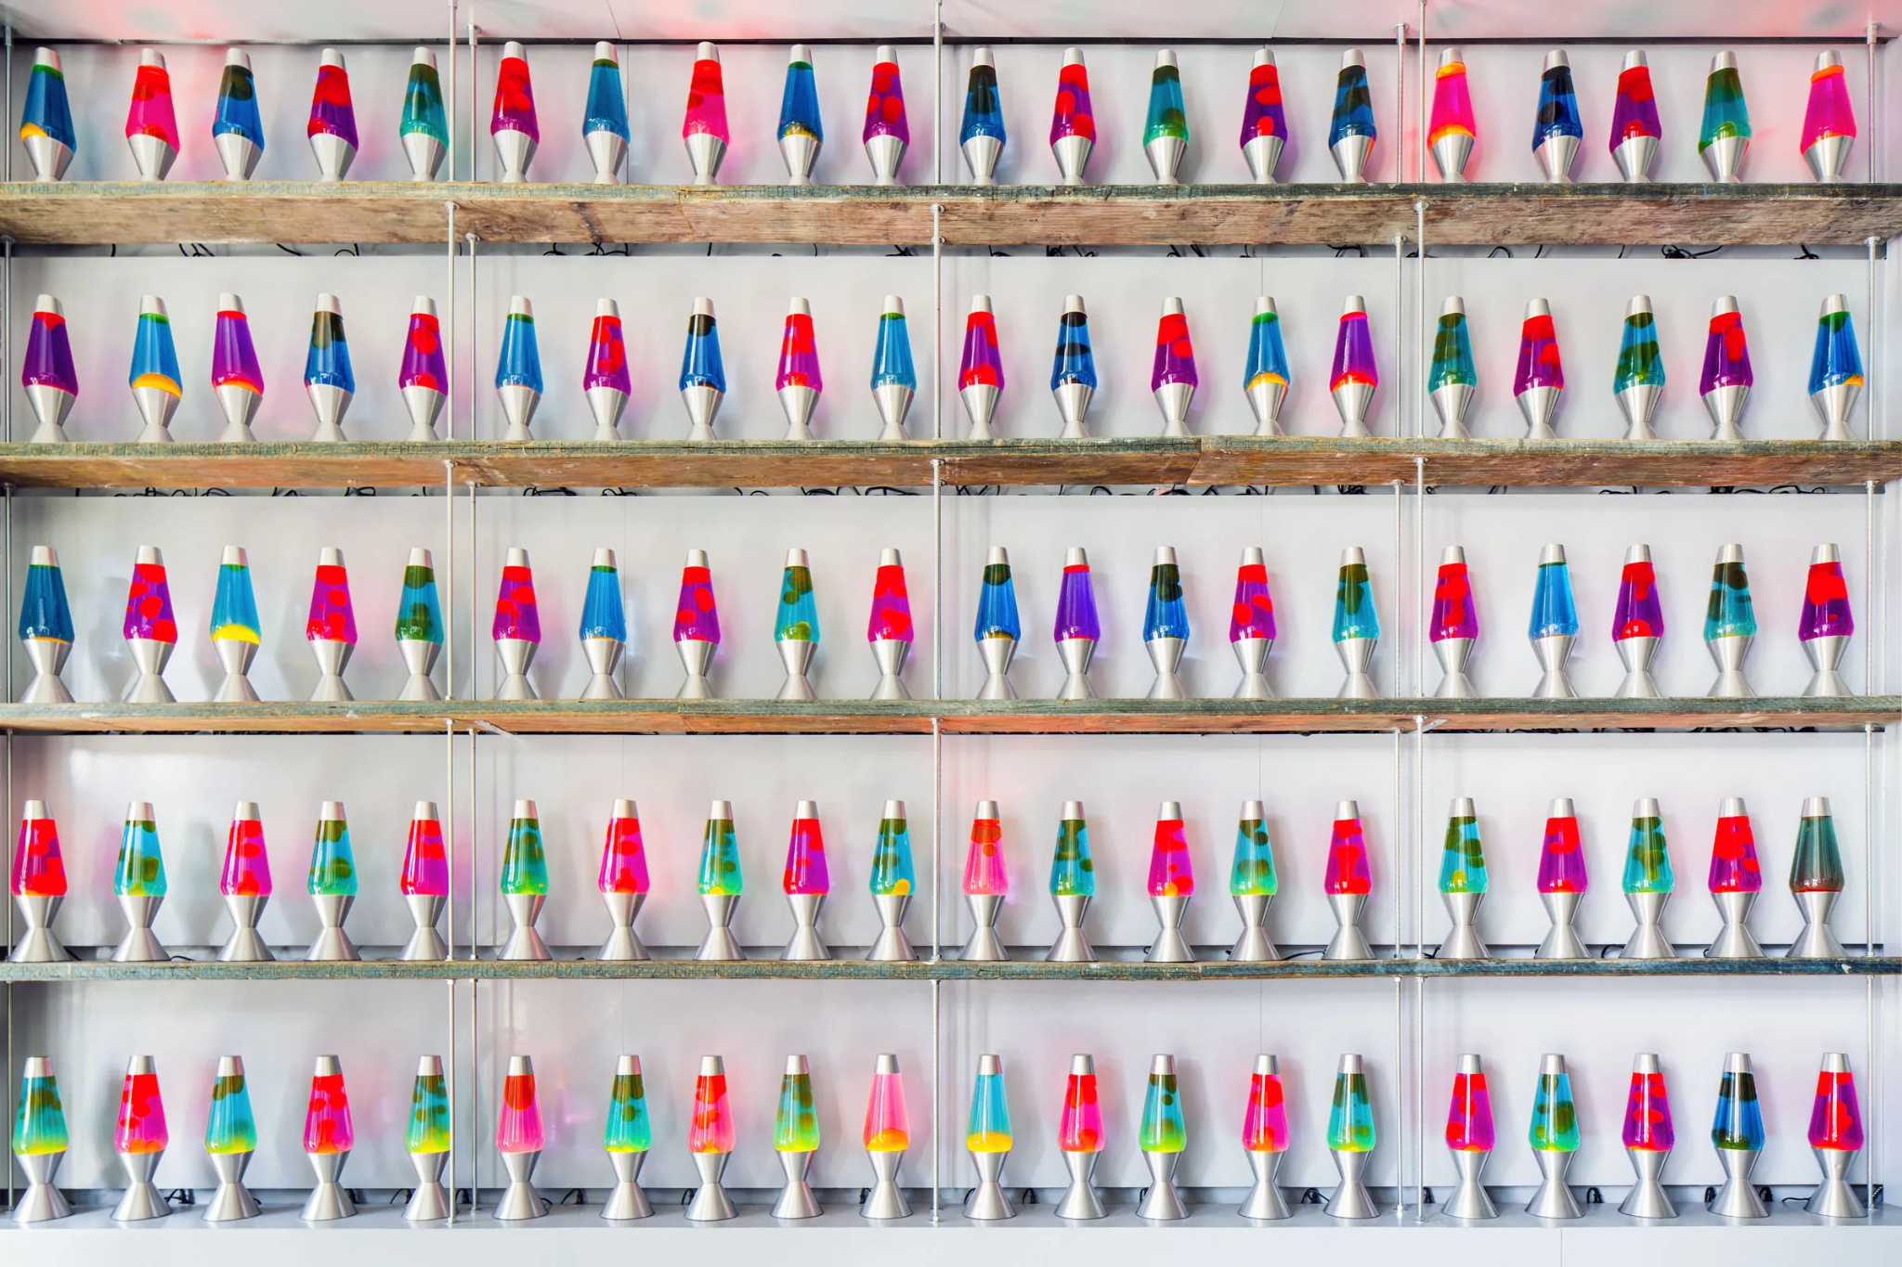
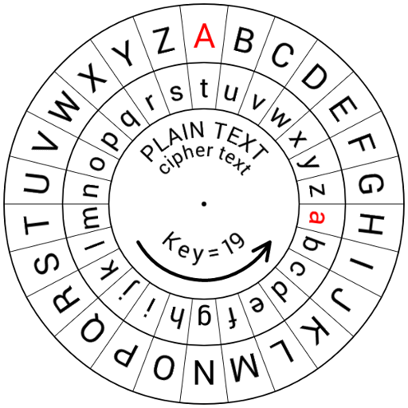
Review: Cryptography
What is cryptography?
What is a Caesar cipher?
Do you remember any of the other ciphers we learned about?
What are some ways people generate random numbers?

Slide 3
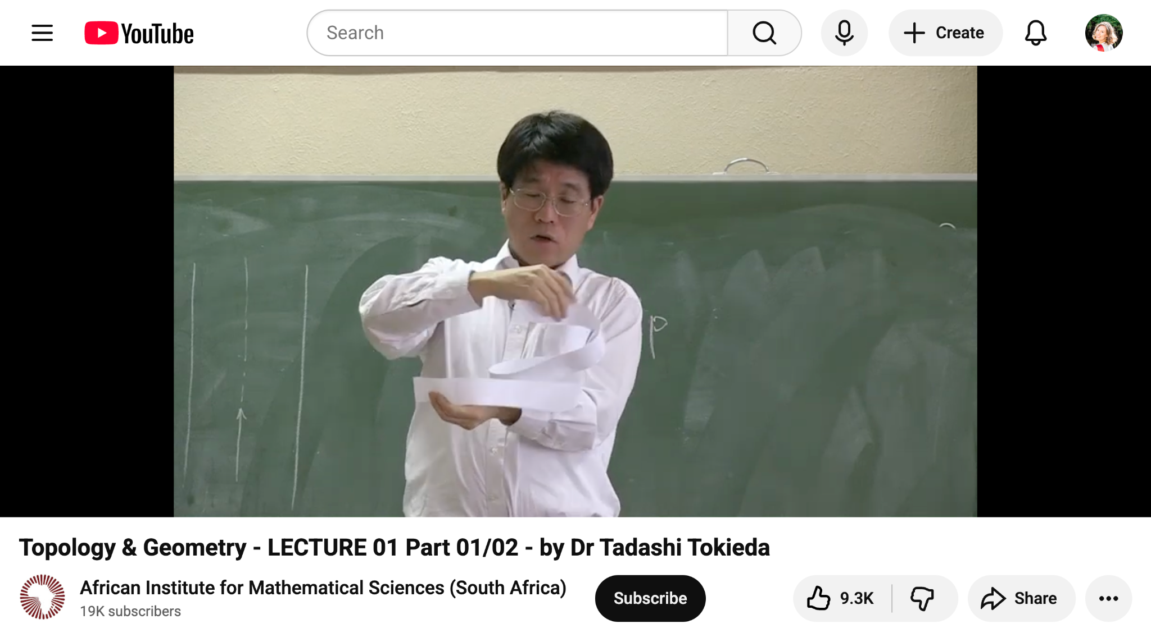
Möbius strip experiments

Slide 4
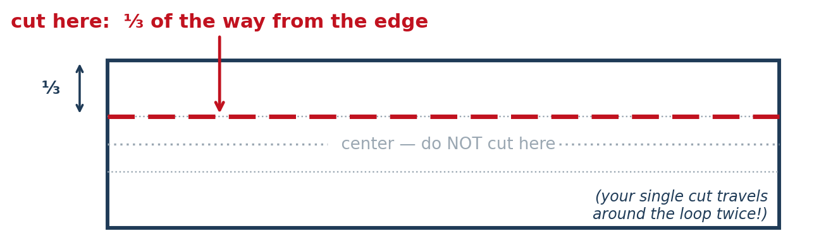

Your turn (15 minutes)
Create a Möbius strip using the paper and tape at your table.
Instead of cutting along the center of the strip, start cutting along ⅓ of the strip.
What do you think will happen? Make a guess BEFORE you finish cutting!
Once you’ve finished cutting, describe the figure you’ve actually created. Were any of your guesses correct?

Slide 5
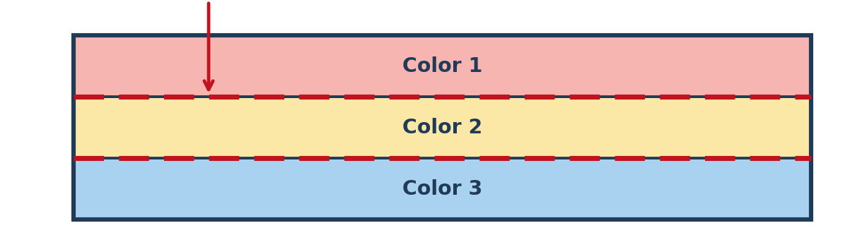
Your turn (15 minutes)
Color each part of your paper a different color.
Use your paper to make another Möbius strip.
Start cutting along the ⅓ line.
What do you think will happen? What parts of the strip will be connected? Make a guess and write it down before you finish cutting.
Once you’ve finished cutting, describe the figure you’ve actually created. Which colors are chained together? Was your guess correct?

Slide 6

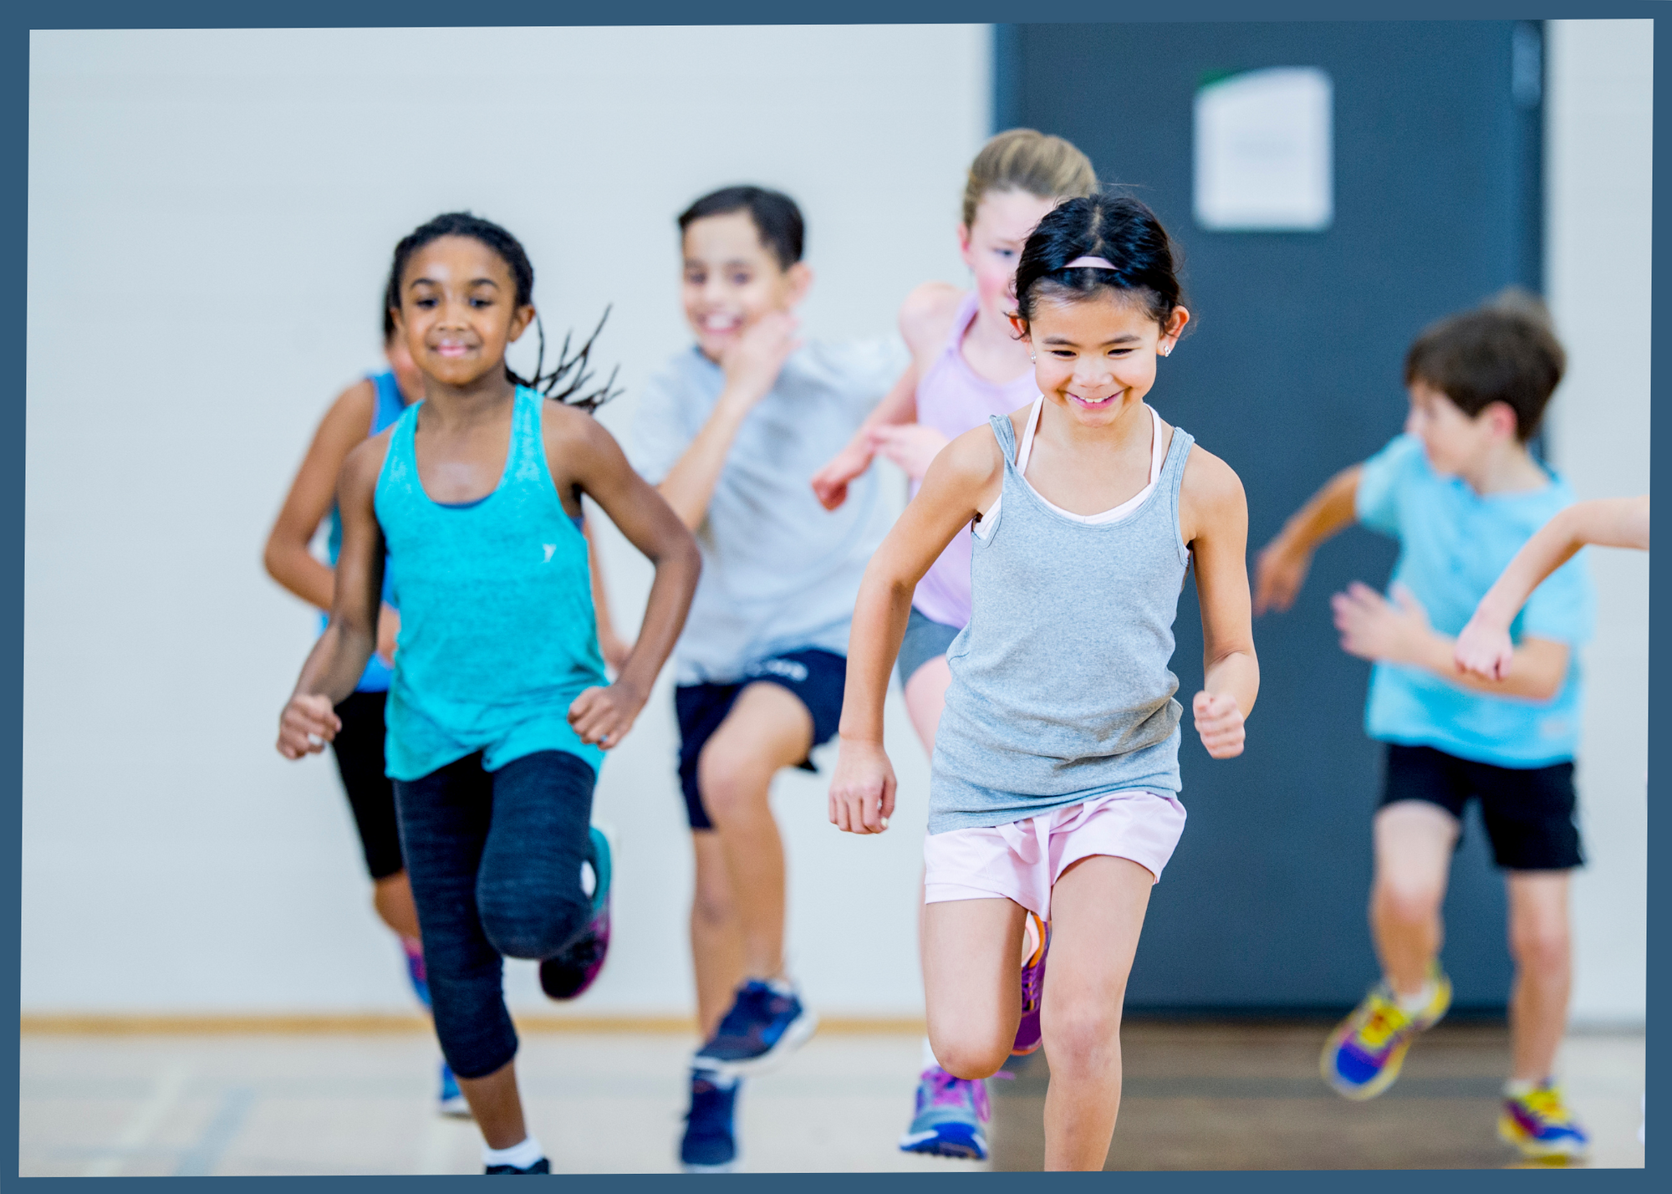
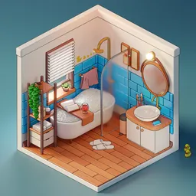
BREAK TIME (15 minutes)
You can…
Go to the bathroom
Get some water
Talk to Ms. Murphy or the peer counselors
Play a game

Slide 7
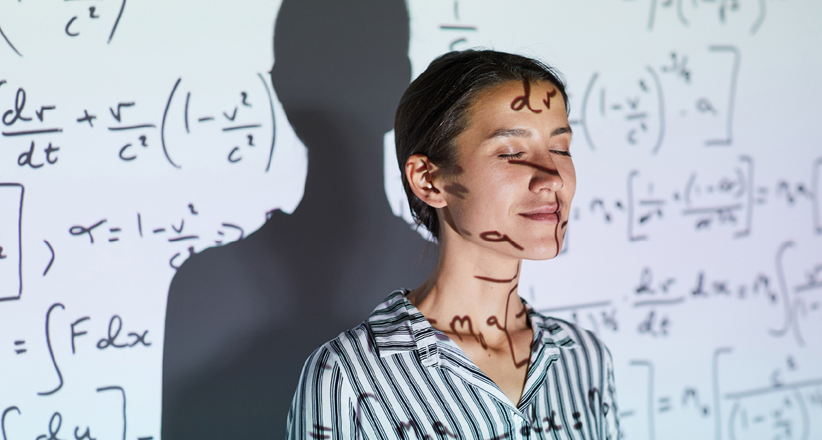
Mathematician of the day: Maryam Mirzakhani
Born in 1977 in Tehran, Iran
She studied the geometry of curved surfaces — 2-dimensional shapes.
First female mathematician to win the Fields Medal (2014)
“I don't have any particular recipe [for developing new proofs] ... It is like being lost in a jungle and trying to use all the knowledge that you can gather to come up with some new tricks, and with some luck, you might find a way out.”

Slide 8
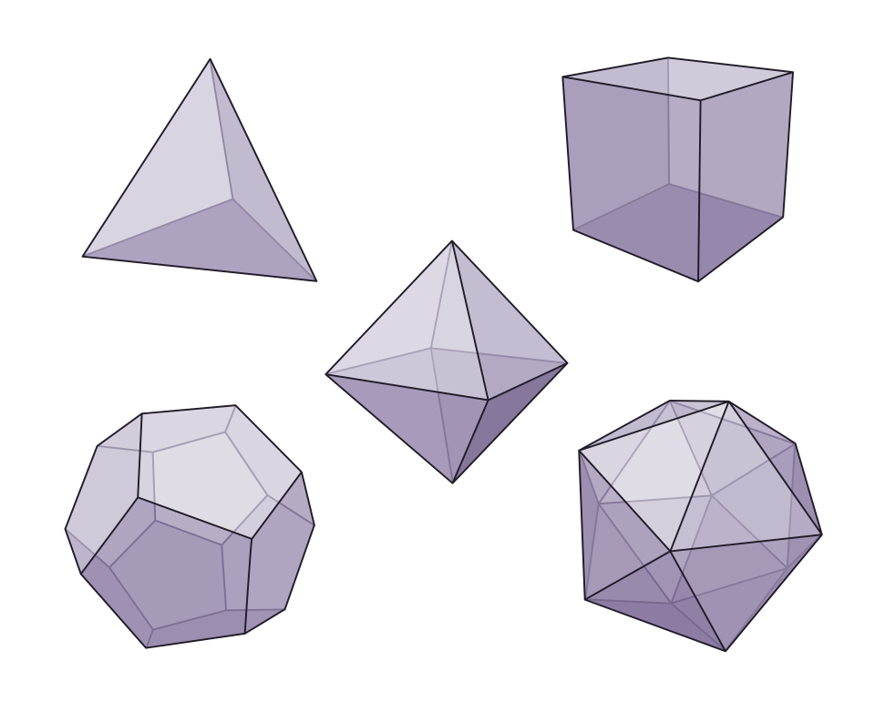
Platonic solids
A Platonic solid is a simple, 3D figure, where all faces are the same shape
Cubes
Tetrahedrons
Dodecahedrons
F = # of faces
V = # of vertices
E = # of edges

Slide 9
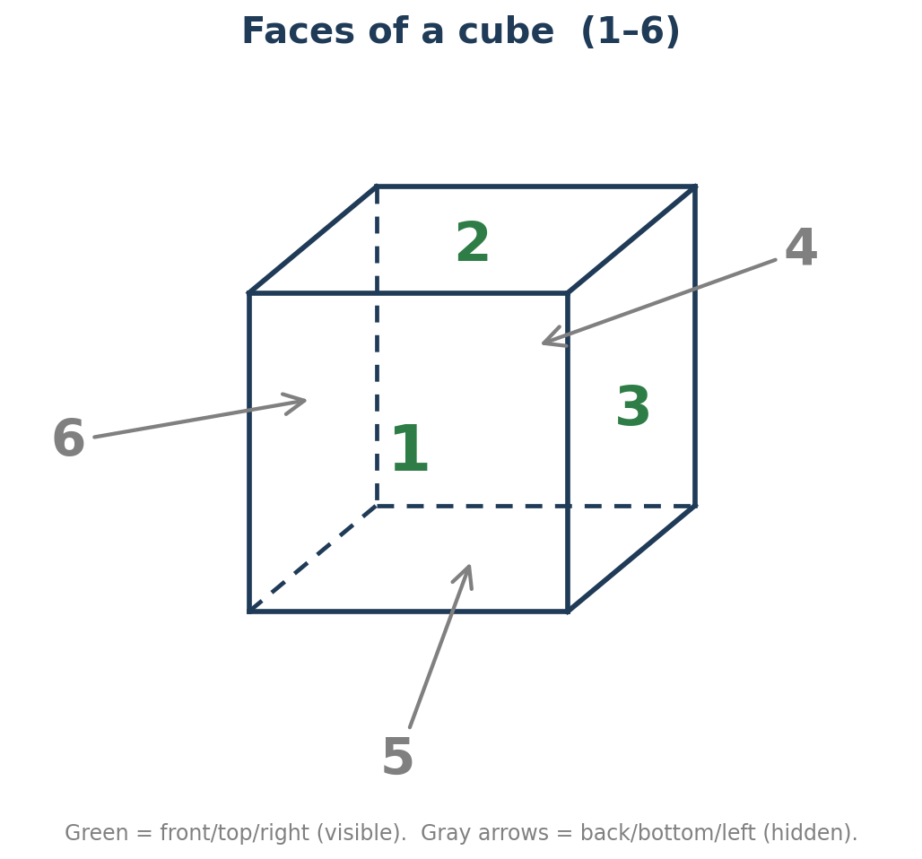
Example: A Cube
F = # of faces = 6

Slide 10
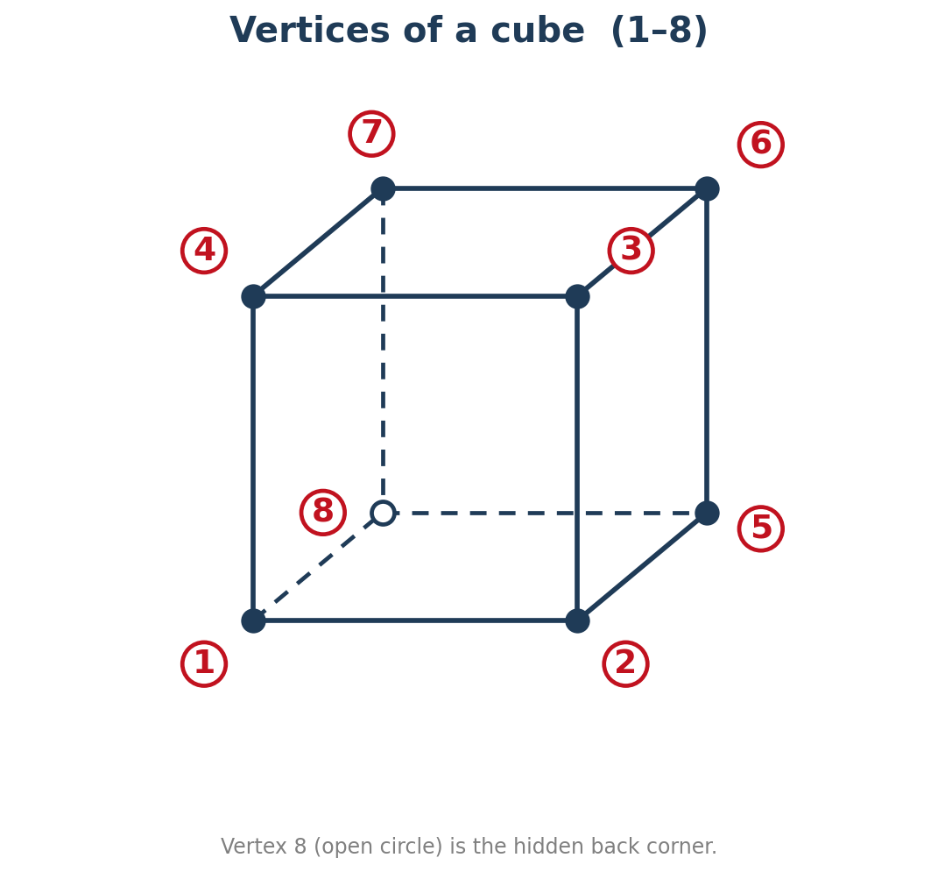
Example: A Cube
F = # of faces = 6
V = # of vertices = 8

Slide 11
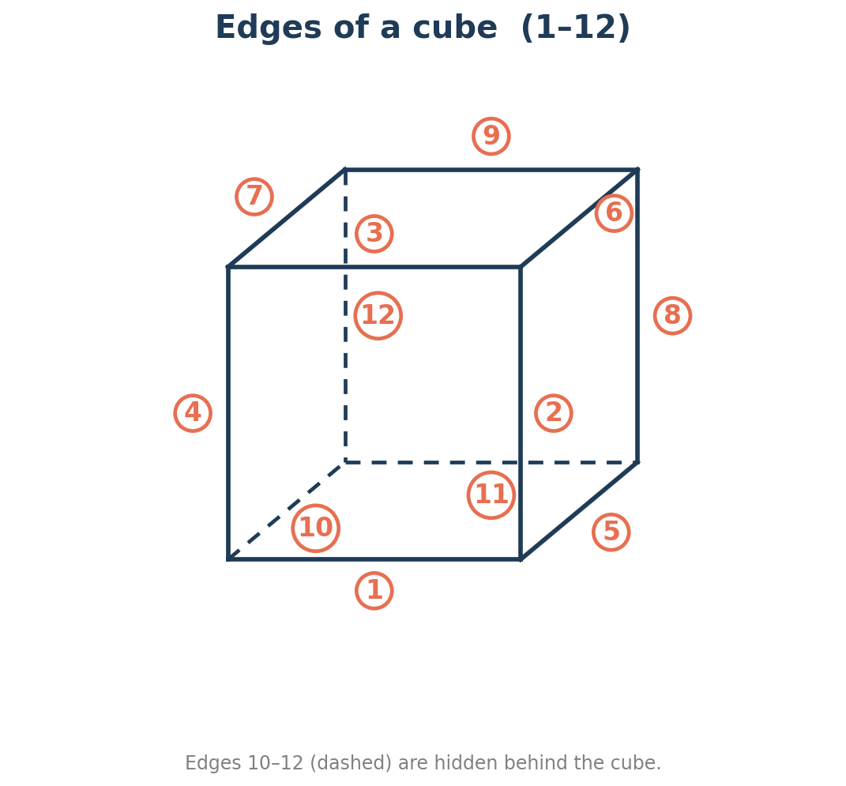
Example: A Cube
F = # of faces = 6
V = # of vertices = 8
E = # of edges = 12

Slide 12
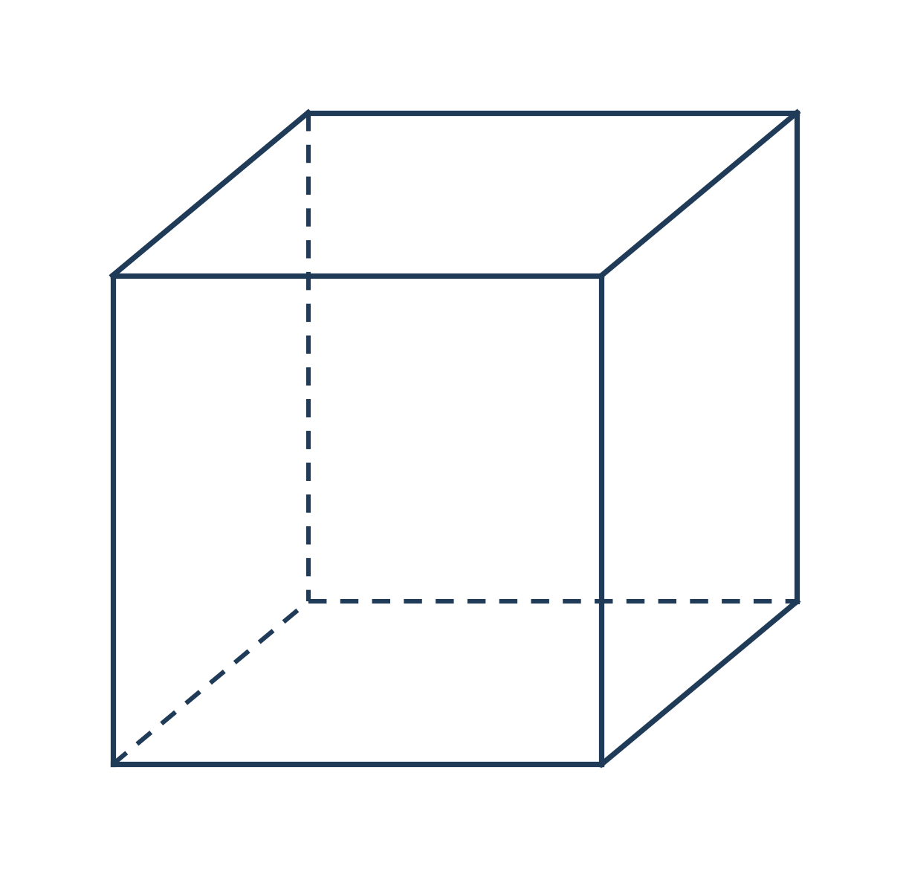
Example: A Cube
F = # of faces = 6
V = # of vertices = 8
E = # of edges = 12
F + V - E = 2

Slide 13
Your turn (20 minutes)
Every 5 minutes, the peer counselors will provide your group with a new Platonic solid.
Count
  F = # of faces
  V = # of vertices
  E = # of edges
Calculate F + V - E. Write down the number you get.

Slide 14
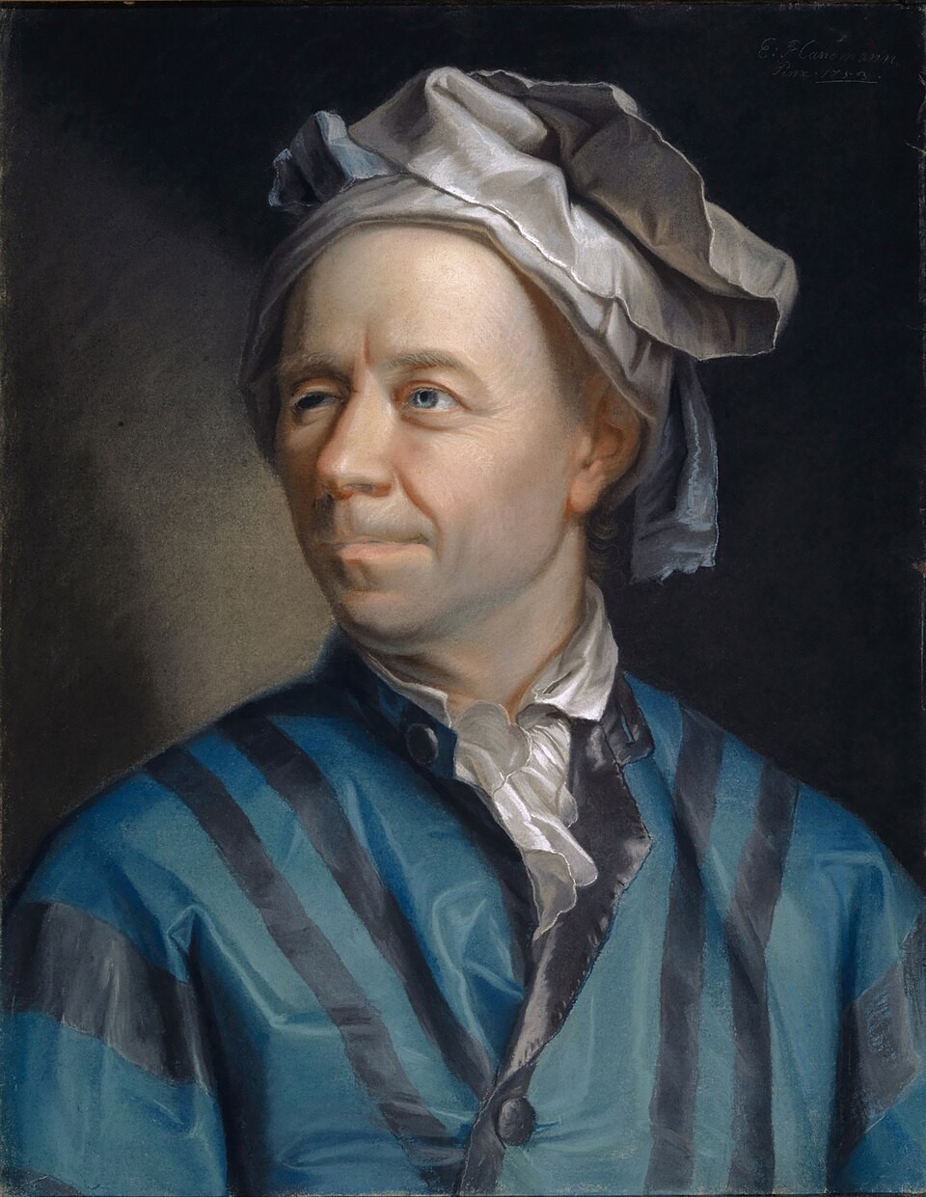
Euler’s Characteristic Equation
Does anyone remember Leonhard Euler from a previous lesson? What result did he prove?
The Euler characteristic is 𝛘 = F + V - E.
The Euler characteristic of a Platonic solid is always 2.

Slide 15
BREAK TIME (15 minutes)
You can…
Go to the bathroom
Get some water
Talk to Ms. Murphy or the peer counselors
Play a game

Slide 16
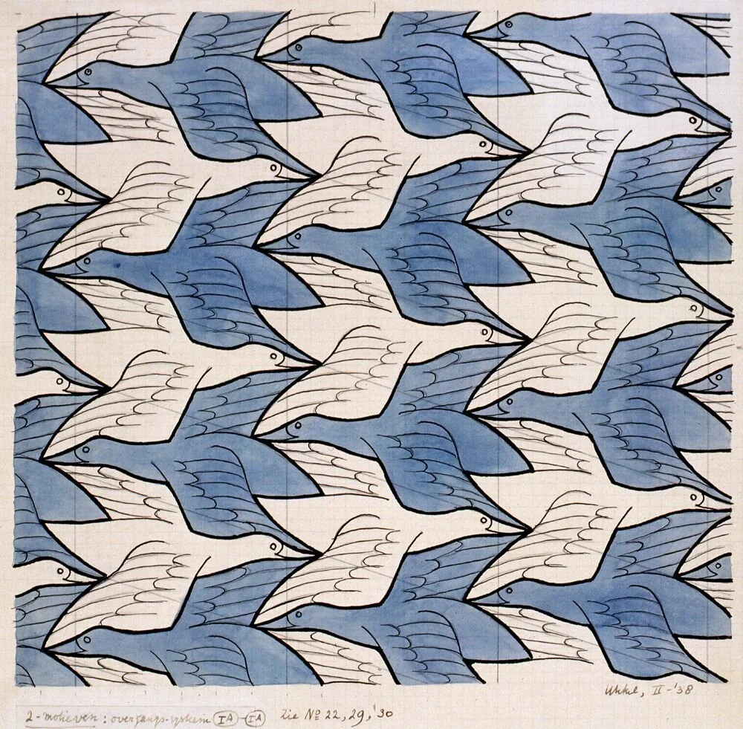
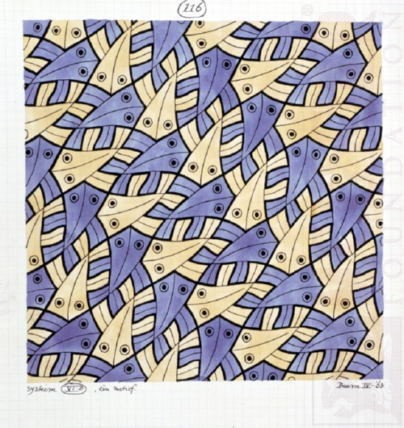
Escher Tiles

Slide 17
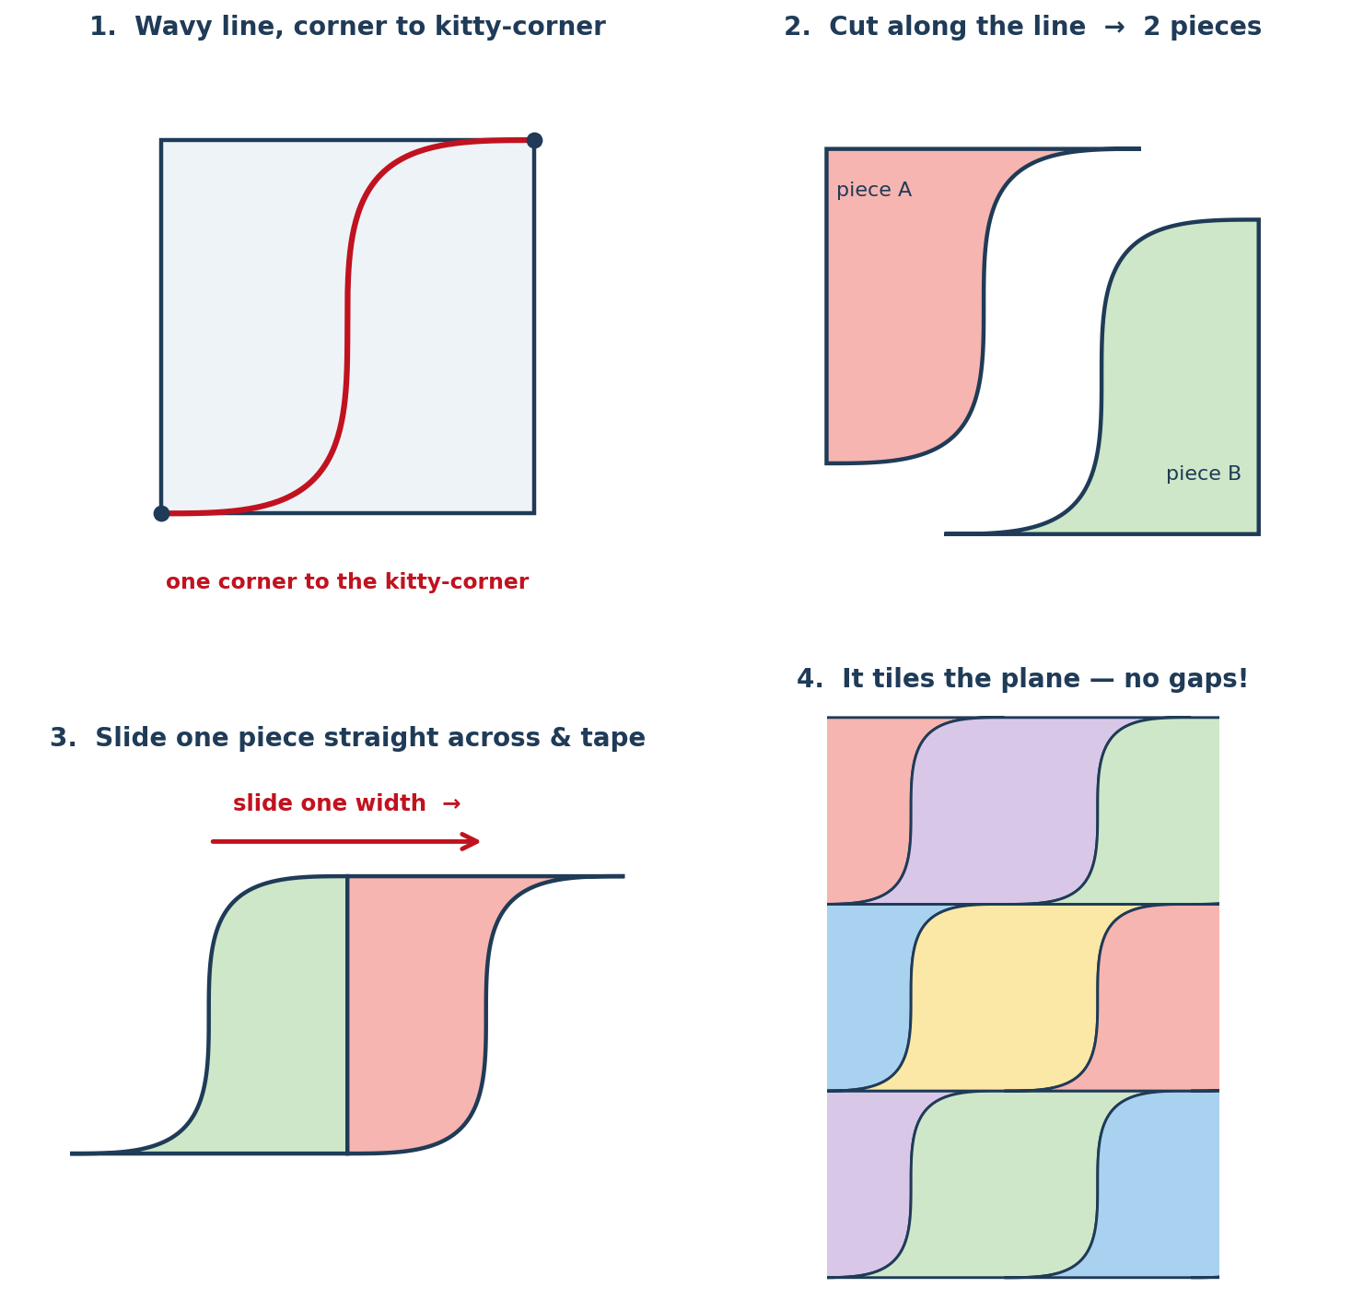

Create your own Escher tile (35 minutes)
Draw a wavy line connecting opposite corners of your small square together.
Use scissors to along the line.
Slide your two pieces so you get an Escher tile (this part is tricky — check with Ms. Murphy or a peer counselor before moving on to the next step).
Use tape to connect the two pieces.
On the large piece of paper, trace your Escher tiles.
If time permits, color in your design.

Slide 18
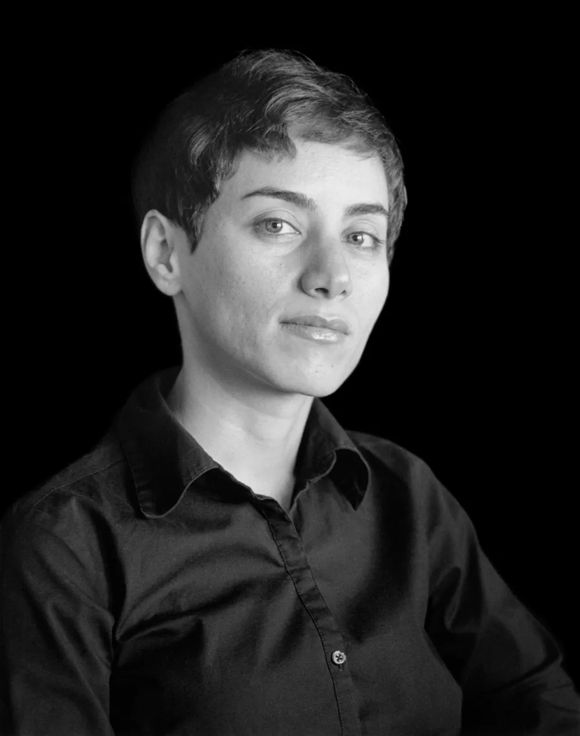
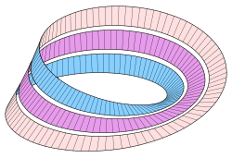
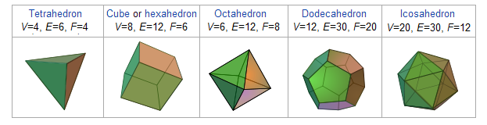
Daily Reflection
What’s one new thing you learned today?

Slide 19
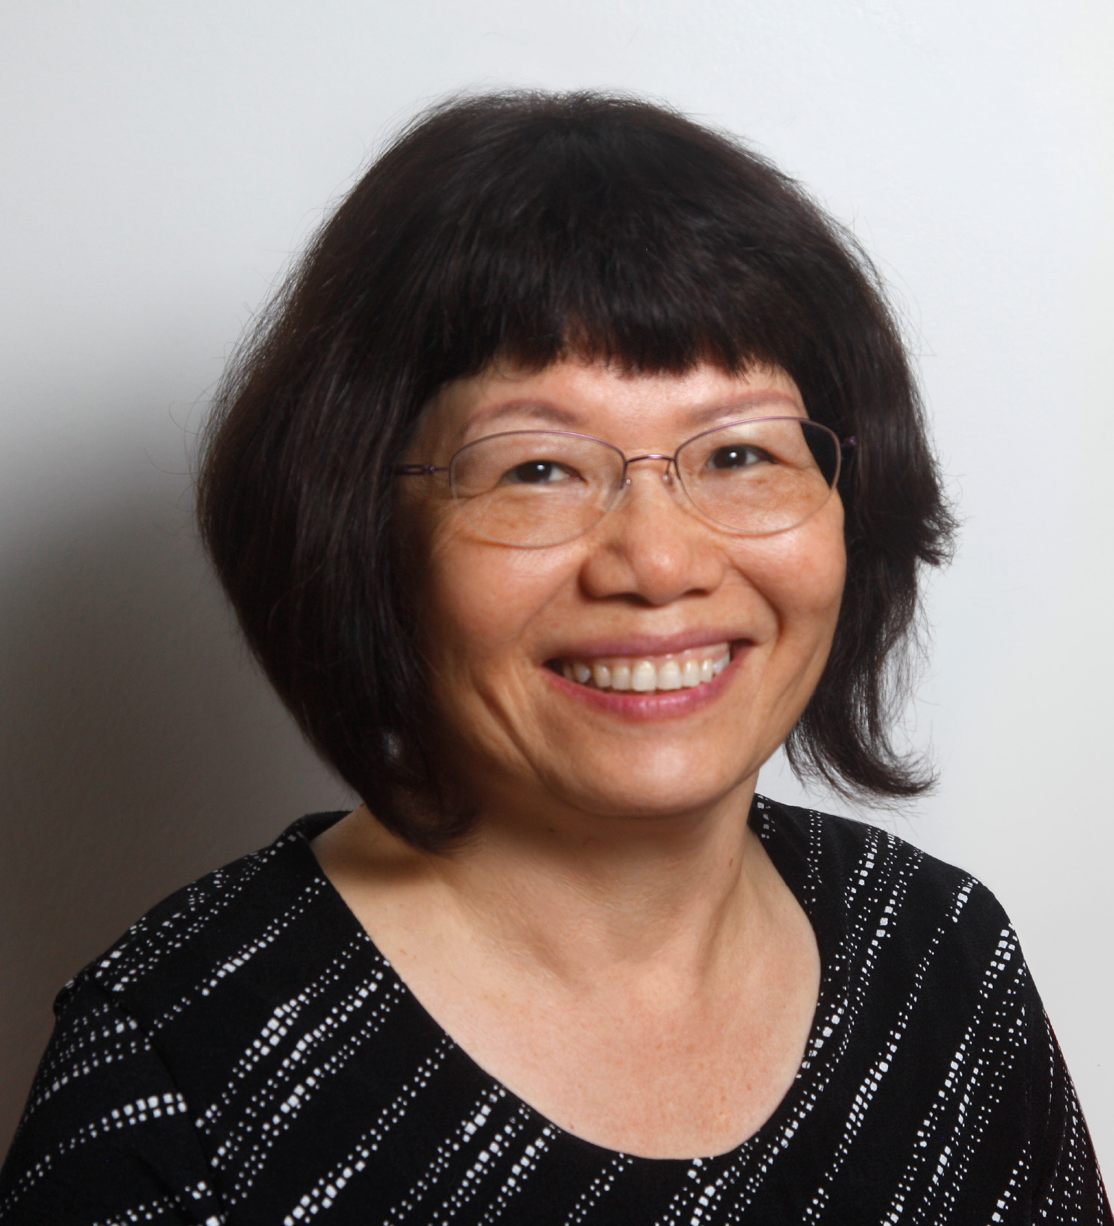
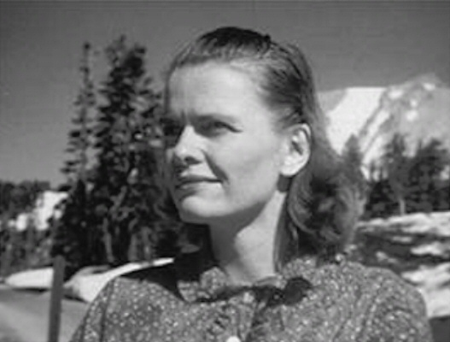
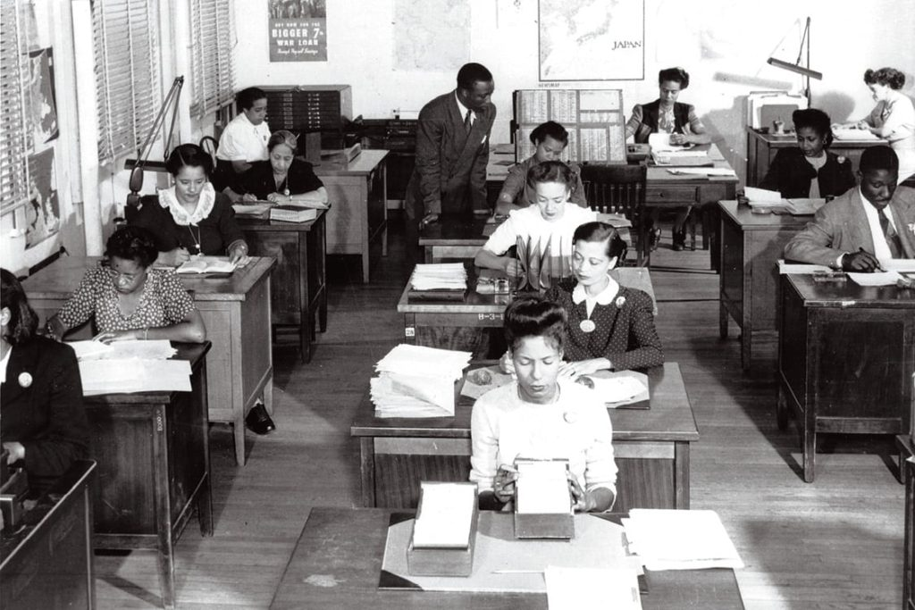
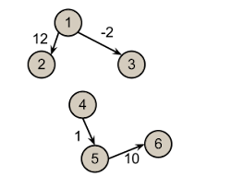
Weekly Reflection
(5 minutes) What was your favorite topic this week? Why?
(5 minutes) How is the math you learned at camp this week different from the math you learn in school? Are there any similarities?
(5 minutes) What would you tell a friend who says she's not a math person?

